Slide 1
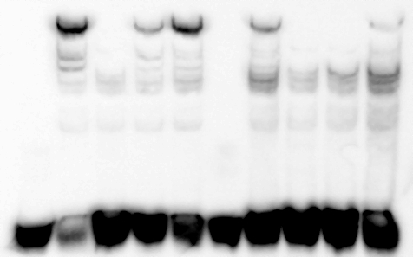
Supplemental Figure 1 rs6495309 EMSA
A. SH-SY5Y nuclear extract
Lane 1 2 3 4 5 6 7 8 9 10
Nuclear Extract - + + + + - + + + +
Competitor - - A G O - - A G O Labeled Probe rs6495309_A rs6495309_G
rs6495309_A 5’-CTA GCC ATC AGG GAC ATG CAA ATT AAA ACC AG-3’
rs6495309_G 5’-CTA GCC ATC AGG GAC ACG CAA ATT AAA ACC AG-3’
Oct-1 5’-TGT CGA ATG CAA ATC ACT AGA A-3’
CONSENSUS SEQUENCE FOR OCT-1 = ATG(^{C}/_{T})AAA(^{T}/_{G})
Notes:
Supplemental Figure 1 rs6495309 EMSA: Biotin-labeled rs6495309_A shifts more nuclear extract than G
Nuclear extract is either 15μg SH-SY5Y (+) or no extract (-). Competitor indicates either none (-) or 100x molar excess, double-stranded, unlabeled rs6495309_A (A), rs6495309_G (G), or 450x excess oct-1 consensus (O). Labeled probe is either 3’ biotin-labeled, double-stranded rs6495309_A or G. All 4 extracts tested demonstrated the same effect in duplicate experiments, with intensity of bands ranking brightest to dimmest SH-SY5Y-Differentiated>SHSY-5Y>PC12>PC12-Differentiated. Sequences provided are for both the biotin labeled and unlabeled probes as well as the Oct-1 competitor.

