Slide 1
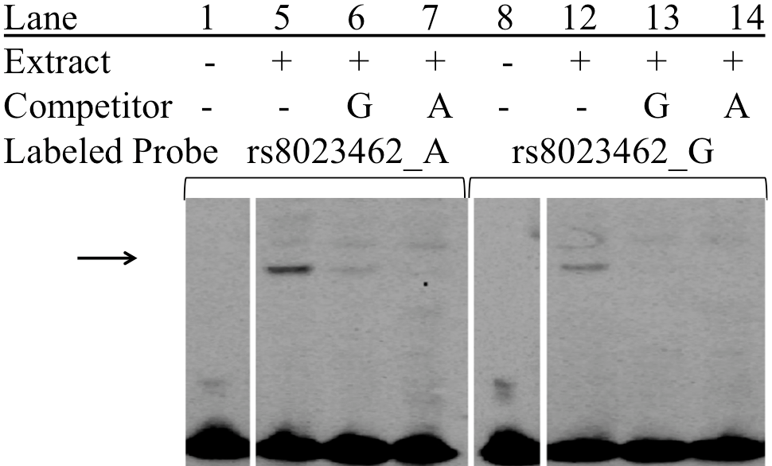
Supplemental Figure 2 rs8023462 EMSA
C H446 nuclear extract
Notes:
H446

