Slide 1
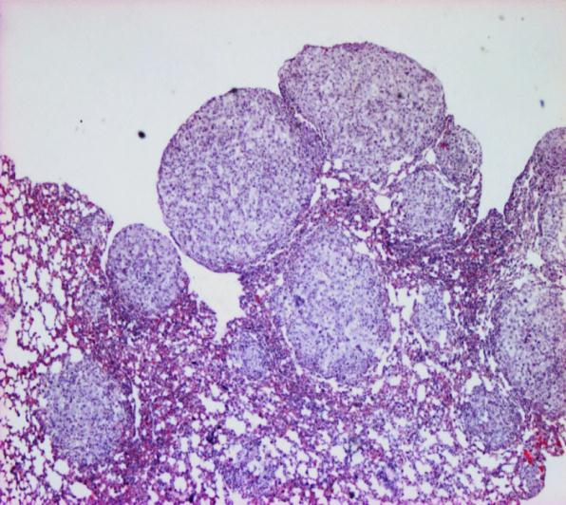
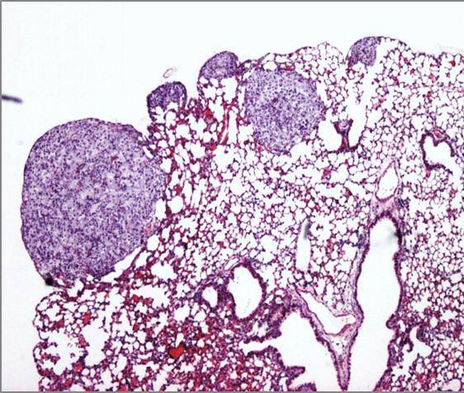
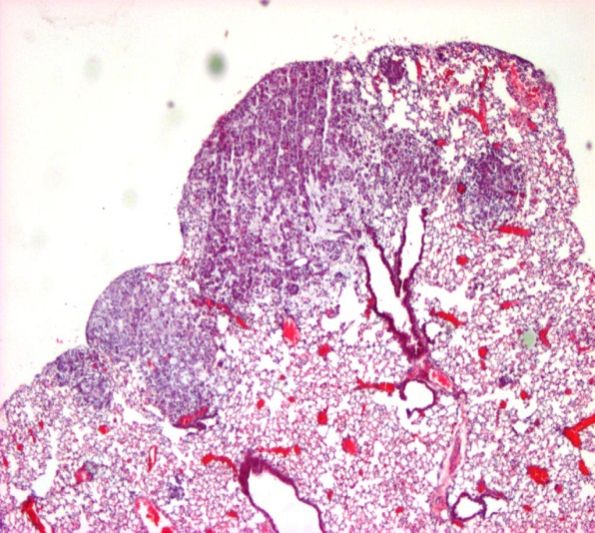
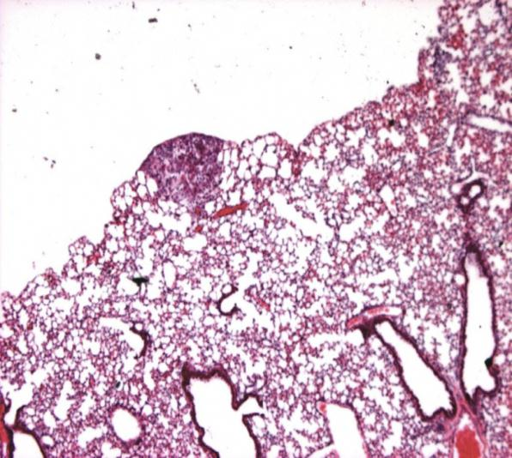
Supplemental Figure 1
A. Control
T
B. Soy
T
T
T
T
T
T
C. Radiation
D. Rad + Soy
T
T

