Slide 1
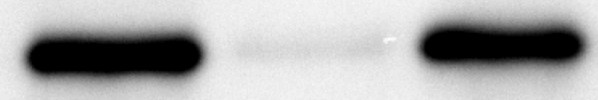
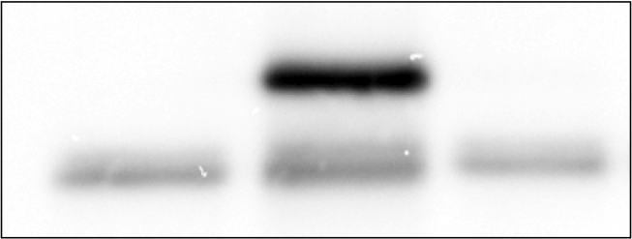
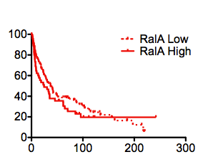
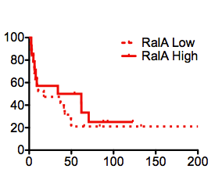
Figure S1
A
siControl
siRalA
siRalB
B
FLAG Control
FLAG RALA
IB: RalA
FLAG-
RalA
FLAG-
RalB
Empty FLAG
C
D
% Survival
% Survival
P=0.28
P=0.50
Months Following Radical Cystectomy
Months Following Radical Cystectomy

Slide 2
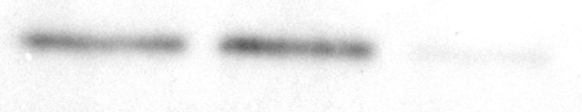
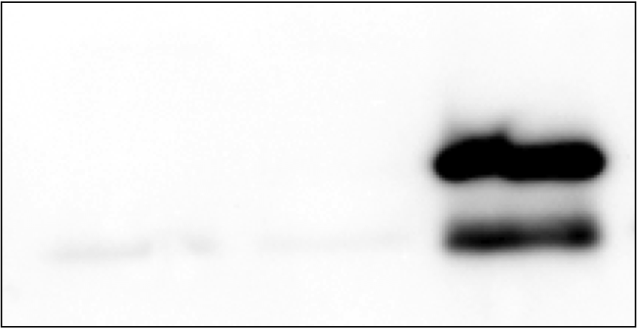
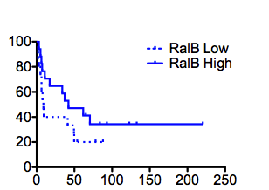
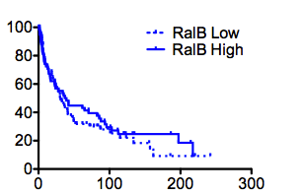
Figure S2
A
siControl
siRalA
siRalB
FLAG RALB
A
B
FLAG Control
IB: RalB
FLAG-
RalA
FLAG-
RalB
Empty FLAG
C
D
% Survival
% Survival
P=0.28
P=0.50
Months Following Radical Cystectomy
Months Following Radical Cystectomy

Slide 3
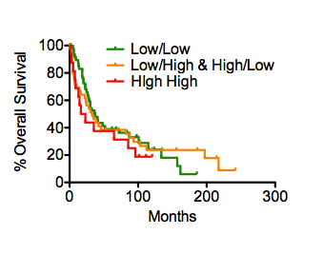
Figure S3
P=0.45
Months Following Radical Cystectomy

Slide 4
Figure S4
A
B
RalA
RalB
False Discovery Rate (mean%)
False Discovery Rate (mean%)
P-value Threshold for Correlation
P-value Threshold for Correlation

Slide 5
Figure S4
C
Normalized Relative Expression

Slide 6
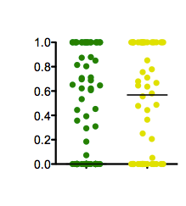
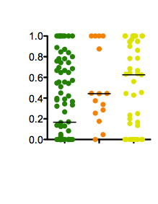
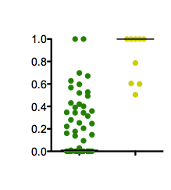
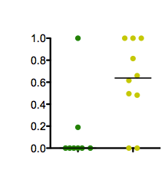
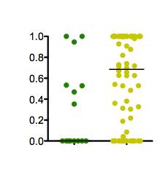
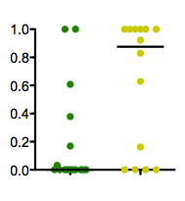
Figure S5
Lindgren et al, N=144
P=0.02
Kim et al., N=165
P=0.04
C
Dyrskjøt et al., N=71
A
B
Ral Signature Score
Ral Signature Score
Ral Signature Score
P=0.007
P<0.0001
Ta/T1
T2+
Ta/T1
Ta/T1
T2+
Ta/T1
T2+
-Prog
+Prog
Stransky et al., N=30
F
Riester et al., N=93
D
E
UVA-19
Ral Signature Score
Ral Signature Score
Ral Signature Score
P=0.025
P=0.032
P=0.039
Ta/T1
T2+
Ta/T1
T2+
Ta/T1
T2+

Slide 7
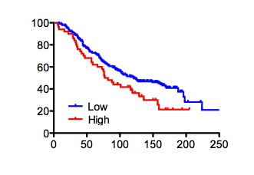
Figure S6
Sboner et al.
% Disease Specific Survival
P=0.03
Months Post Diagnosis

