Slide 1
Suppl Fig. S1
B
*
A
45
*
*P<0.05
40
35
*
*
30
Colony formation(%)
25
Colony formation(%)
Colony formation(%)
20
15
10
5
0
H460
H460/CR
H460/CR
H460/CR
SP
*
NSP
D
C
2
*
1.8
2.5
1.6
1.4
2
1.2
1.5
1
*
RFU
RFU
0.8
1
0.6
0.4
0.5
0.2
0
0
H460
H460/CR
H460/CR
H460/CR
A549
A549/CR
A549/CR
A549/CR
E
SP
NSP
SP
NSP
*
*
*
*
Telomerase activity

Slide 2
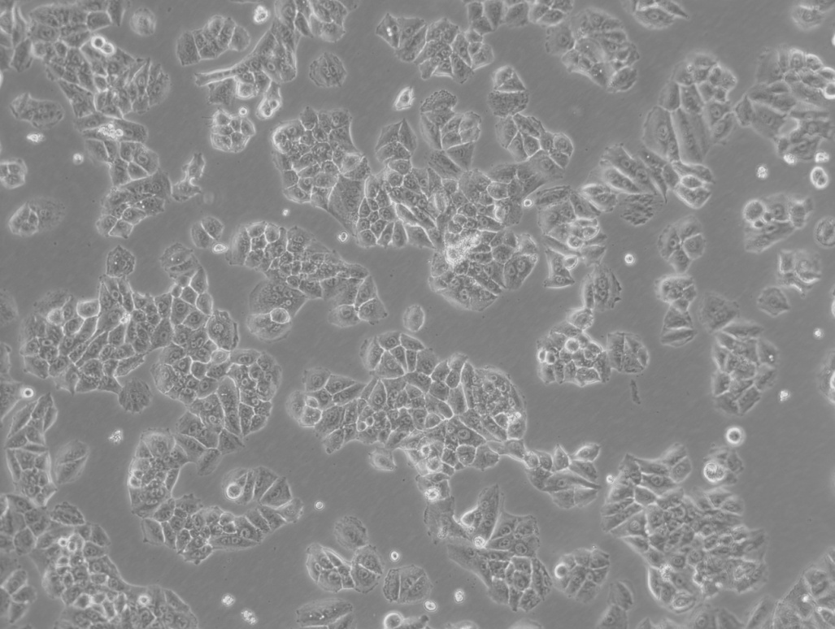
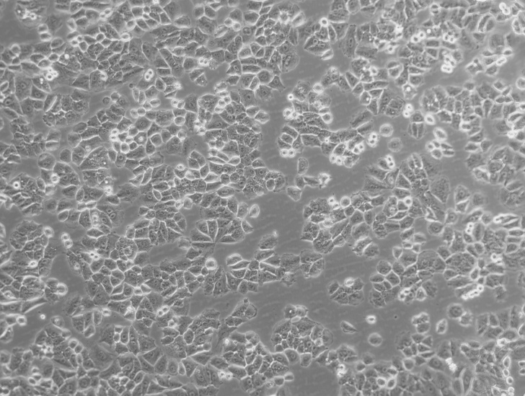
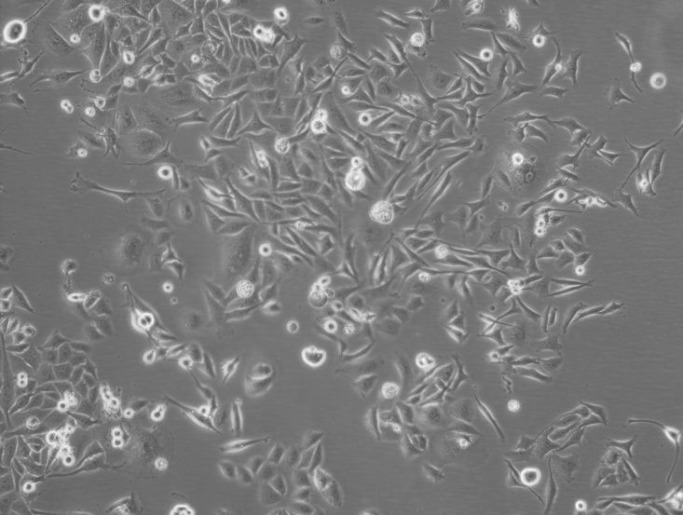
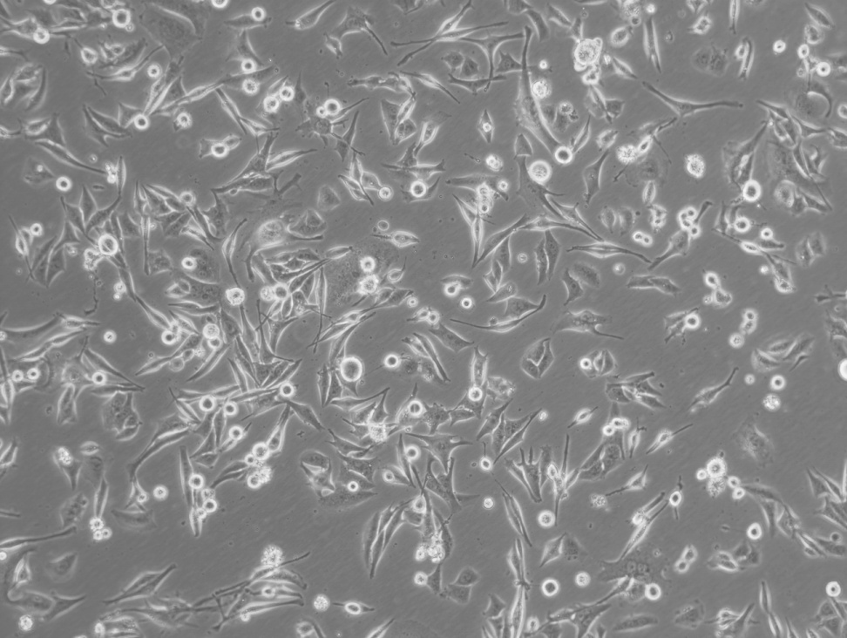
Suppl. Fig. S2
H460 H460/RR/CAR- H460/shCAR
H460/RR H460/RR/CAR+ H460/CAR

