Slide 1
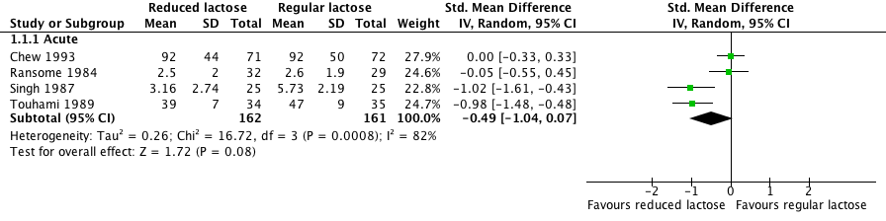
1. LIQUID FEEDS: REDUCED LACTOSE VS. REGULAR LACTOSE
1.1 DURATION

Slide 2
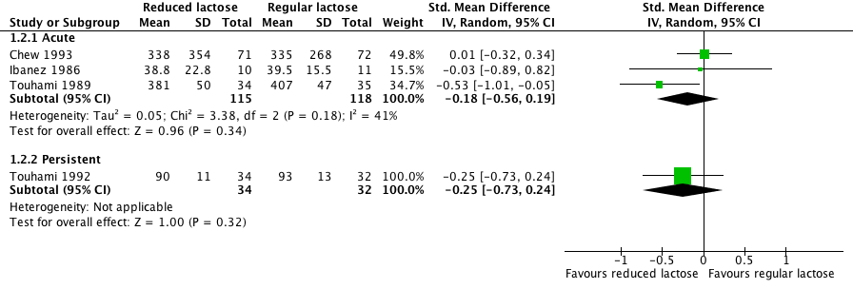
1. LIQUID FEEDS: REDUCED LACTOSE VS. REGULAR LACTOSE
1.2 STOOL OUTPUT

Slide 3
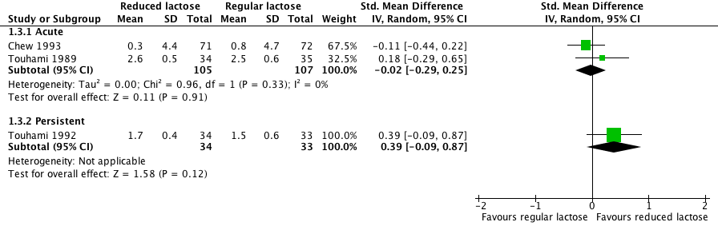
1. LIQUID FEEDS: REDUCED LACTOSE VS. REGULAR LACTOSE
1.3 WEIGHT CHANGE

Slide 4
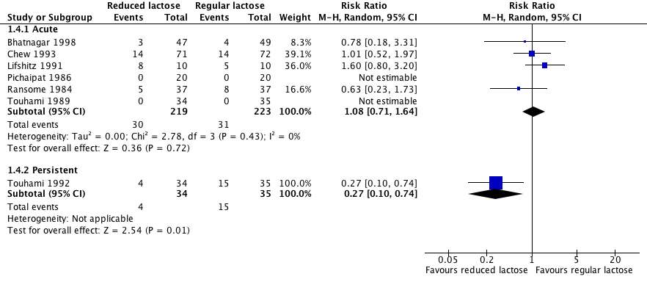
1. LIQUID FEEDS: REDUCED LACTOSE VS. REGULAR LACTOSE
1.4 TREATMENT FAILURE

Slide 5
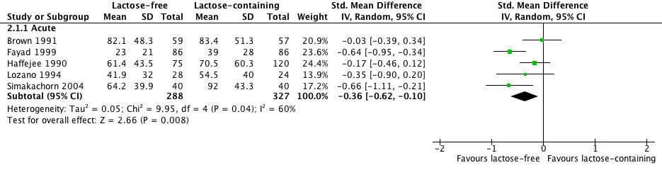
2. LIQUID FEEDS: LACTOSE-FREE VS. LACTOSE-CONTAINING
2.1 DURATION

Slide 6
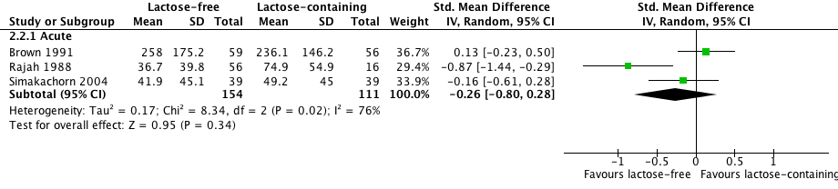
2. LIQUID FEEDS: LACTOSE-FREE VS. LACTOSE-CONTAINING
2.2 STOOL OUTPUT

Slide 7
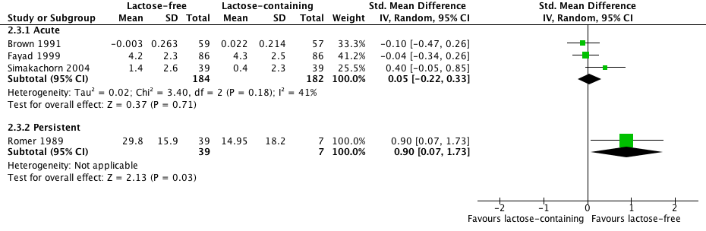
2. LIQUID FEEDS: LACTOSE-FREE VS. LACTOSE-CONTAINING
2.3 WEIGHT GAIN

Slide 8
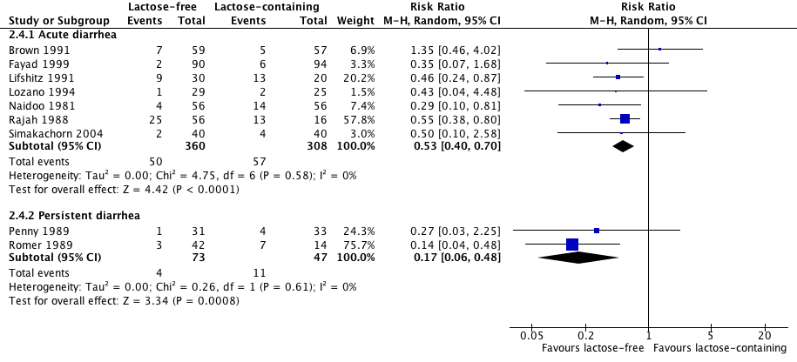
2. LIQUID FEEDS: LACTOSE-FREE VS. LACTOSE-CONTAINING
2.4 TREATMENT FAILURE

Slide 9
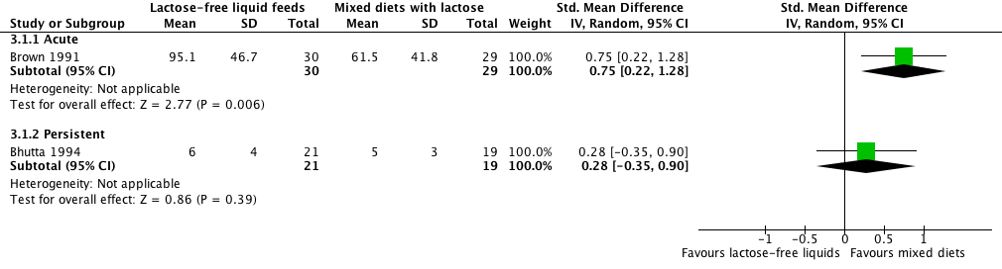
3. LACTOSE-FREE LIQUID FEEDS VS. LACTOSE-CONTAINING MIXED DIETS
3.1 DURATION

Slide 10
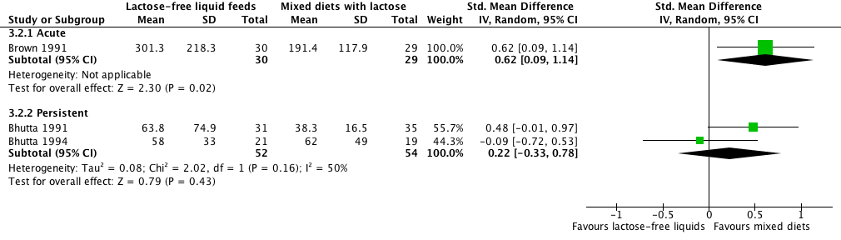
3. LACTOSE-FREE LIQUID FEEDS VS. LACTOSE-CONTAINING MIXED DIETS
3.2 STOOL OUTPUT

Slide 11
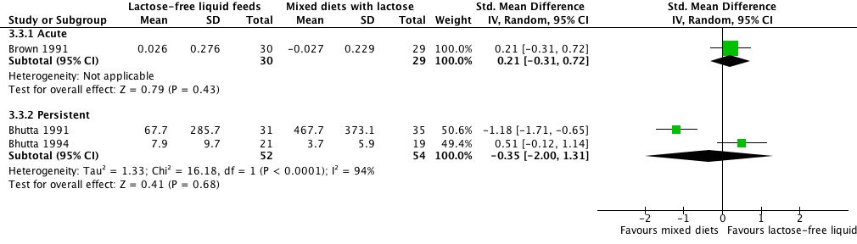
3. LACTOSE-FREE LIQUID FEEDS VS. LACTOSE-CONTAINING MIXED DIETS
3.3 WEIGHT GAIN

Slide 12
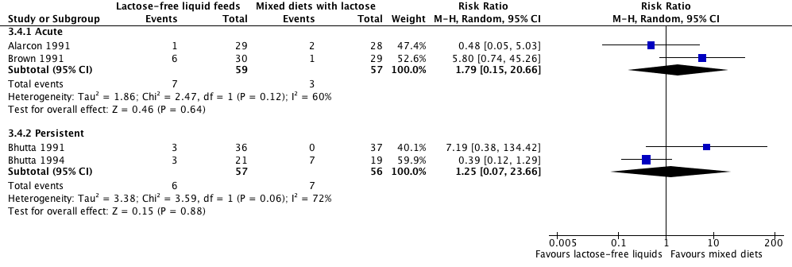
3. LACTOSE-FREE LIQUID FEEDS VS. LACTOSE-CONTAINING MIXED DIETS
3.4 TREATMENT FAILURE

Slide 13
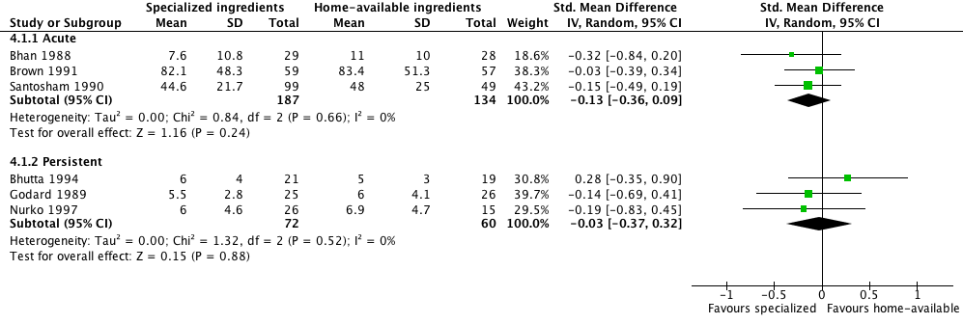
4. COMMERCIAL/SPECIALIZED INGREDIENTS VS. HOME-AVAILABLE INGREDIENTS
4.1 DURATION

Slide 14
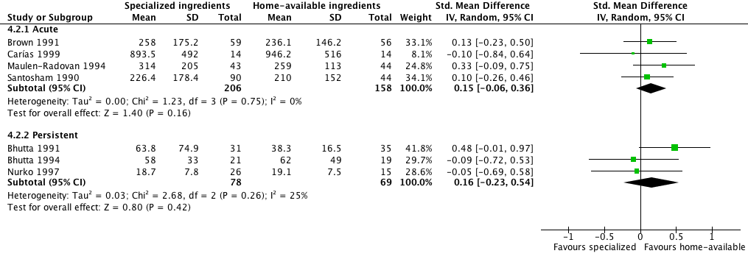
4. COMMERCIAL/SPECIALIZED INGREDIENTS VS. HOME-AVAILABLE INGREDIENTS
4.2 STOOL OUTPUT

Slide 15
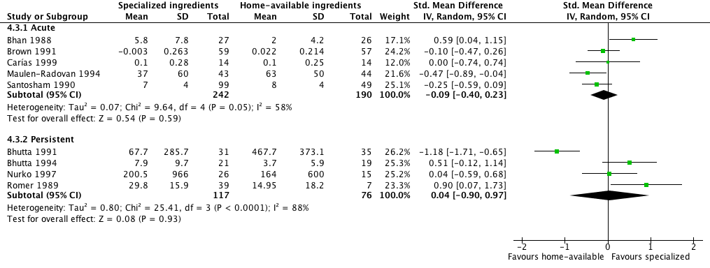
4. COMMERCIAL/SPECIALIZED INGREDIENTS VS. HOME-AVAILABLE INGREDIENTS
4.3 WEIGHT GAIN

Slide 16
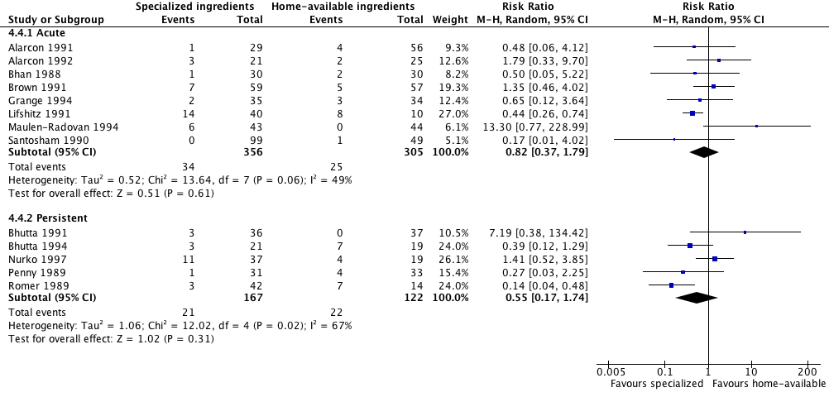
4. COMMERCIAL/SPECIALIZED INGREDIENTS VS. HOME-AVAILABLE INGREDIENTS
4.4 TREATMENT FAILURE

Slide 17
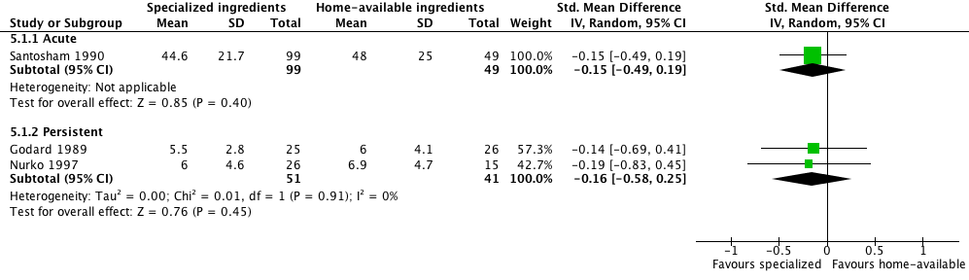
5. LACTOSE-FREE DIETS:
COMMERCIAL/SPECIALIZED INGREDIENTS VS. HOME-AVAILABLE INGREDIENTS
5.1 DURATION

Slide 18
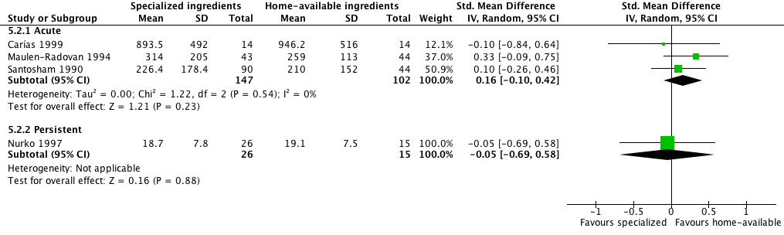
5. LACTOSE-FREE DIETS:
COMMERCIAL/SPECIALIZED INGREDIENTS VS. HOME-AVAILABLE INGREDIENTS
5.2 STOOL OUTPUT

Slide 19
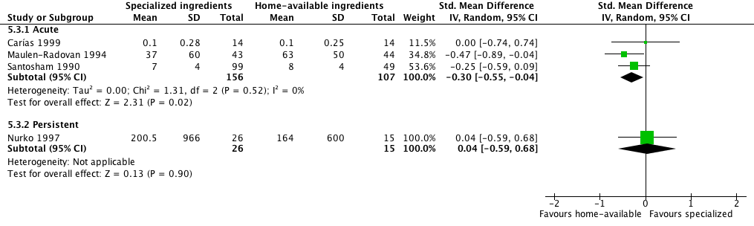
5. LACTOSE-FREE DIETS:
COMMERCIAL/SPECIALIZED INGREDIENTS VS. HOME-AVAILABLE INGREDIENTS
5.3 WEIGHT CHANGE

Slide 20
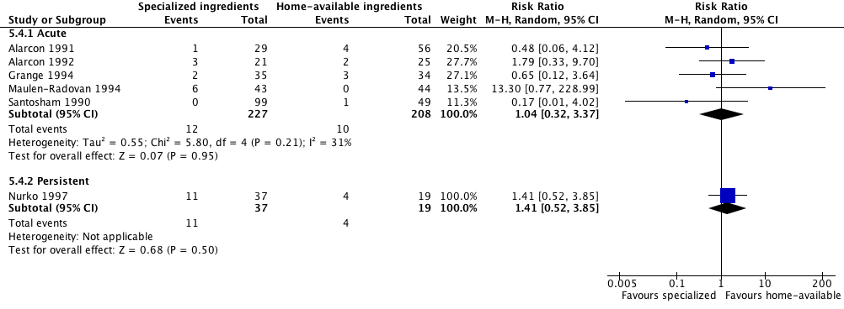
5. LACTOSE-FREE DIETS:
COMMERCIAL/SPECIALIZED INGREDIENTS VS. HOME-AVAILABLE INGREDIENTS
5.4 TREATMENT FAILURE

