Slide 1
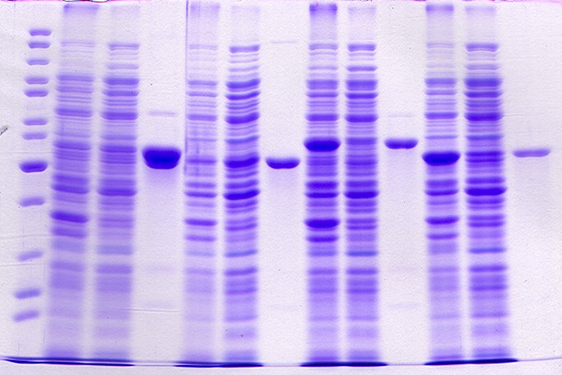
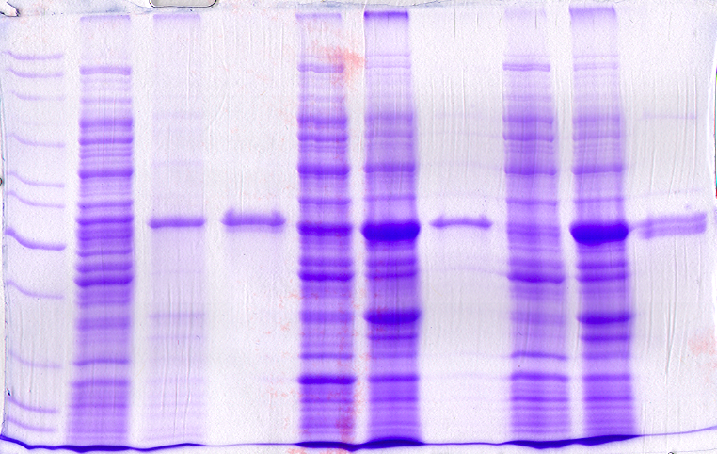
B.
AtGAD1
HAtGAD1
HAtGAD1∆C32
HMdGAD3
kDa
L P S E
P S E
P S E
P S E
A.
85
HAtGAD1 HAtGAD1ΔC32 HMdGAD3 HMdGAD3ΔC34
kDa
L P S E P S E P S E P S E
60
50
30
85
60
50
C.
AtGAD1
MdGAD1
MdGAD2
kDa
L S P E S P E S P E
30
85
60
50
30
Figure S2 SDS-PAGE analysis of expression and purification
of various recombinant GAD proteins characterized in Figures 3A-C. L, P, S, and E
lanes for each protein represent molecular mass standards and protein in the pellet,
supernatant, and affinity-purified fractions, respectively.

