Slide 1
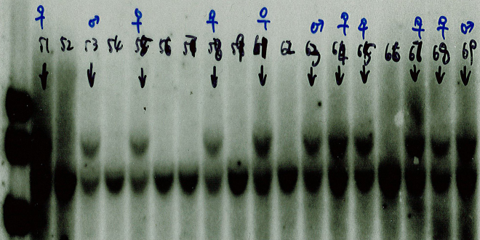
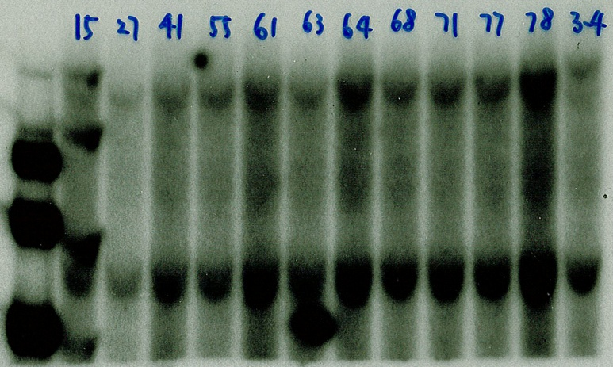
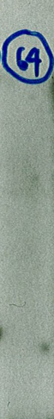
SupFig 1
A
AflII
9.22Kb+1.9Kb+71bp
AflII
EcoRV
Probe1
BsrGI
BsrGI
E19a
NdeI
NdeI
PGK-Neo
STOP
Chr4
2.4Kb
3.8Kb
FRT
FRT
LoxP
LoxP
151
1.9Kb
157
700
101
300
71
66
1Kb
F1
R1
F2
140
R2
Table 1. Identifying WT and Mutant Alleles by Southern Blot
Hyb band size (kb) | AflII | AflII+EcoRV
wt | 7.24 | 7.24
mu | 16.55 | 10.27
x Flipper | 14.75 | 8.48
(x Flipper) x EIIa-Cre | 13.73 | 7.45
Table 2. Identifying WT and KO Alleles by PCR
Amplicon size (bp) | F1+R2 | F2+R2
wt | 1170 | 380
ko | 328 | No amplify
B
Notes:
Note in legend:
D. The mutated regions in (x Flipper) progenies were amplified using F1+R1 and F2+R2 respectively and sequenced. The mutated regions in ((x Flipper) x EIIa-Cre) progenies were amplified using F1+R2. These PCR products sequenced and the results confirmed the design: the proper deletion of the ObRa 19a exon coding region, the insertion of FRT and/or LoxP sequence(s) and the mutation of the Afl II site in exon 19a.

