Slide 1
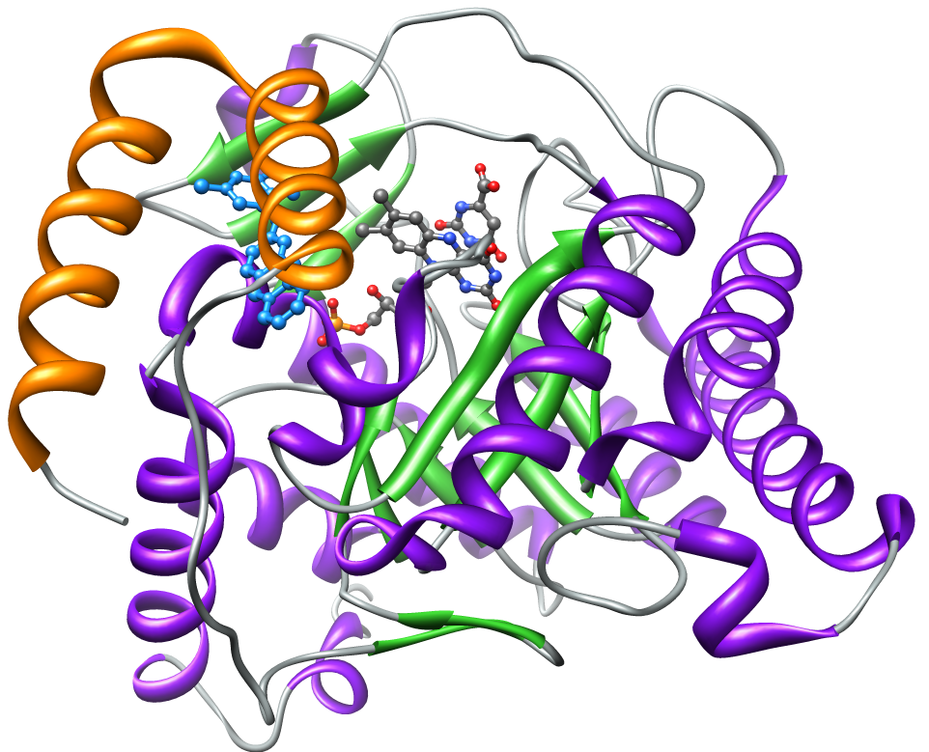
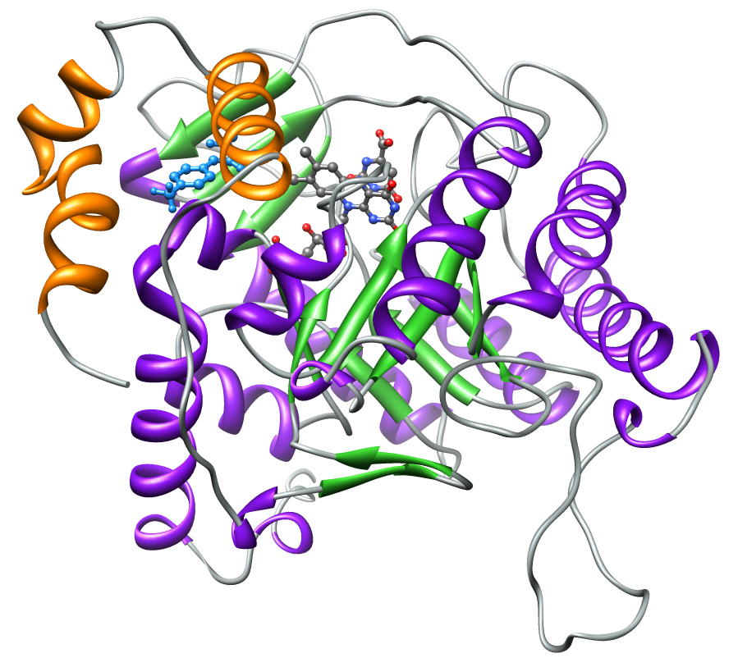
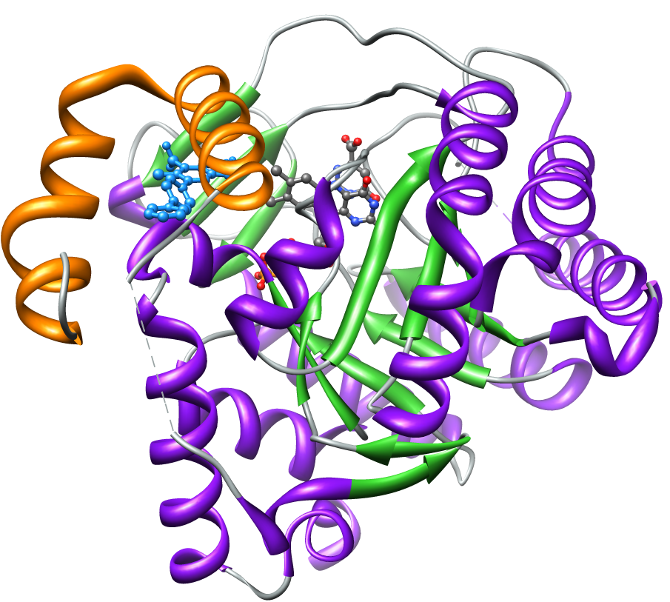
A
B
C
Fig. S1 Ribbon diagrams showing the human DHOD (PDB:1D3G) Panel A, and the P. falciparum DHOD (PDB:3I68) Panel B. The proteins contain a small N-terminal domain consisting of alpha helices αA/αB (in orange) connected by an extended loop to a large (α/β)₈ barrel domain (in purple and green). A model of the T. gondii DHOD built using SWISS-MODEL (Based on template structure PDB: 3I68) is shown in Panel C. Inhibitors are shown in blue ball and stick representations, brequinar analog (Panel A), or the P. falciparum triazolopyrimidine inhibitor DSM2 (Panels B, C). The flavin cofactor (FMN) is shown in CPK ball and stick representation. Figures were produced by UCSF Chimera.

