Slide 1
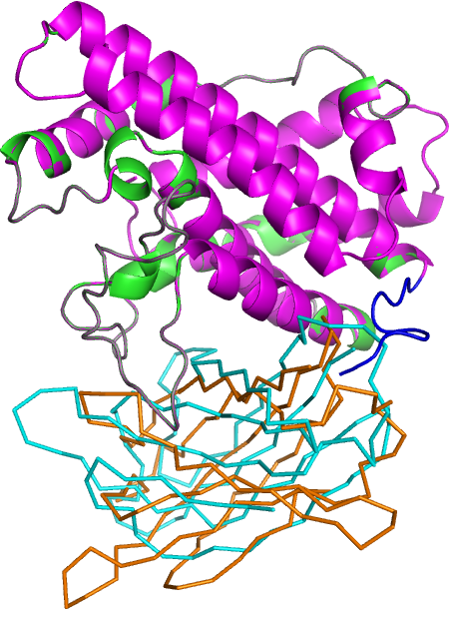
N-domain
Linker
C-domain
Figure S1: Superposition of Cp-PLC (PDB ID: 1CA1) and modelled Cp-PLC N and C-domain complex with N-domain in ribbon format and C-domain in stick format. Cp-PLC N and C-domain residues are colored green and cyan, respectively and N and C-domains of the complex are colored pink and brown, respectively. The shift in orientation of C-domain is showed by arrow.

