Slide 1
Supplemental Fig. S1. 4T1 Cells Do Not Express Functional α₂-AR. High dose DEX-induced effects on 4T1 (A) proliferation and (B) VEGF production in vitro are not blocked by the α₂-AR antagonist yohimbine (YOH). (C) The alpha₂-AR agonists clonidine (CLON) and dexmedetomidine (DEX) do not inhibit forskolin (FORSK)-induced cAMP in 4T1 cells. (D) CLON and DEX reduced FORSK-induced cAMP in human foreskin fibroblasts (HFF). Groups labeled with same letter are not significantly different from each other, but are significantly different from groups labeled with different letters, p≤0.01, Tukey’s post-hoc test.

Slide 2
Supplemental Fig. S2. DMI Elevates Spleen Norepinephrine (NE) and the NE Metabolite, Normetanephrine (NMN). Spleen (A) NE and (B) NMN were increased 3 days post-DMI pellet implantation. (C) Spleen weight was decreased day 3 post-DMI implantation. *** indicates significant differences versus corresponding placebo group, Holm-Sidak multiple comparison test, p<0.001.

Slide 3
C. CD31+ blood vessels
Supplemental Fig. S3. DMI-induced Tumor Growth is Not Associated with Altered Tumor Angiogenesis. Immunocytochemical staining of CD31+ blood vessels in tumor slices were quantified by two different methods: (A) percentage of pixels above threshold and (B) calculating the area of traced vessels per cell density based on nuclear DAPI staining (not shown). (C) A representative image of CD31+ blood vessels. Scale bar = 50 µm.

Slide 4
Supplemental Fig. S4. TNF-α Does Not Induce 4T1 Proliferation in Vitro. Results are expressed as mean ± SD of triplicate wells.

Slide 5
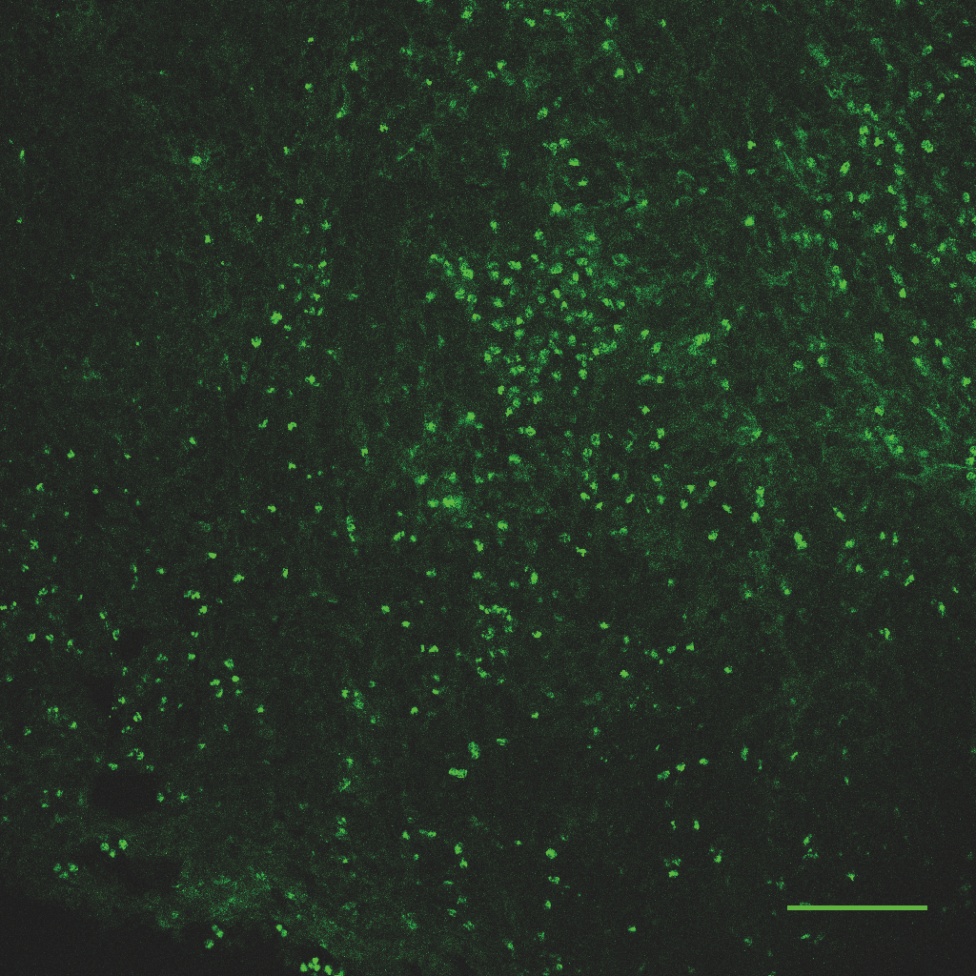
A.
B.
C.
Supplemental Fig. S5. Tumor F4/80+ Macrophage Density Is Not Significantly Changed with A) DMI or B) DEX treatment. (C) Representative image of F4/80+ macrophages in a 4T1 tumor section by immunofluorescence; scale bar = 100 µm. Statistical analysis by Mann-Whitney (M-W) nonparametric test.

