Slide 1
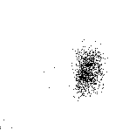
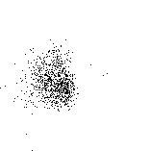
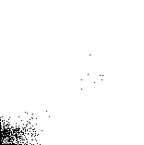
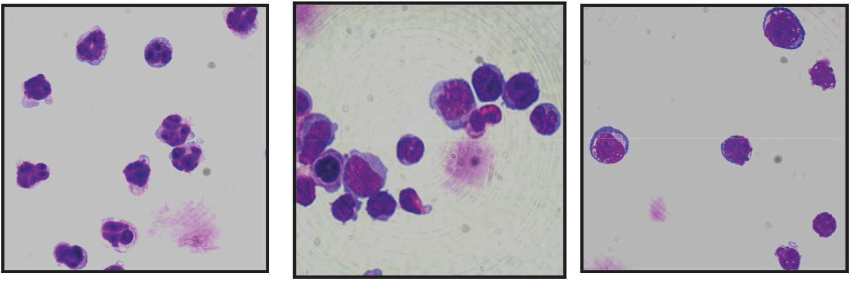
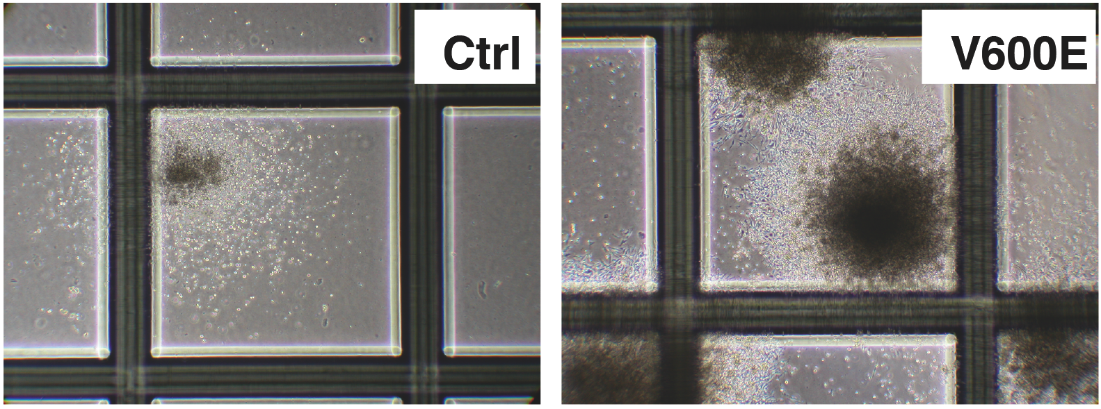
Figure S3
Mac1+
Gr1^{high}
Mac1+
Gr1^{low/-}
Mac1-
Gr1 -
99.1%
98.2%
Mac1
98.4%
Gr1
Figure S3. Purity and morphology of the sorted bone marrow populations.
Representative FACS plots (top) and morpholoby (bottom) of the sorted Mac1+Gr1^{high}, Mac1+Gr1^{low/-} and Mac1-Gr1-populations of Braf^{V600E} bone marrow cells upon re-analyses showing 98-99% purities. The majority of the Mac1+Gr1^{high} cells are granulocytes, but the Mac1+Gr1^{low/-} population contains largely monocytes.
Figure S4
Figure S4. Morphology of the colonies developed in the presence of low-dose IL-3
Representative colonies from control (Ctrl) and Braf^{V600E} (V600E) BM cells in the presence of 1 ng/ml IL-3 (shown at x40 original magnification, grid: 2mm).

