Slide 1
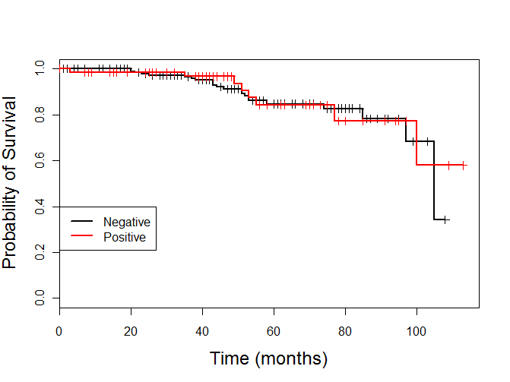
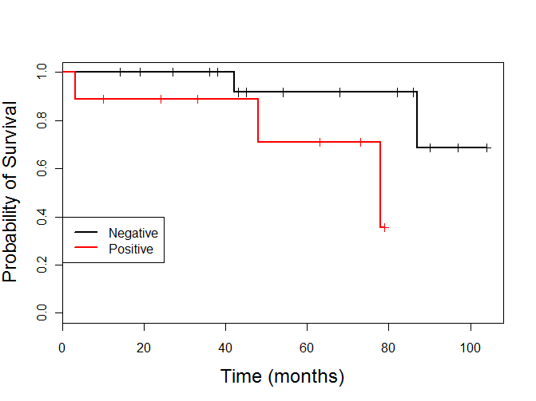
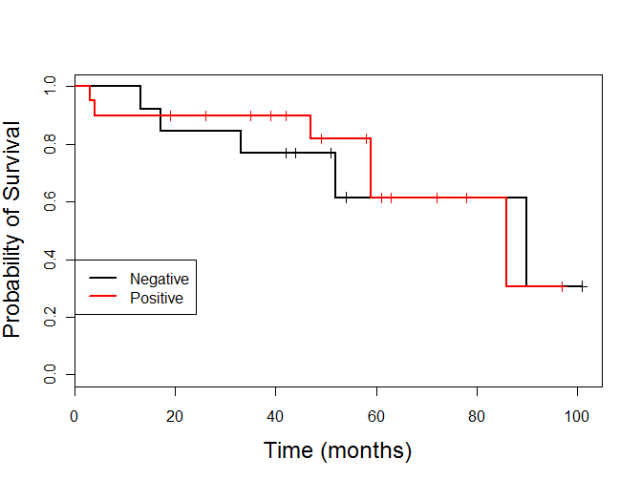
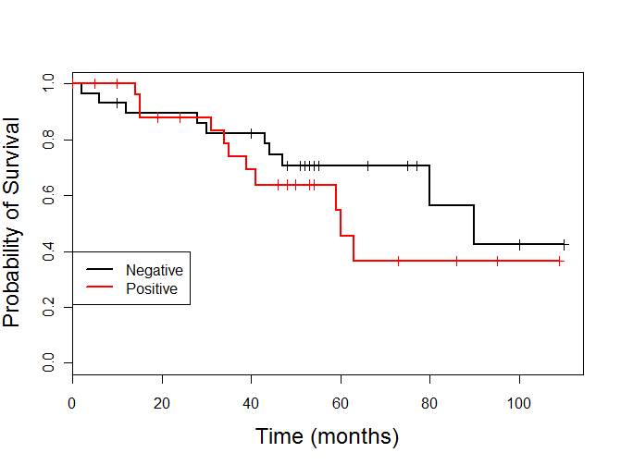
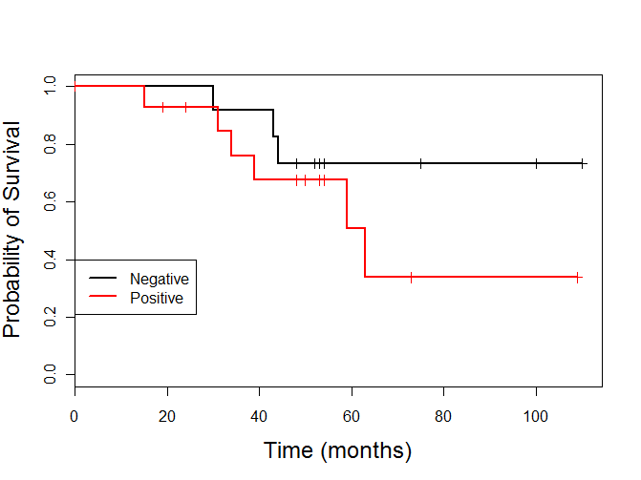
A
B
p = 0.792
(n=17)
p= 0.057
(n=70)
(n=9)
(n=205)
Luminal A
Luminal B
C
D
(n=21)
p = 0.684
p = 0.363
(n=13)
(n=29)
(n=28)
HER2 overexpressing
Triple Negative
E
p = 0.316
(n=12)
(n=15)
Basal-like
Figure A

Slide 2
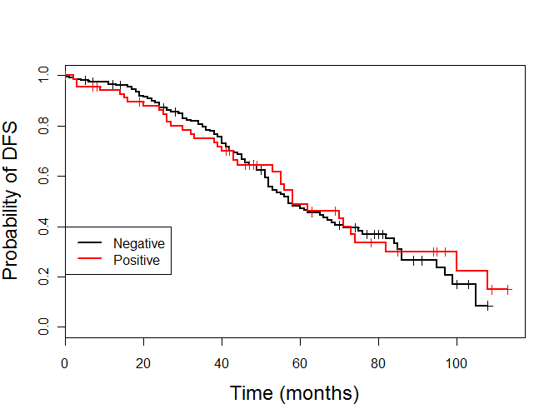
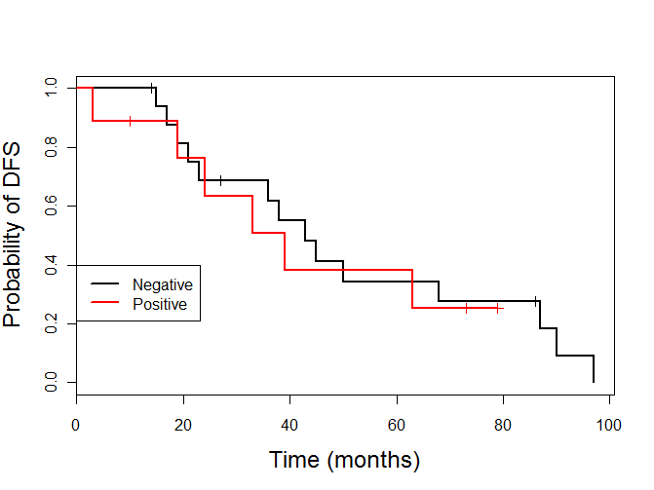
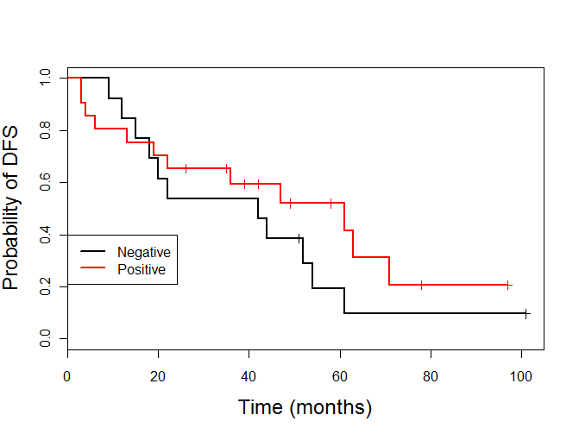
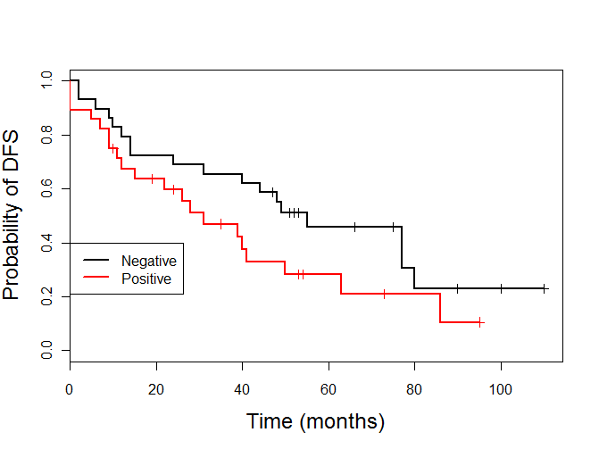
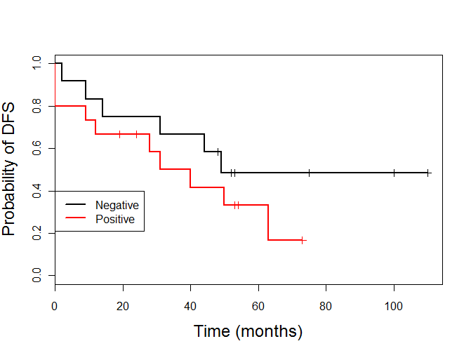
A
B
p = 0.868
p = 0.780
(n=17)
(n=9)
(n=70)
(n=205)
Luminal A
Luminal B
C
D
p = 0.295
p = 0.104
(n=21)
(n=29)
(n=13)
(n=28)
HER2 overexpressing
Triple Negative
E
p = 0.250
(n=12)
(n=15)
Basal-like
Figure B

