Slide 1
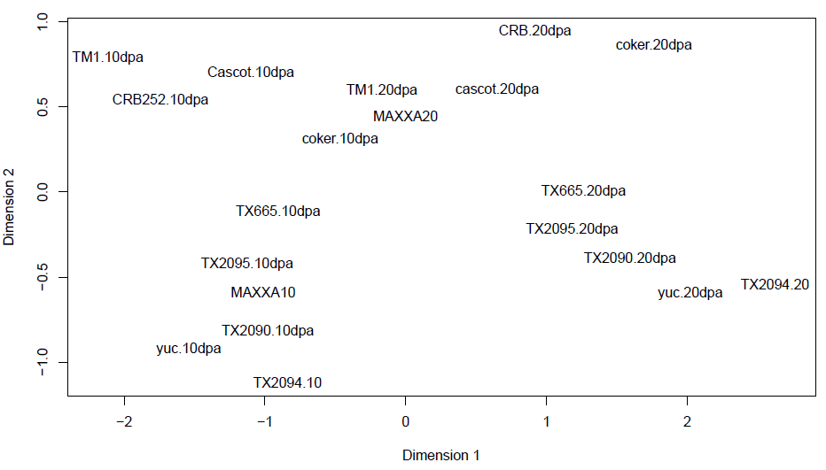
“domestication”
“development”

