Slide 1
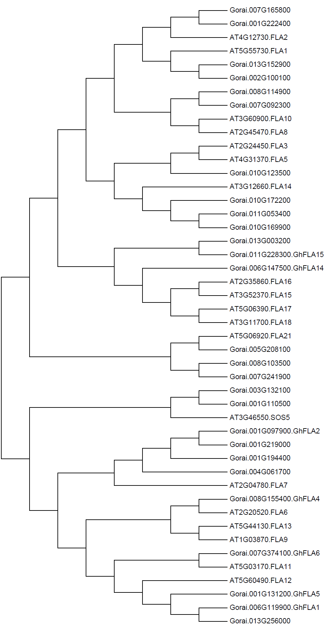
Group C
Group B
Group D
AtFLA4
Group A

