Slide 1
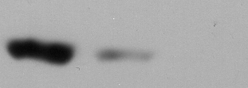
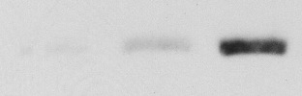
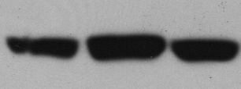
Supplementary Fig. 3
shCon
shCUL3#1
shCUL3#2
IB: Cul3
IB: NF1
IB: p120

