Slide 1
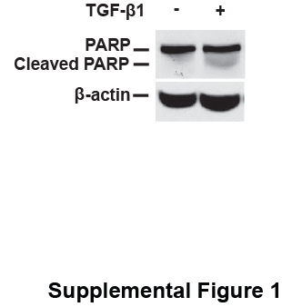
Supplemental Figure 1. TGF-beta induces PARP cleavage

Slide 2
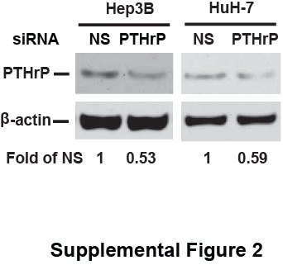
Supplemental Figure 2. PTHrP protein is knocked down by PTHrP siRNA

