Slide 1
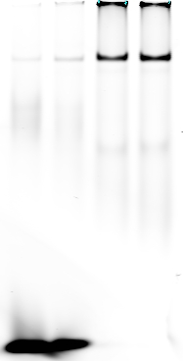



Supplemental figure 1
A
Wt - 962
AAT GCG GGC CTT GTC TGG TTC
TTA CGC CCG GAA CAG ACC AAG
CCC AAC GCC TAG AAC AGT GCG
GGG TTG CGG ATC TTG TCA CGC
AAT GCG GGA TTA TAT TGG TTC
TTA CGC CCT AAT ATA ACC AAG
CCC AAC ATT ATA CAC AGT GCG
GGG TTG TAA TAT GTG TCA CGC
Wt - 899
Mut - 962
Mut - 899
B
1 2 3 4 5 6 7 8 9 10
*
IR Dye^{TM700}
Oligo Nucleotide
WT – 962 + - - - + - - - - +
899 - + - - - + - - - -
Mutant – 962 - - + - - - + - - -
899 - - - + - - - + - -
In vitro Translated ERG Protein - - - - + + + + - -
VCAP Nuclear Extract + + + + - - - - + -
Notes:
The CXCR4 and ERG nuclear factor binding complex were verified by using the mutated probes designed against novel binding probes. (A) Mutation changes made against the putative binding sites 1 and 2 (Wt-962, Wt-899, Mut-962 and Mut-899). (B) EMSA experiment with mutation probes significantly reduced the binding intensity in VCaP nuclear protein and in vitro translated ERG protein.

Slide 2
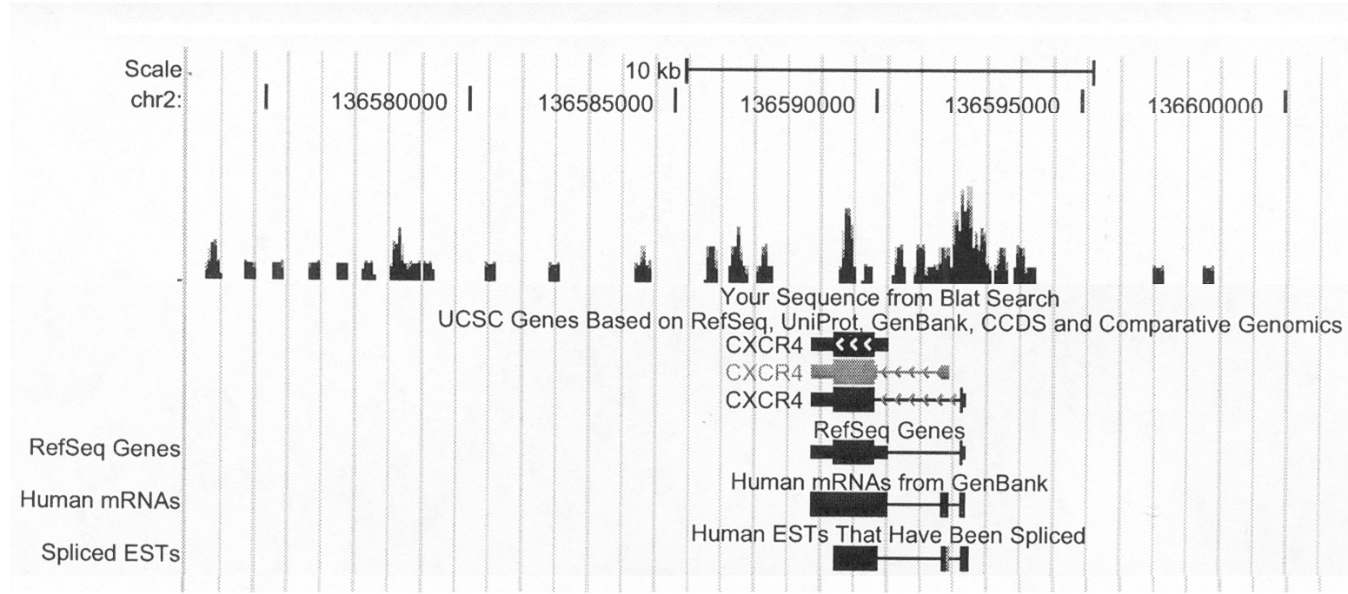
Supplemental figure 2

Slide 3
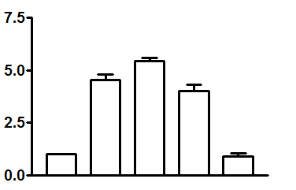
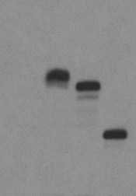
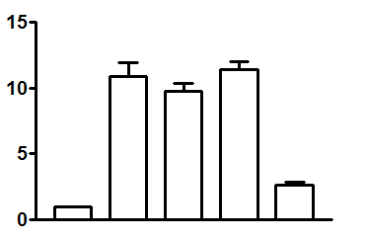
Supplemental figure 3
B
962 CXCR4 promoter
A
Topo empty
Topo ERG-Wt-V5
Topo ERG-40-V5
Topo ERG-CTD-V5
Fold induction of Luciferase/
CMV-Renilla Luciferase
MW
(kDa)
ERG
ERG-V5
ERG40-V5
82
Topo empty
ERGCTD-V5
64
49
ERG-V5
C
899 CXCR4 promoter
37
GAPDH
Fold induction of Luciferase/
CMV-Renilla Luciferase
ERG
ERG-V5
ERG40-V5
Topo empty
ERG-CTD-V5
Notes:
Effects of deletions in ERG transcription factor on transcriptional activation of the human CXCR4 luciferase promoter. (A) Western blot showing the V5 fusion protein expression with different ERG amino acid deletions. (B,C) Transcriptional activation of human CXCR4 996 and 899 luciferase reporter in HEK-293T cells by co-transfection of different ERG deletions constructs. Data represent the means of relative luciferase activities (normalized to Renilla reniformis) from atleast 5 independent transient transfection experiments each performed in triplicate

Slide 4
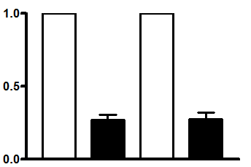
Supplemental figure 4
Normaliszed gene
expression (folds)
R1881 (nM) 0 5 0 5
ARR2Pb-Luc
ARR2Pb-ERG-Luc

Slide 5
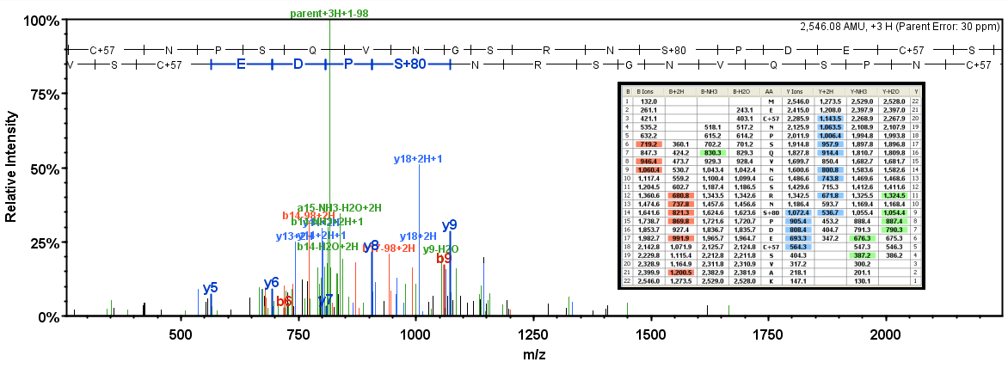
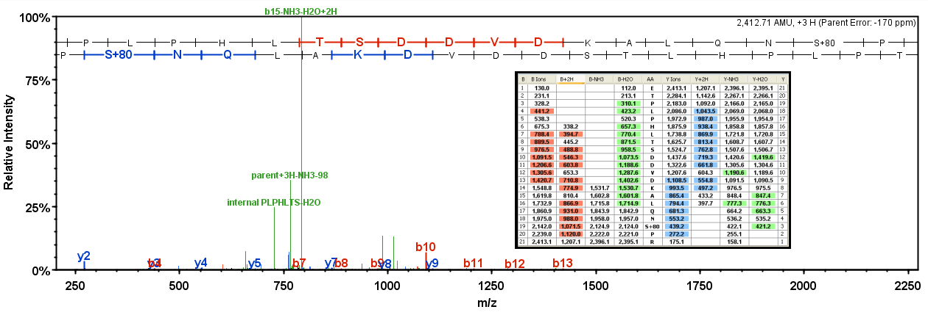
Supplemental figure 5

Slide 6
Table 1
 | Primer sequence | Position in CXCR4 promoter
1 | 5' AAT GCG GGC CTT GTC TGG TTC 3' | 912 - 932
 | 3' TTA CGC CCG GAA CAG ACC AAG 5'
2 | 5' CCC AAC GCC TAG AAC AGT GCG 3' | 871 - 891
 | 3' GGG TTG CGG ATC TTG TCA CGC 5'
3 | 5' CAG TTC GTC CTT CTA TAA ATA 3' | 843 - 863
 | 3' GTC AAG CAG GAA GAT ATT TAT 5'
4 | 5' CAT ACT TTT AGG ATA ATA AAG 3' | 694 - 794
 | 3' GTA TGA AAA TCC TAT TAT TTC 5'
5 | 5' TCC TCC GAA GGA AGG ATC TTT 3' | 509 - 529
 | 3' AGG AGG CTT CCT TCC TAG AAA 5'
6 | 5' GCA TTG CCG CCT ACT GGT TGG 3' | 409 - 429
 | 3' CGT AAC GGC GGA TGA CCA ACC 5'
7 | 5' TCA AAC TTA GGA AAT GCC TCT 3' | 228 - 248
 | 3' AGT TTG AAT CCT TTA CGG AGA 5'
8 | 5' TGC GCC CTC CTT CCT CGC GTC 3' | 112 - 132
 | 3' ACG CGG GAG GAA GGA GCG CAG 5'

Slide 7
Table 2
Name of Gene | Forward Primer Sequence | Reverse Primer Sequence
ERG | AACGAGCGCAGAGTTATCGT | GTGAGCCTCTGGAAGTCGTC
CXCR4 | CCGTGGCAAACTGGTACTTT | GACGCCAACATAGACCACCT
CXCR7 | ACGTGGTGGTCTTCCTTGTC | AAGGCCTTCATCAGCTCGTA
GAPDH | ATCACCATCTTCCAGGAGCGA | GCCAGTGAGCTTCCCGTTCA
ETS1 | ACCCAGCCTATCCAGAATCC | TCTGCAAGGTGTCTGTCTGG
ETS2 | CAAGGCTGTGATGAGTCAAGC | GGTGCCAGCTCCAGAAAGC
ETV 1 | ATGGATGGATTTTATGACCAGCA | GACTTAGATCTTGAAAGAGTTCTTCTG
ETV4 | TCATGCATCTCCAAACTCAACTC | CAAAGGAGGAAAGGAGTTACAG
ETV5 | CTCCTTTGCCGACGATGC | TGCCAACCATGGTGTTGTG
FLI-1 | ACGGGGAGTTCAAAATGACG | GCATGTAGGAGATGTCAGAAGG

