Slide 1
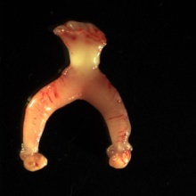
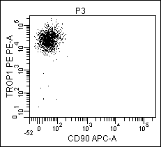

Supplementary Figure S4
Uteri from
PTEN^{loxP/loxP} mice
FACS isolate
epithelia
Cre-RFP
lentivirus
Trop1-PE
CD90-APC
Infect PTEN^{loxP/loxP}
Epithelia
Lentivirus infects subsets of PTEN^{loxP/loxP} epithelia. Expression of Cre-recombinase in infected cells results in deletion of PTEN. Infected cells can be visualized and selected by expression of RFP.
Plate endometrial epithelia in 3-dimensional culture with endometrial stromal layer at the culture base. Culture 2 weeks with or without estrogen to form epithelial spheres.
RFP+
PTEN WT
sphere
RFP+
PTEN null
sphere
Culture with Estrogen
Culture with NO Estrogen
Stromal cell
layer
+ Olaparib
+ Vehicle
+ Olaparib
+ Vehicle
Estrogen + Olaparib
Estrogen + Vehicle
No Estrogen + Olaparib
No Estrogen + Vehicle
Hand-pick RPF positive spheres
Dissociate
Cytospin
& Co-immunostain
for γH2A.X/Rad51
Dissociate
Cytospin
& Co-immunostain
for γH2A.X/Rad51
Dissociate
Cytospin
& Co-immunostain
for γH2A.X/Rad51
Dissociate
Cytospin
& Co-immunostain
for γH2A.X/Rad51

