Slide 1
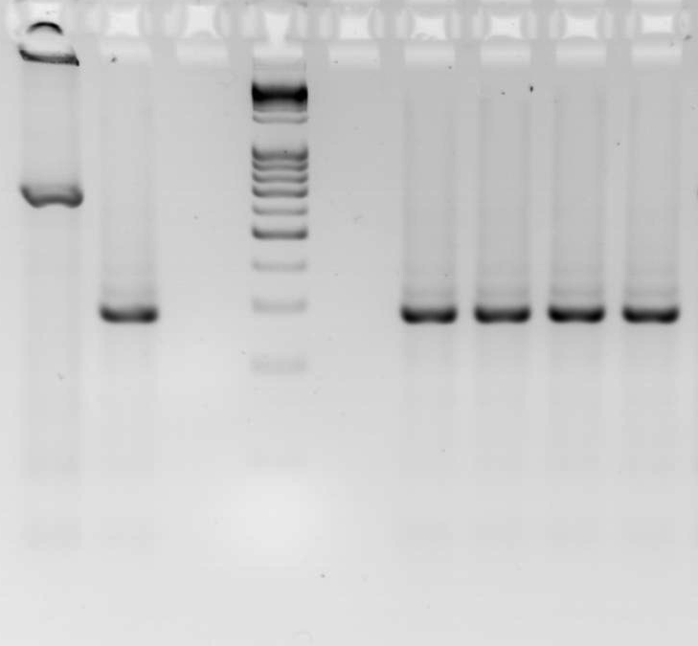
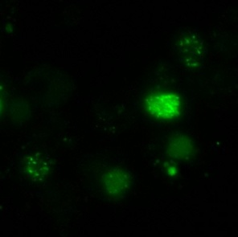

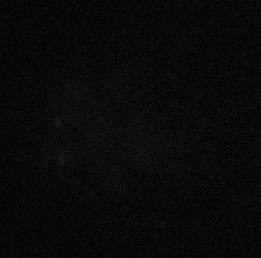
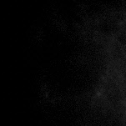
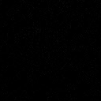
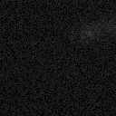


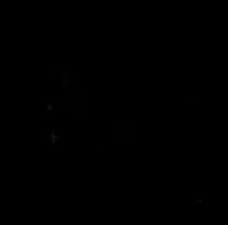



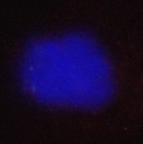
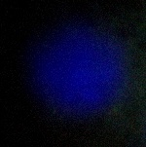
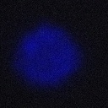
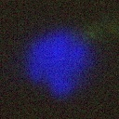
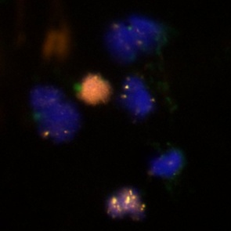
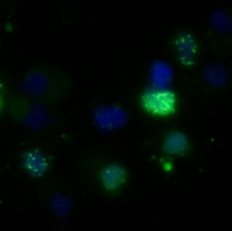

Supplementary Figure S5
A.
B.
QPCR
p < 0.001
No Estrogen + Olaparib
p > 0.05
Estrogen + Olaparib
No Estrogen + Vehicle
PTEN^{loxP/loxP} + Cre
Estrogen + Vehicle
5
PTEN^{loxP/loxP}
DNA Ladder
4
Rad51 Transcript Levels relative to GAPDH
(X 10⁻³)
Floxed
PTEN
1000
3
800
600
2
p > 0.05
Δ PTEN
400
200
1
0
Estrogen
Olaparib
+
-
+
-
+
+
-
-
C.
Estrogen
+ Olaparib
No Estrogen
+ Olaparib
D.
a
d
Estrogen
+
-
+
-
γH2AX
Olaparib
-
-
+
+
a
d
g
j
γH2AX
b
e
b
e
h
k
Rad51
Rad51
c
f
i
l
c
f
Merge
Merge
Vehicle treated cells
Matched isotype stains

