Slide 1
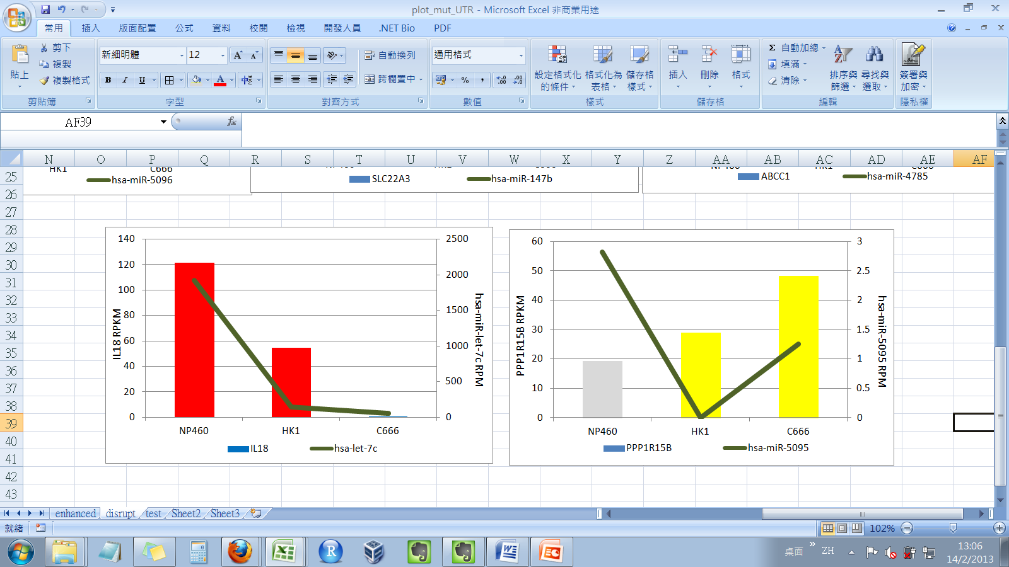
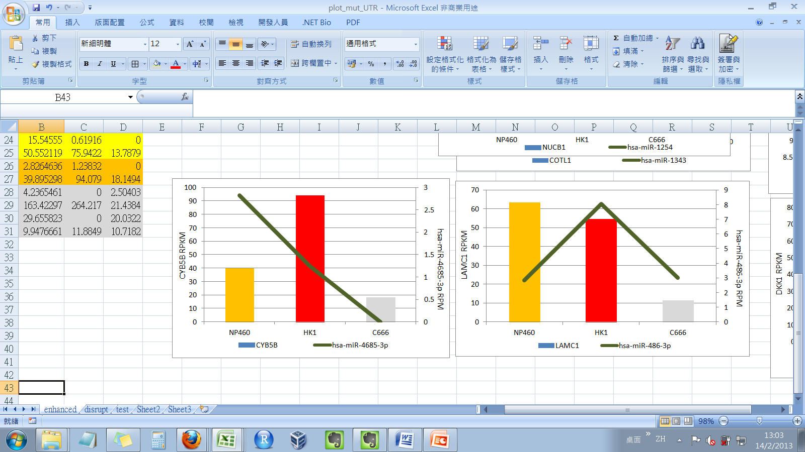
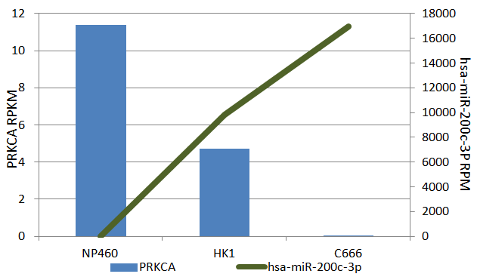
Disrupted
Enhanced
**
B
**
A
C
Without sequence variant
**
**
Variation frequency:
0%
20-39%
40-70%
>70%
NA
Notes:
Supplementary figure 2. Integrated analysis on example candidates with sequence variation in miRNA binding UTRs. By two-fold cut-off ,disrupted candidates whose co-expression was observed with sequence variation and enhance candidates that show inverse expression. A)miRNA expression (line) and target mRNA expression (bar) of disrupted binding pair; B) miRNA expression (line) and target mRNA expression (bar) of enhanced binding pair ; C) miRNA expression (line) and target mRNA expression (bar) of binding pair without UTR variant. Left Y-axis: expression value of mRNA in RPKM; right Y-axis: expression value of miRNA in RKM; Grey bar: no read detected in UTR sequence; blue bar: expression of mRNA without UTR variant; yellow bar: expression of mRNA with 20-39% UTR variation frequency; orange bar: expression of mRNA with 40-70% UTR variation frequency; red bar: expression of mRNA with over 70% UTR variation frequency. . *: p<0.05; **:p<0.01 in NGS and QPCR are p-value analyzed by DeSeq package.

