Slide 1
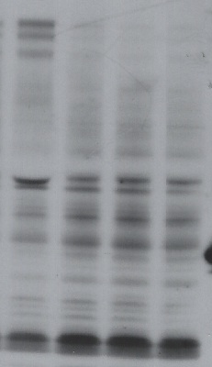

E2A/PBX1 siRNA Experiment 1
E2A/PBX1 siRNA Experiment 2
E2A/PBX1 siRNA Experiment 3
control siRNA
E2A-PBX1a
E2A-PBX1b
Tubulin

