Slide 1
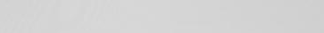
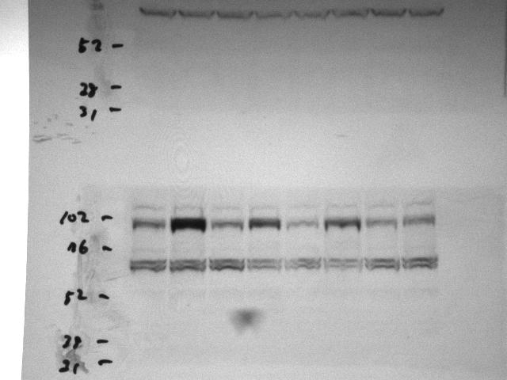
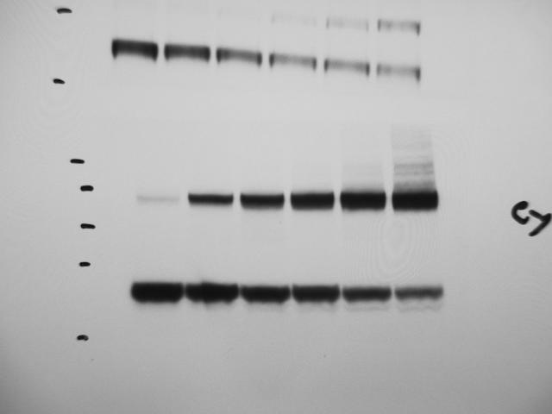
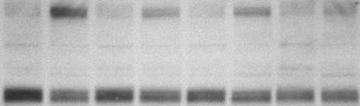
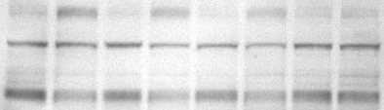
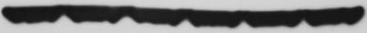
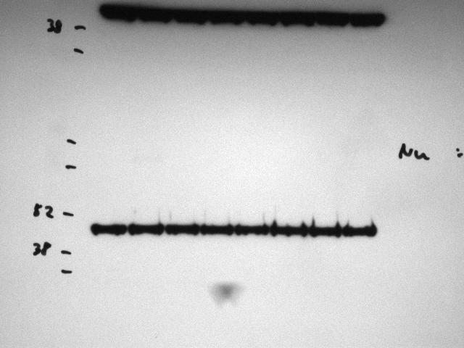
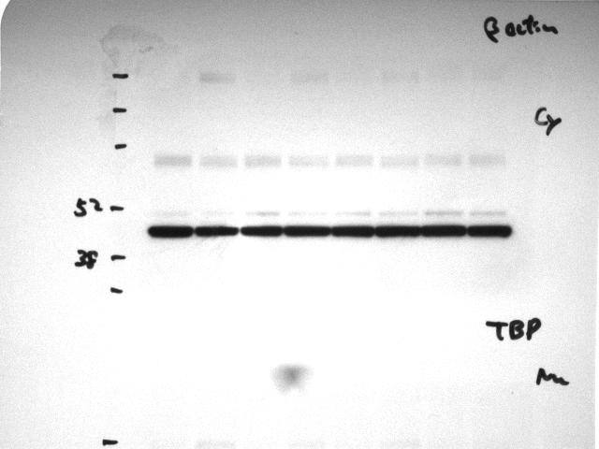
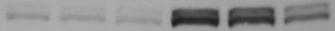
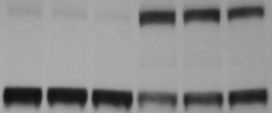
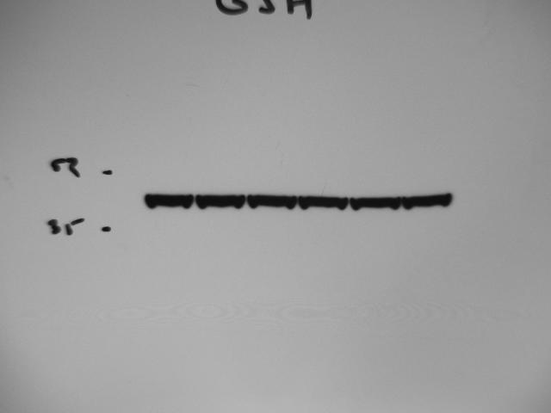
Supplementary Figure 2
A
SKI-II
Keap1 69 kDa
B
0 10 20 30 60 120 Time (min)
Keap1 140 kDa
2
4
8
24
hrs
2
4
8
24
IB: Nrf2
- + - + - + - + - + - + - + - + SKI-II
IB: Nrf2
Keap1 vs β-actin
140 kDa
IB: Keap1
IB: Keap1
69 kDa
IB: β-actin
IB: β-actin
IB: TBP
C
D
E
F
G
H
- - - + + + SKI-II
- 5 10 - 5 10 GSH
(µM)
IB: Nrf2
140 kDa
IB: Keap1
69 kDa
IB:β-actin

