Slide 1
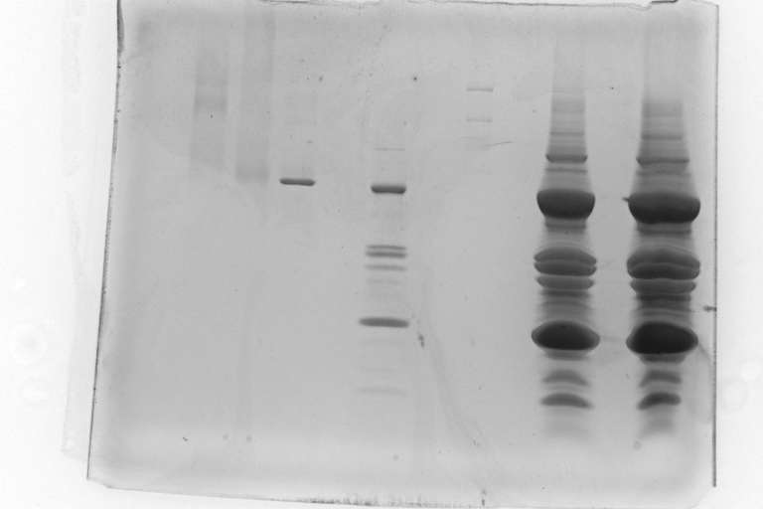
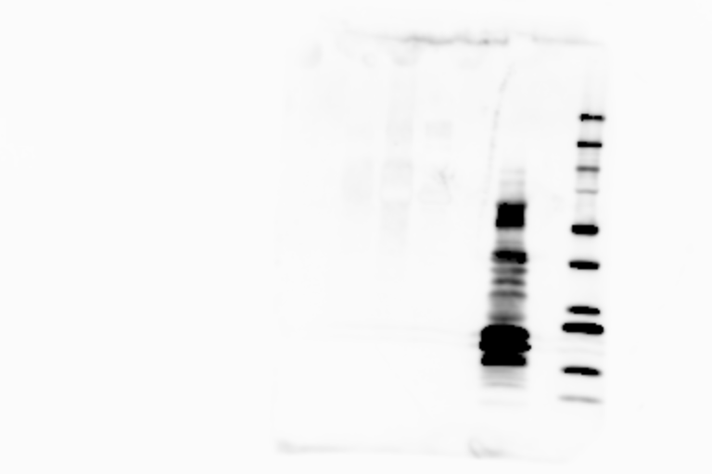
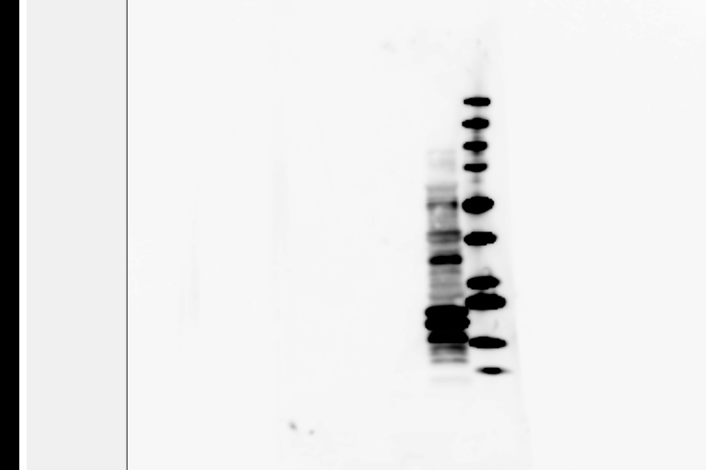
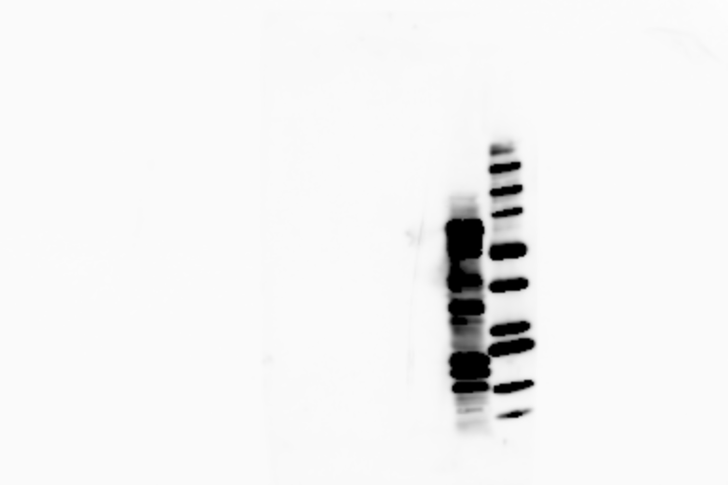
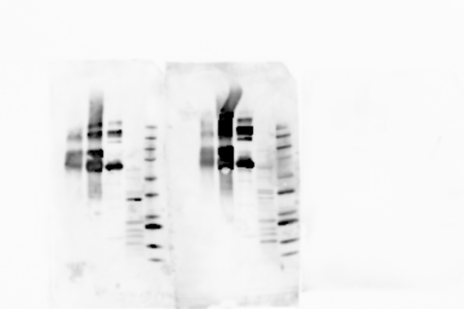
Supplementary Figure 1
A
B
C
D
E
IgE binding
Anti-Bos d 6
SDS-PAGE
P1
P2
P3
M 3 4 5
1 2 3 4 5
1 2 3 4 5
M 1 2 3 4 5
M 1 2 3 4 5
250
150
100
75
50
37
25
20
15
Supplementary Figure 1. Lack of IgE binding from peanut allergic patient sera to Bos d 6 before and after Maillard reaction.
Panel A is a stained SDS-PAGE and panels B-D are a Western blot of allergic patient sera from patients 1-3 respectively. Panel E is a Western blot with anti-Bos d 6. The lanes for each panel contain M: Marker (BioRad PPP marker), 1: Crude peanut protein, 2: Empty, 3: Bos d 6, 4: Bos d 6 treated with glucose for 10 days, and 5: Bos d 6 treated with xylose for 10 days.

Slide 2
Supplementary Table 1
Mass spectrometry identification of Ara h 3 iso-allergens including percent identity to Ara h 3.0101
 |  | Distinct
 |  | Summed
 |  | MS/MS Search | % AA | Mean |  | GenPept
No. Spectra | Distinct Peptides | Score | Coverage | Peptide Intensity | Species | Database # | Name | %ID Ara h 3 | Seq Query Coverage
9 | 9 | 144.8 | 25 | 4.32E+07 | Arachis hypogaea | 52001219 | arachin Ahy-1 | 99 | 100
9 | 9 | 144.8 | 25 | 4.32E+07 | Arachis hypogaea | 37789212 | storage protein | 99 | 100
8 | 8 | 138.4 | 22 | 3.29E+07 | Arachis hypogaea | 9864777 | Gly1 | 88 | 99
8 | 8 | 132.4 | 23 | 4.44E+07 | Arachis hypogaea | 21314465 | allergen Arah3/Arah4 | 100 | 100
8 | 8 | 126.0 | 22 | 4.80E+07 | Arachis hypogaea | 118776570 | arachin 6 | 88 | 96
6 | 6 | 103.0 | 14 | 4.09E+07 | Arachis hypogaea | 52001221 | arachin Ahy-2 | 95 | 100
6 | 6 | 101.5 | 15 | 4.04E+07 | Arachis hypogaea | 57669861 | arachin Ahy-4 | 88 | 100
4 | 4 | 68.0 | 11 | 6.42E+07 | Arachis hypogaea | 5712199 | glycinin | 86 | 100
4 | 4 | 66.2 | 8 | 5.51E+07 | Arachis hypogaea | 3703107 | glycinin | 73 | 100
1 | 1 | 20.7 | 7 | 2.75E+07 | Arachis hypogaea | 22135348 | trypsin inhibitor* | 99 | 40
1 | 1 | 20.7 | 8 | 2.75E+07 | Arachis hypogaea | 118776572 | arachin 7* | 97 | 38
 |  |  |  |  |  |  |  |  | *- reported clone is a fragment

Slide 3
Supplementary Table 2
Top 15 hits from a BLAST search of the NCBI database using Ara h 3 as the query
 |  |  |  |  |  |  | GenBank
 | Description | Max score | Total score | Query cover | E value | Max ident | Accession
1 | allergen Arah3/Arah4 [Arachis hypogaea] | 1101 | 1101 | 100% | 0 | 100% | AAM46958.1
2 | arachin Ahy-1 [Arachis hypogaea] | 988 | 988 | 100% | 0 | 99% | AAU21490.1
3 | storage protein [Arachis hypogaea] | 975 | 975 | 100% | 0 | 99% | AAR02860.1
4 | arachin Ahy-2 [Arachis hypogaea] | 949 | 949 | 100% | 0 | 95% | AAU21491.1
5 | Gly1 [Arachis hypogaea] | 912 | 912 | 99% | 0 | 88% | AAG01363.1
6 | arachin Arah3 isoform [Arachis hypogaea] | 903 | 903 | 100% | 0 | 89% | ACH91862.1
7 | arachin Ahy-4 [Arachis hypogaea] | 893 | 893 | 100% | 0 | 88% | AAW56067.1
8 | arachin 6 [Arachis hypogaea] | 890 | 890 | 100% | 0 | 91% | ABL14270.1
9 | Chain A, Crystal Structure Of Peanut Major Allergen Ara H 3 | 865 | 865 | 96% | 0 | 88% | 3C3V_A
10 | glycinin [Arachis hypogaea] | 859 | 859 | 95% | 0 | 87% | AAC63045.1
11 | glycinin [Arachis hypogaea] | 842 | 842 | 100% | 0 | 86% | AAD47382.1
12 | iso-Ara h3 [Arachis hypogaea] | 754 | 754 | 100% | 0 | 73% | ABI17154.1
13 | Ara h 3 allergen [Arachis hypogaea] | 751 | 751 | 100% | 0 | 73% | ADQ53859.1
14 | glycinin, partial [Arachis hypogaea] | 751 | 751 | 99% | 0 | 73% | AAT39430.1
15 | gb|AAU21492.1| arachin Ahy-3 [Arachis hypogaea] | 671 | 671 | 100% | 0 | 68% | Q647H2.1

Slide 4
Xylose
MS/MS spectrum of ion m/z 626.3 corresponding to residues 516-531 of Arah1 with K522 CML
IFLAGDkDNVIDQIEK
CML
Intens.
x10
5
+MS2(626.3), 27.9min #1468
8
y₁₄²⁺
6
4
y₆
(M+3H)³⁺
y₁₃²⁺
2
b₂
y₁₂²⁺
b₃
y₄
y₅
y₁₁²⁺
y₇
y₁₅²⁺
y₈
0
300
400
500
600
700
800
900
m/z

Slide 5
Xylose
MS/MS spectrum of ion m/z 862.1 corresponding to residues 260-282 of Arah1 with K262 CML
VAkISMPVNTPGQFEDFFPASSR
CML
Intens.
x10
4
y₅
+MS2(862.1), 31.6min #1671
1.5
1.0
y₁₇²⁺
y₆
(M+3H)³⁺
y₁₃²⁺
y₈
b₆
y₉
0.5
y₇
y₁₈²⁺
b₁₀
y₁₀
y₁₃
b₄
y₁₄²⁺
y₁₂
0.0
400
600
800
1000
1200
1400
m/z

Slide 6
Xylose
MS/MS spectrum of ion m/z 616.2 corresponding to residues 591-601 of Arah1 with K598 CML
GPLLSILkAFN
CML
y₇
b₁₀
y₅
y₄
b₉
y₂
b₆^{-H}₂^{O}
y₃
b₅^{-H}₂^{O}
b₆
b₇^{-H}₂^{O}
y₆
b₄
b₈
y₈

Slide 7
Xylose
MS/MS spectrum of ion m/z 614.0 corresponding to residues 535-550 of Arah1 with K547 pyrraline
DLAFPGSGEQVEkLIK
pyrraline
y₁₂⁺⁺
y₁₄⁺⁺
y₁₃⁺⁺
b₂
b₃
b₄

Slide 8
Xylose
MS/MS spectrum of ion m/z 643.3 corresponding to residues 516-531 of Arah1 with K522 pyrraline
IFLAGDkDNVIDQIEK
pyrraline
y₁₄⁺⁺
y₁₂⁺⁺
y₁₃⁺⁺
y₉⁺⁺
y₅
b₂
b₃
y₈⁺⁺
y₁₁⁺⁺
b₄
y₁₀⁺⁺
y₁₅⁺⁺

Slide 9
Xylose
MS/MS spectrum of ion m/z 670.9 corresponding to residues 294-309 of Arah1 with R308 +116
NTLEAAF(NAEFNEIRR)₊₁₁₆
y₁₃⁺⁺
y₁₄⁺⁺
(M+3H)³⁺-H₂O
y₁₂⁺⁺
y₁₀⁺⁺
y₁₁⁺⁺
b₂
y₉⁺⁺
y₁₃^{++ -H}₂^{O}
b₃ ^{–H}₂^{O}
b₃

Slide 10
glucose
MS/MS spectrum of ion m/z 749.2 corresponding to residues 427-446 of Arah1 with K 435 fructose lysine
AMVIVVVNkGTGNLELVAVR
FL
Intens.
x10
6
+MS2(749.5), 26.7min #800
2.5
(M+3H)³⁺-2H₂0
2.0
1.5
y₆
b₁₄²⁺
1.0
y₃
b₁₈²⁺
y₅
y₁₄²⁺
b₁₇²⁺
b₁₉²⁺
y₂
y₁₉³⁺
b₁₆²⁺
y₄
b₁₅²⁺
0.5
637.9
y₇
y₁₅²⁺
y₉
y₁₁
b₅
b₆
b₃
b₄
y₉²⁺
b₉²⁺
y₁₀
387.3
0.0
300
400
500
600
700
800
900
1000
1100
m/z

Slide 11
raw
MS/MS spectrum of ion m/z 473.2 corresponding to residues 415-426 of Arah1
EGALmLPHFN(SK)_{CM}
y₇⁺⁺
y₈⁺⁺
y₅⁺⁺
b₅^{-H}₂^{O}
y₆⁺⁺
y₉⁺⁺
y₂
y₂’
y₁₀³⁺
y₁₀⁺⁺
y₆

Slide 12
roasted
MS/MS spectrum of ion m/z 754.6 corresponding to residues 516-534 of Arah1 with K522/531 CML
IFLAGDkDNVIDQIEkQAK
CML
CML
Intens.
y₁₄³⁺
+MS2(754.6), 19.0min #1119
x10
4
587.3
b₈
1.5
918.3
1.0
y₁₈³⁺
716.4
b₁₃⁺⁺
744.3
0.5
y₅
789.3
b₁₂
y₃^{-NH}₃
y₃^{-H}₂^{O}
515.2
661.2
y₇
1245.4
1358.5
328.1
395.2
441.2
622.3
844.4
1061.3
0.0
955.5
1013.9
400
600
800
1000
1200
1400
m/z

Slide 13
roasted
MS/MS spectrum of ion m/z 862.2 corresponding to residues 260-282 of Arah1 with K262 CML
VAkISMPVNTPGQFEDFFPASSR
CML
y₅
y₁₅⁺⁺
y₂₀³⁺
y₆
y₁₄⁺⁺
y₁₈⁺⁺
b₁₈⁺⁺
b₁₁
y₂

Slide 14
roasted
MS/MS spectrum of ion m/z 517.2 corresponding to residues 332-345 of Arah1 with K342 CML
SSENNEGVIVkVSK
CML
b₈⁺⁺
y₁₂⁺⁺
y₁₁⁺⁺
y₁₀⁺⁺
y₄^{-H}₂^{O}
b₇⁺⁺
b₈

Slide 15
roasted
MS/MS spectrum of ion m/z 597.1 corresponding to residues 535-549 of Arah1 with K546 CML
DLAFPGSEQVEkLIK
CML
y₁₄⁺⁺
y₁₂⁺⁺
y₁₃⁺⁺
b₆³⁺
b₃
b₂
b₄

Slide 16
raw
MS/MS spectrum of ion m/z 769.9 corresponding to residues 326-338 of Ara h 3 with K338 CML
NGIEETICSASVkK
CML
y₄
(M+2H)²⁺ ^{– H}₂^{O}
b₁₀
y₁₂^{-NH}₃
y₃
y₈^{-NH}₃
b₁₀^{-NH}₃
b₁₃
b₁₁

Slide 17
raw
MS/MS spectrum of ion m/z 889.7 corresponding to residues 489-509 of Ara h 3 with Q489 CM
(Q)LKNNNPFKFFVPpFDHQSMR
CML
y₁₅⁺⁺
y₁₇⁺⁺
y₁₈⁺⁺
y₁₆⁺⁺
y₅
y₂₀⁺⁺
b₄^{-NH}₃
b₆
y₁₉⁺⁺

Slide 18
roasted
MS/MS spectrum of ion m/z 769.9 corresponding to residues 326-338 of Ara h 3 with K338 CML
NGIEETICSASVkK
CML
y₄
y₁₂ ^{–NH}₃
b₁₀
(M+2H)²⁺ ^{– H}₂^{O}
b₁₀ ^{–H}₂^{O}
b₁₁

Slide 19
roasted
MS/MS spectrum of ion m/z 889.7 corresponding to residues 489-509 of Ara h 3 with Q489 CM
(Q)LKNNNPFKFFVPpFDHQSMR
CML
y₁₇⁺⁺
y₁₅⁺⁺
y₁₆⁺⁺
y₁₈⁺⁺
y₅
y₂₀⁺⁺
y₁₉⁺⁺
b₈³⁺

Slide 20
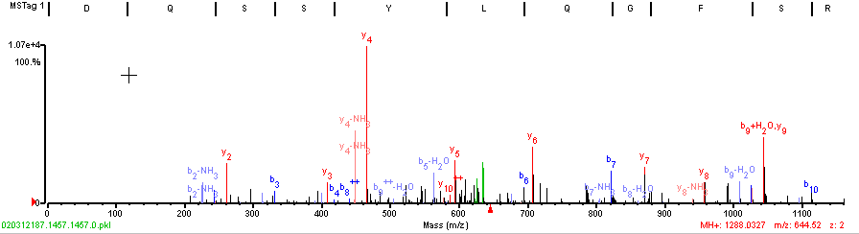
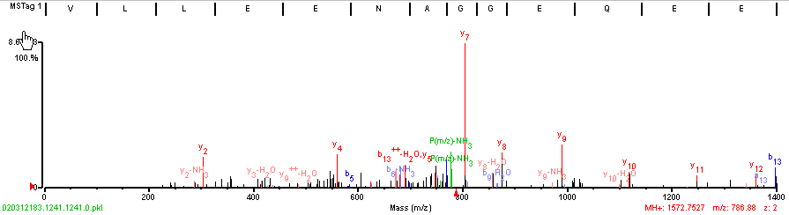
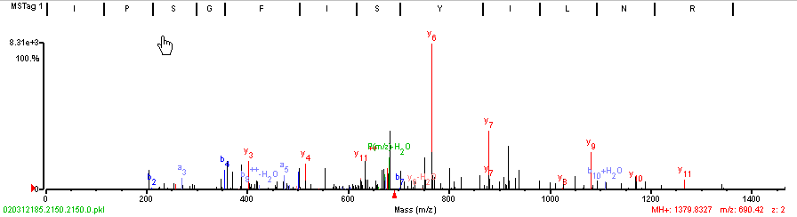
MS/MS of Ara h 1 Peptides Observed by RAGE Pull-down

Slide 21
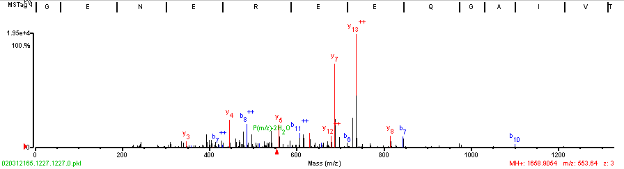
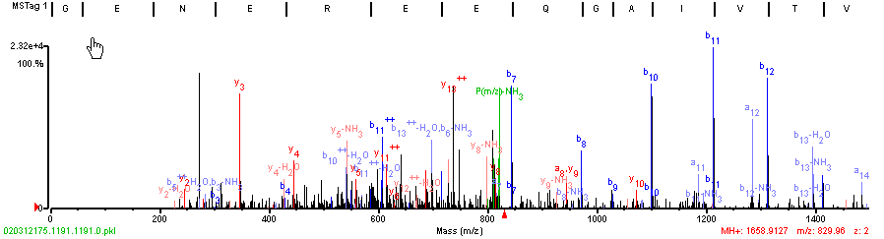
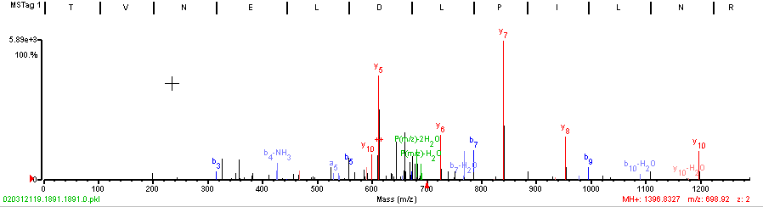
MS/MS of AHY-3 Peptides Observed by RAGE Pull-down

