Slide 1
Supplemental Figure 1
Characterization of the anti-OX40 mAb (9B12). (A) Co-stimulatory potency of the 9B12 mAb as measured in vitro on CD4+ T cells. PHA-activated human CD4+ T cells were were exposed to sub-threshold amounts of anti-CD3 making proliferation dependent on added anti-OX40 (9B12) co-stimulation. Anti-CD3 and 9B12 were plate-bound. Proliferation was detected by incorporation of [³H]Tthymidine on day 3. (B) Binding affinity of 9B12, as measured by an ELISA. Plates were coated with goat anti-human IgG antibody to capture hOX40:hIg fusion protein. Serial dilutions of 9B12 were applied and detected with HRP-conjugated sheep anti mouse secondary antibody.

Slide 2
Supplemental Figure 2
Total peripheral lymphocyte counts. Absolute lymphocyte count was determined for all patients. Results are represented as mean values for each cohort.

Slide 3
Supplemental Figure 3
Pharmacokinetics of CD134 (anti-OX40) mAb in patients. Patients were infused with anti-OX40 mAb on days 1, 3 and 5. Blood samples were taken before (pre), and 2, 6 and 24 hours after the day 1 dose and before (D5-pre), 2 and 6 hours after the day 5 dose. The last sample was obtained on day 8. Each point represents the mean value for the ten patients at that time point. The concentration of CD134 mAb was determined by ELISA as described in Methods.

Slide 4
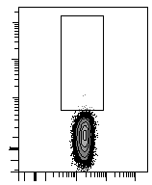
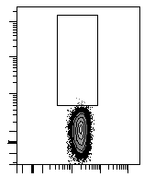
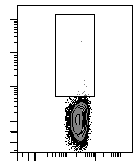
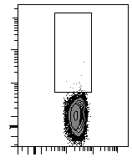
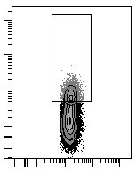
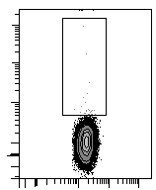
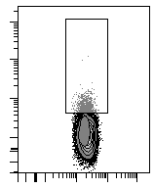
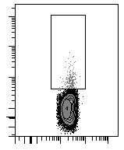
Supplemental Figure 4
A
B
C
FITC Anti-mouse IgG
FITC Anti-rat IgG
FITC Anti-mouse IgG
FITC Anti-rat IgG
Day 0
0%
0.2%
0 %
0.4 %
Day 5
20.4%
0.1%
2.7 %
0.9 %
FITC
FITC
CD4
CD8
Direct ex vivo detection of the murine anti-OX40 mAb bound to T cells in treated patients. PBL collected before treatment and 3 hours after the last/third infusion of anti-OX40 were analyzed by flow cytometry for the presence of a murine Ab bound to the surface of T cells. (A) CD4⁺ T cells and (B) CD8⁺ T cells from the same patient. (C) Summary of the results obtained for five different patients in the third cohort. The Y-axis shown in the bar graph represents staining with the goat anti-mouse IgG minus the background staining (anti-rat IgG).

Slide 5
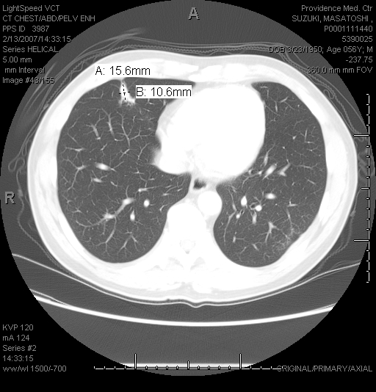
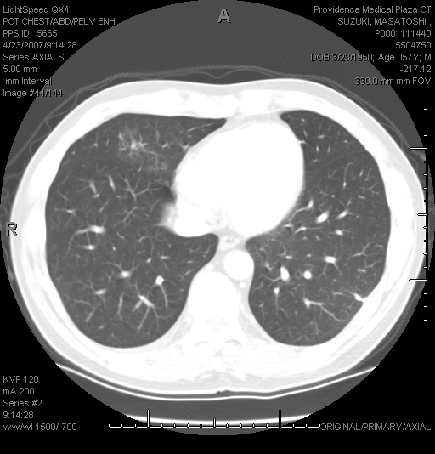
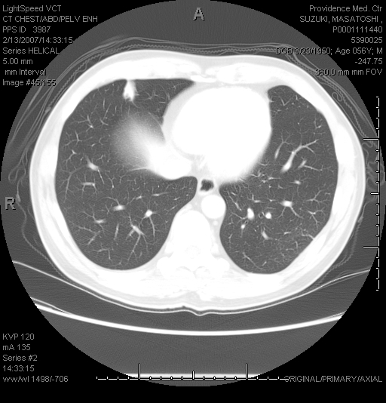
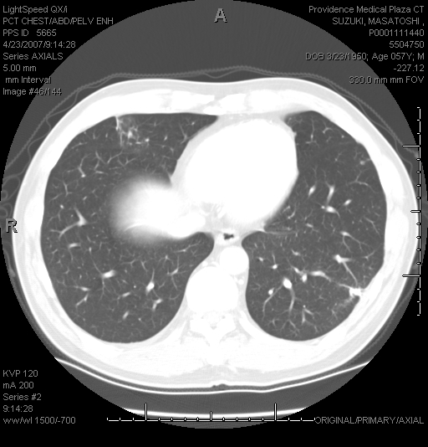
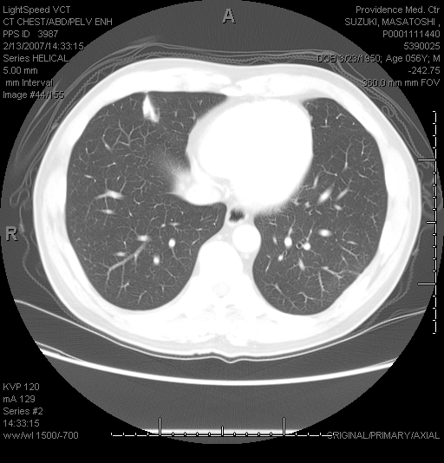
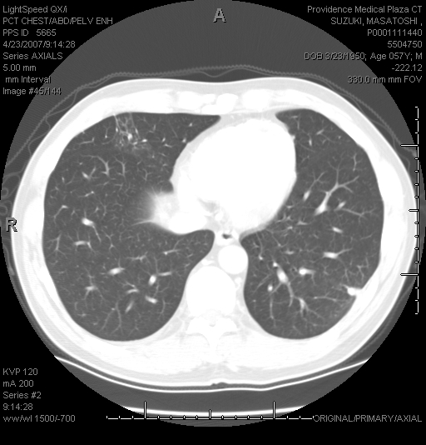
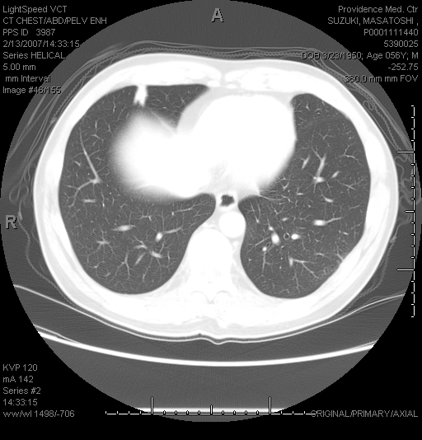
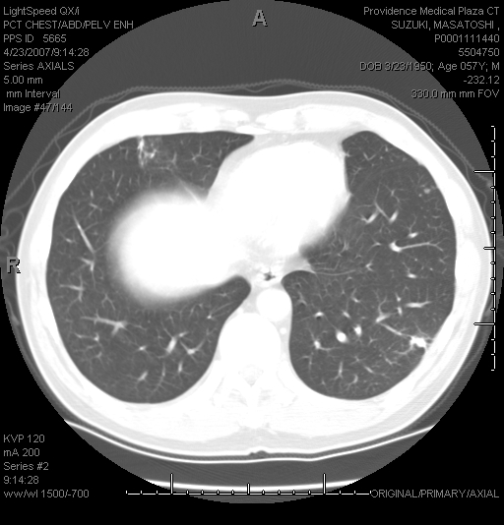
Supplemental Figure 5
A
B
E
F
C
D
G
H
Regression of a pulmonary metastasis in a patient with renal carcinoma enrolled in cohort 1. The CT-scans were taken prior to (A, C, E and G) and 2 months after the infusion of anti-OX40 the monoclonal Ab (B, D, F and H). Four serial sections are shown prior to and after anti-OX40 treatment in order to reaffirm that this lesion completely regressed.

Slide 6
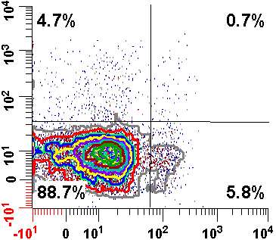
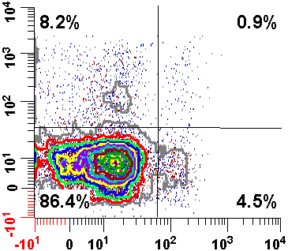
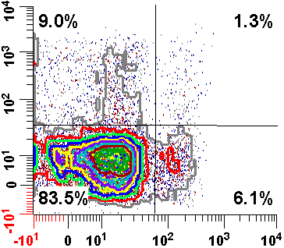
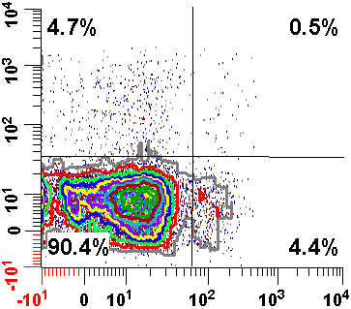
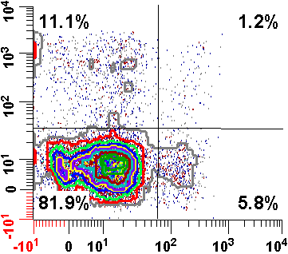
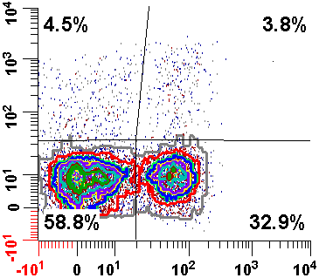
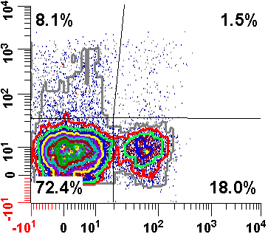
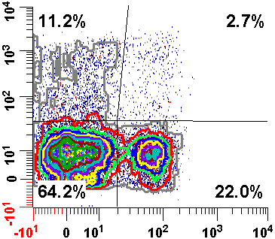
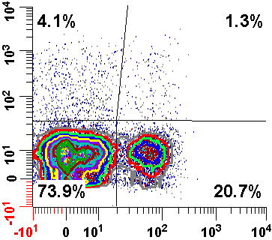
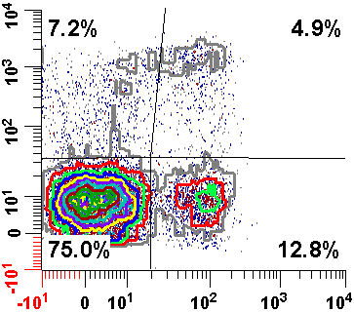
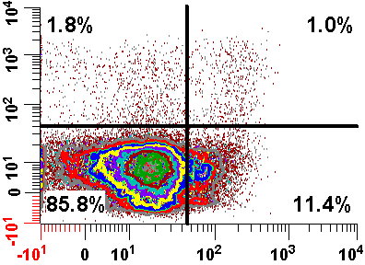
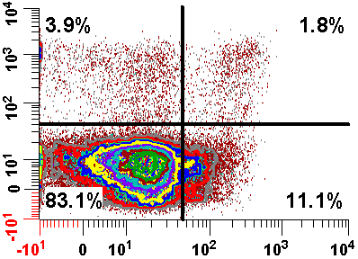
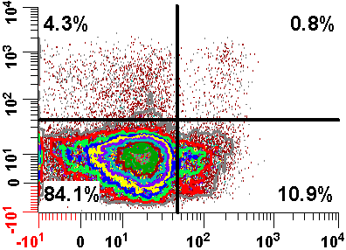
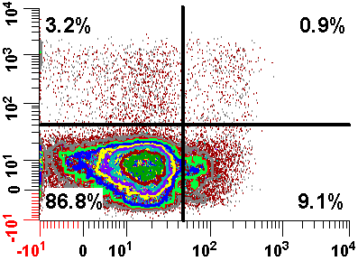
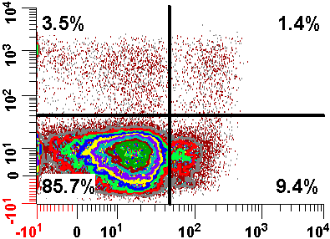
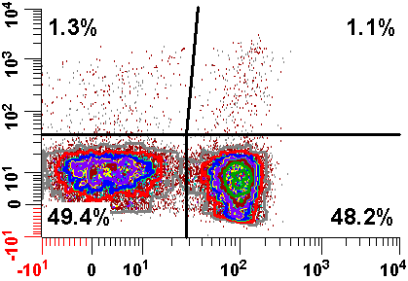
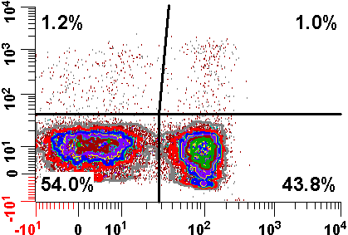
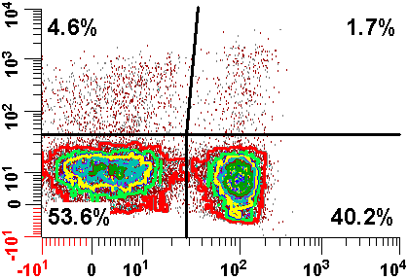
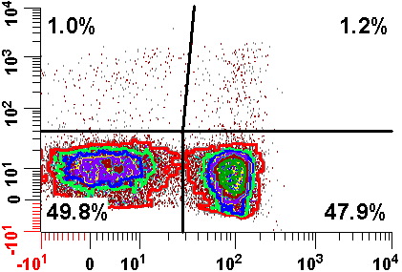
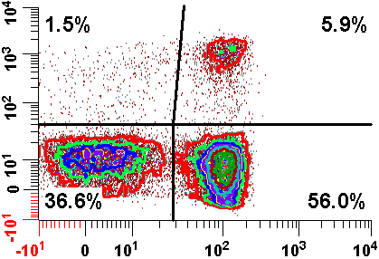
Supplemental Figure 6
A
CD3⁺ CD95⁺ CD4⁺ T cells
B
CD3⁺ CD95⁺ CD8⁺ T cells
Day 0
Day 8
Day 15
Day 29
Day 57
Day 0
Day 8
Day 15
Day 29
Day 57
4.7
0.7
8.2
0.9
9.0
1.3
4.7
0.5
11.1
1.2
4.5
3.8
8.1
1.5
11.2
2.7
4.1
1.3
7.2
4.9
Patient cohort 2
88.7
5.8
86.4
4.5
83.5
6.1
90.4
4.4
81.9
5.8
58.8
32.9
72.4
18.0
64.2
22.0
73.9
20.7
75.0
12.8
1.8
1.0
3.9
1.8
4.3
0.8
3.2
0.9
3.5
1.4
Patient cohort 1
1.3
1.1
1.2
1.0
4.6
1.7
1.0
1.2
1.5
5.9
Ki-67
Ki-67
85.8
11.4
83.1
11.1
84.1
10.9
86.8
9.1
85.7
9.4
49.4
48.2
54.0
43.8
53.6
40.2
49.8
47.9
36.6
56.0
Foxp3
CD28
Changes in Ki-67 expression within CD4⁺ and CD8⁺ T cell subsets examined over time after anti-OX40 from patients in cohorts 1 and 2. PBMC were analyzed using a multi-color flow cytometry at different time post anti-OX40 administration. (A) Cells gated on CD3⁺, CD95⁺, CD4⁺ analyzed for FoxP3 and Ki-67. (B) Cells gated on CD3⁺ CD95⁺, CD8⁺ T cells analyzed for CD28 and Ki-67. These patients illustrate average fold-increase changes in proliferating T cells after anti-OX40.

Slide 7
Supplemental Figure 7
Increased proliferation of CD4⁺ Foxp3⁻ T cells and CD8⁺ T cells correlates with a decrease or stabilization of tumor burden. Patients treated with anti-OX40 were stratified into two groups based on progression of disease (progressors), n = 10 or regression/stabilization of disease (non-progressors), n = 19. The average-fold increase in Ki-67 expression of PBMC was determined in the following four different cell sub-populations; (A) CD3⁺, CD95⁺, CD4⁺ Foxp3⁻ T cells, (B) CD3⁺, CD95⁺, CD8⁺ T cells, (C) CD3⁺, CD95⁺, CD4⁺ Foxp3⁺ T cells and (D) CD3⁻ NK cells. *p=0.021, ** p=0.003, *** p=0.001, **** p=0.01.

Slide 8
Supplemental Figure 8
Ki-67 expression by monkey CD4⁺ and CD8⁺ memory T cells after the administration of anti-OX40 , mouse Immunoglobulin or monkey OX40L:Ig. As in Figure 3, fold-increase of Ki-67 expression was calculated in both CD4⁺ and CD8⁺ T cells. (A-B) Four monkeys per group were immunized with tetanus and received anti-OX40 or mouse immunoglobulin 1mg/kg i.v. (C-D) Four monkeys were infused with 1mg/kg of monkey OX40L:Ig. (A-C) Cells gated on CD3⁺, CD95⁺ CD4⁺ T cells, (B-D) cells gated on CD3⁺ CD95⁺ CD8⁺ and assessed for fold-increase in Ki-67.

Slide 9
Supplemental Figure 9
Determination of the Endpoint Titer for anti-KLH Ab
To determine the titer for each ELISA, a cut-off optical density (OD) value was established that would determine the dilution at which the sera would be considered positive (endpoint dilution). The best fit curve generated by the 1-phase decay model was used to determine the OD values for the bottom plateau for each ELISA plate. The mean for all of the plateaus on the plate + 4 standard deviations was used as the cut-off OD (0.181). To determine the endpoint dilution associated with the cut-off OD, the curve parameters for the 1-Phase decay curve “Y=(Y0 - Plateau)*exp (-K*X) + Plateau” was re-written as “X=(LN((Y-Plateau)/(Y0 - Plateau)))/-K. The resulting X value is the endpoint dilution. Filled squares baseline serum (before KLH vaccine) and filled triangles Day 15 serum (after KLH and anti-OX40).

