Slide 1
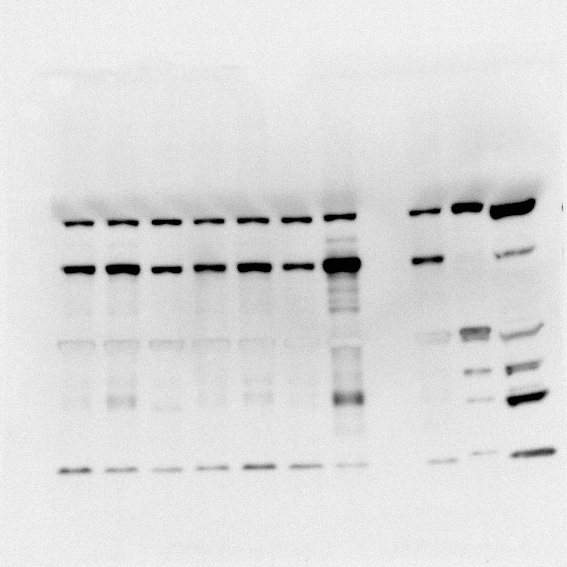
Experimental Samples
+ controls
p67phox

