Slide 1
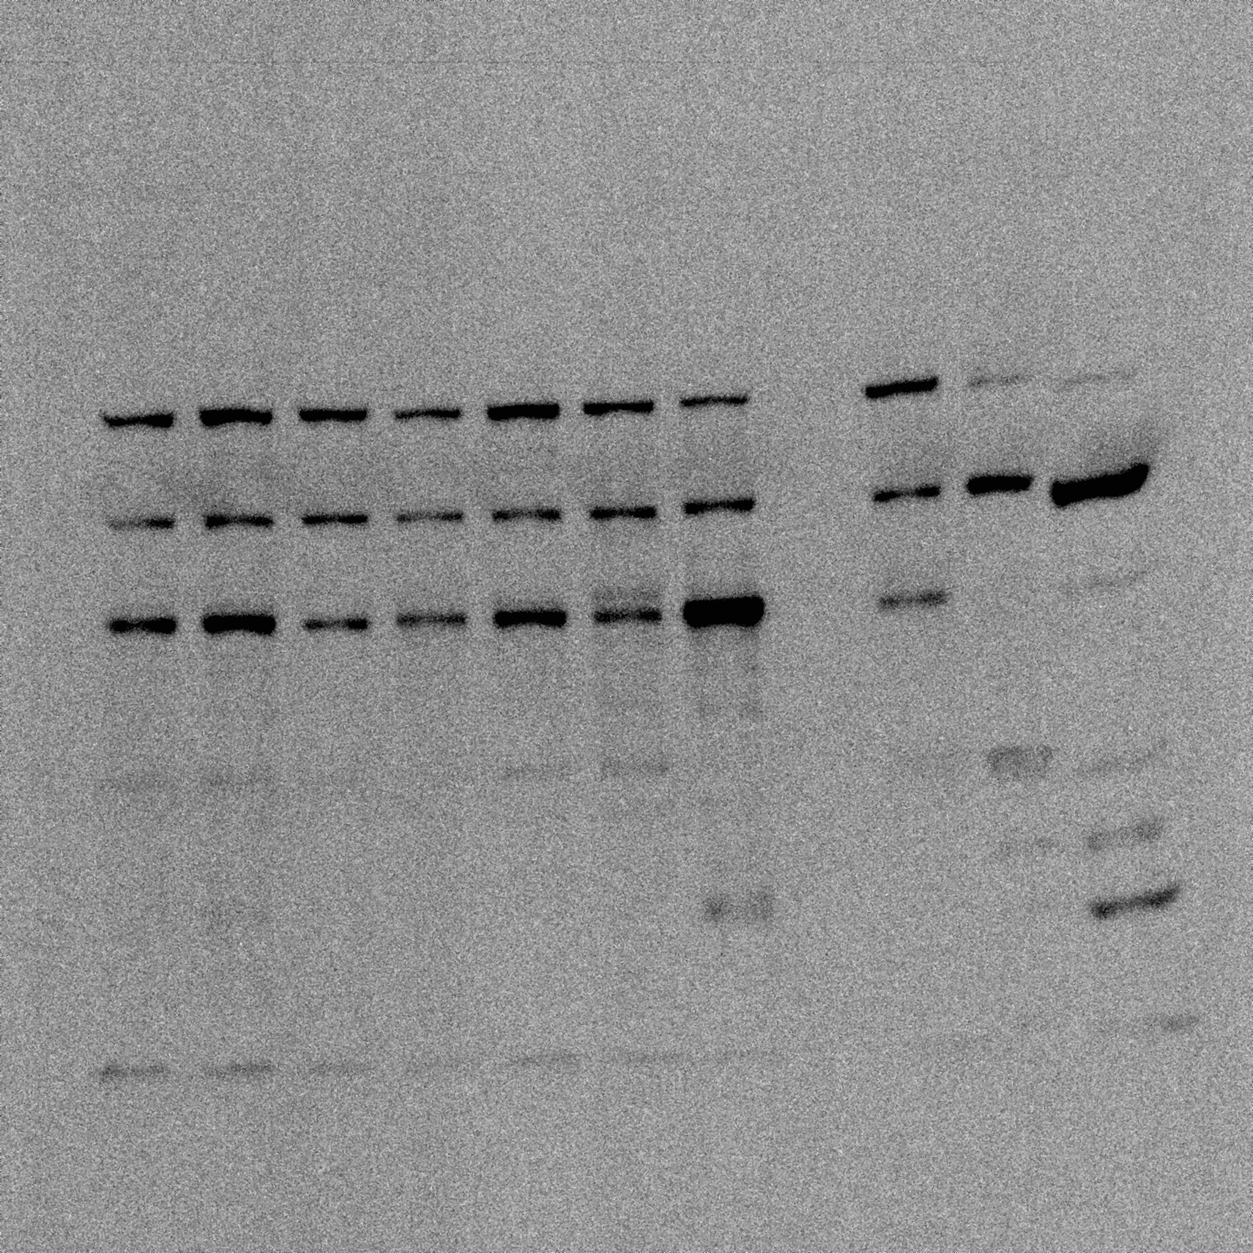
Experimental Samples
+ controls
eNOS

