Slide 1
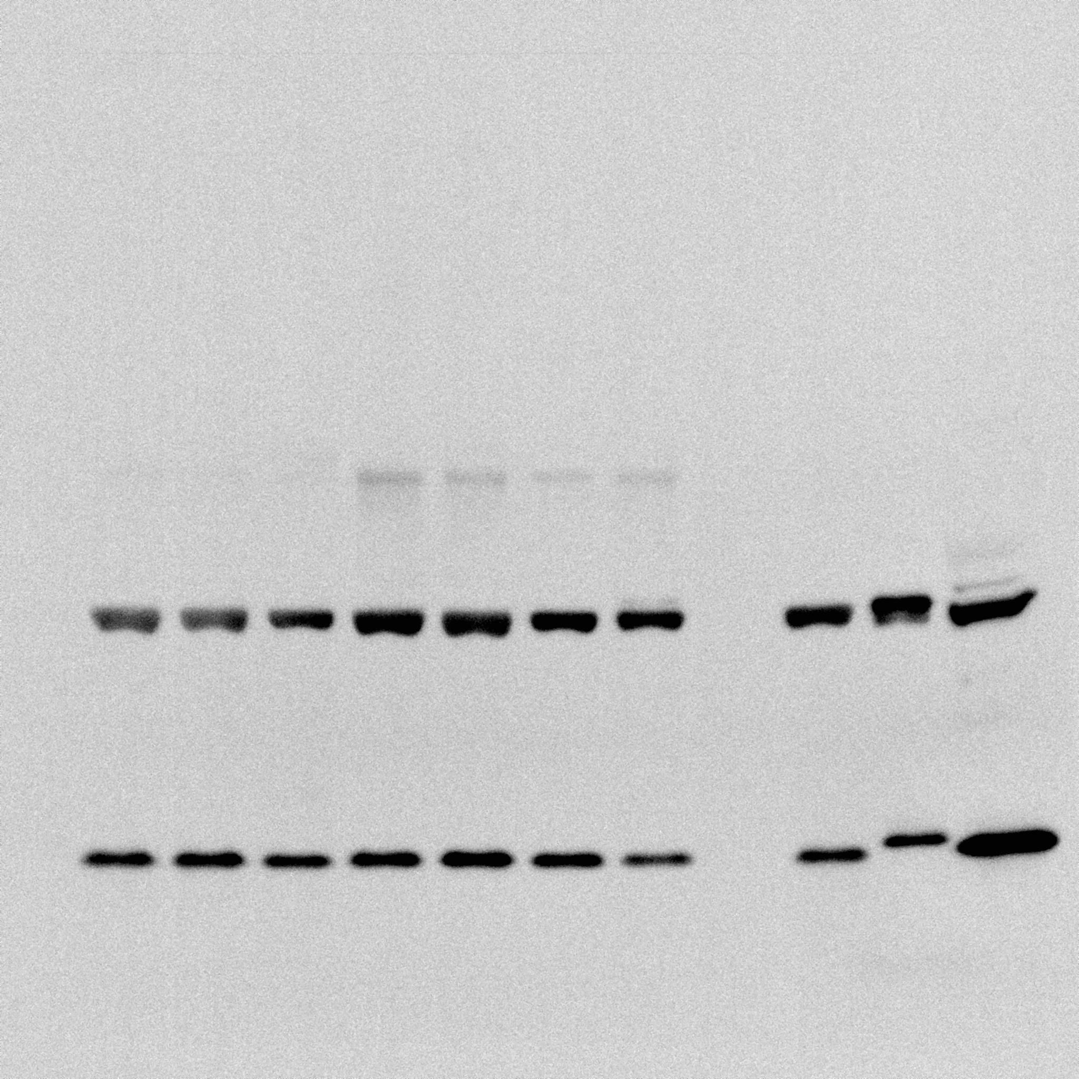
Experimental Samples
+ controls
SOD-1

