Slide 1
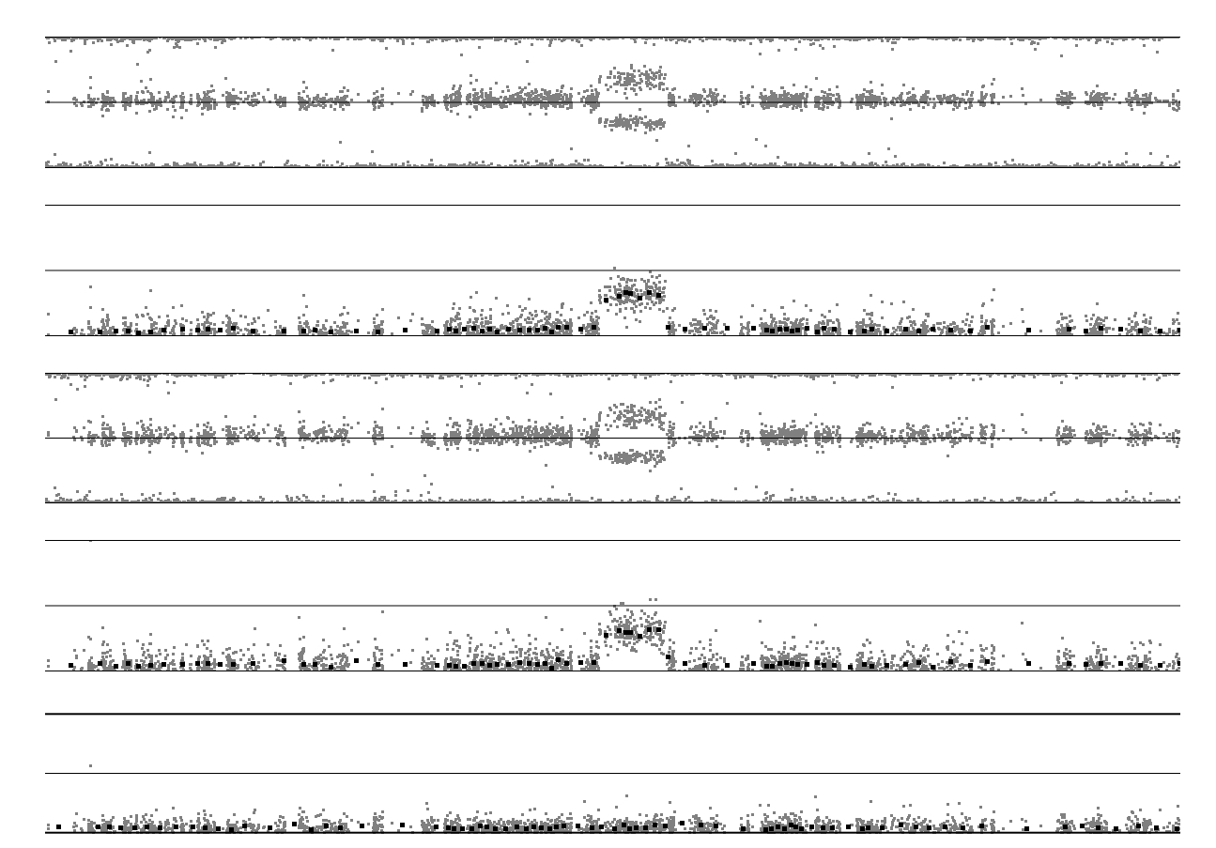
Figure S1
77.3-78.2Mbp
subject plots
BAF_{subject}
modified BAF
(subject)
reference plots
BAF_{reference}
modified BAF
(reference)
paired plot
delta-θ
Chromosome 2 (70-85Mbp)

