Slide 1
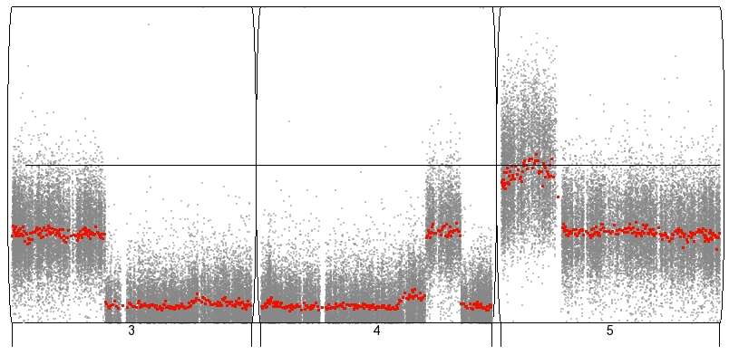
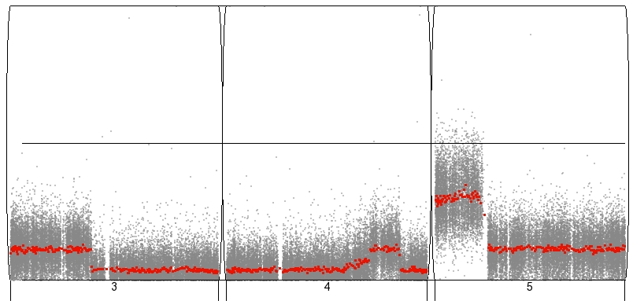
Figure S5
0.5
delta-θ
in
brush
0.25
0.0
1
2
3
4
5
0.5
delta-θ
in
saline
0.25
0.0
Chromosome 3
Chromosome 4
Chromosome 5

