Slide 1
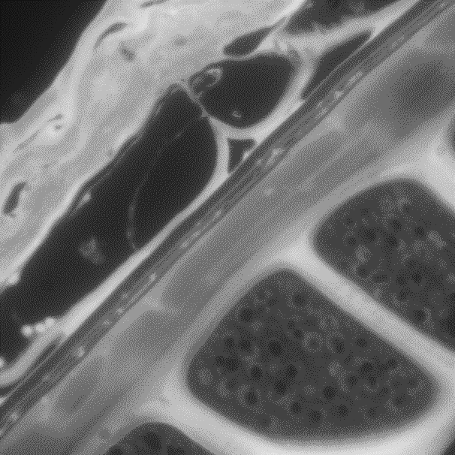
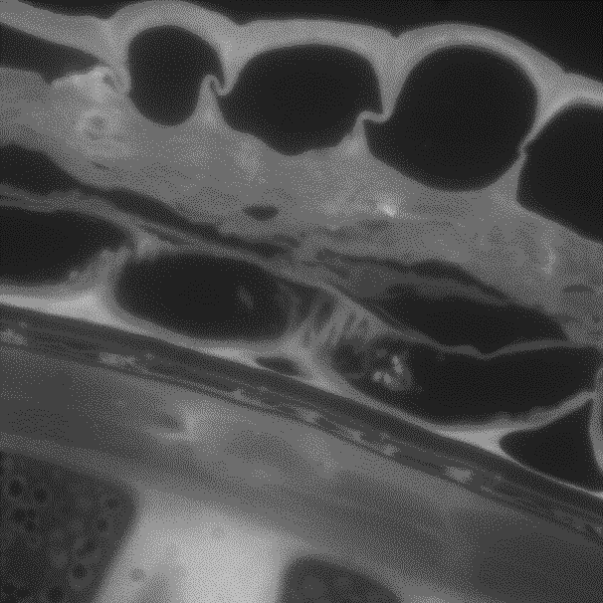
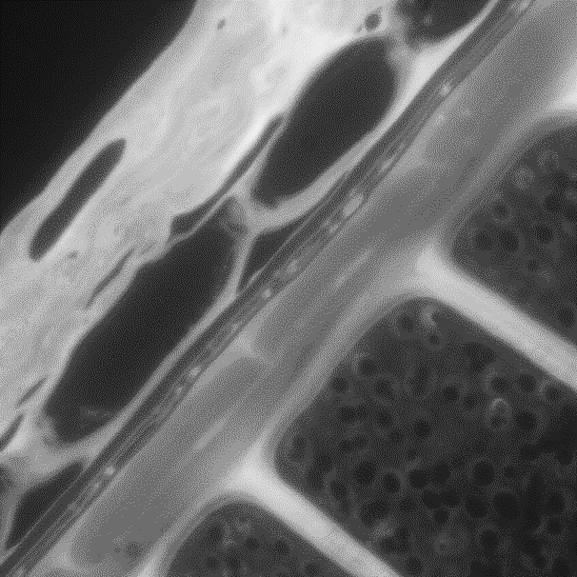
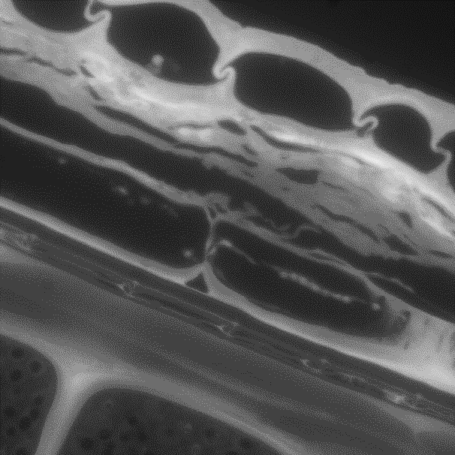
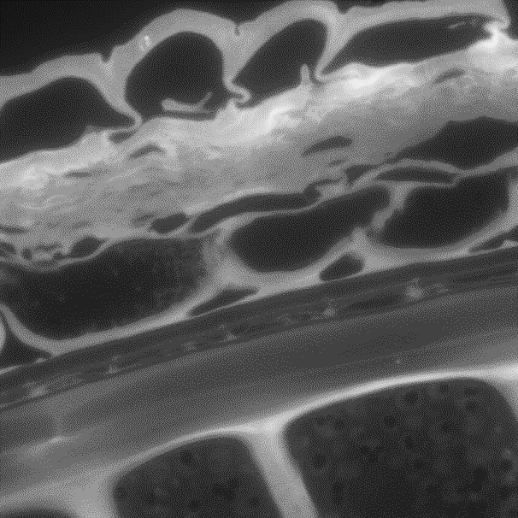
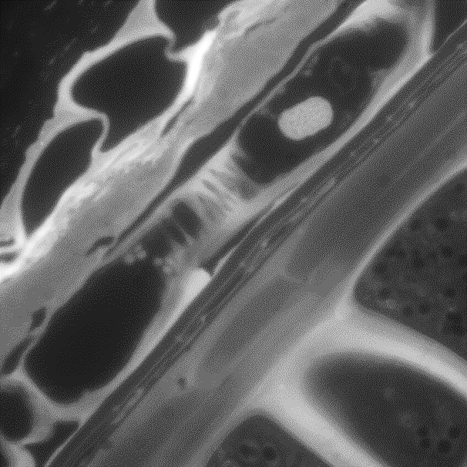
Figure S1 : Effect of pectin lyase on the structure of testa revealed by UV autofluorescence (750°D). Degradation of HG by pectin lyase (PL) after mixed-linked glucans and xylan removal by lichenase (L) and xylanase (X), modified the aspect of the testa cells (pointed by the arrows) which are less visible and appeared crushed (NT : non treated).
A band-pass filter 340–380 nm was used as excitation filters and fluorescence was detected at >425 nm.
NT
PL
10 µm

Slide 2
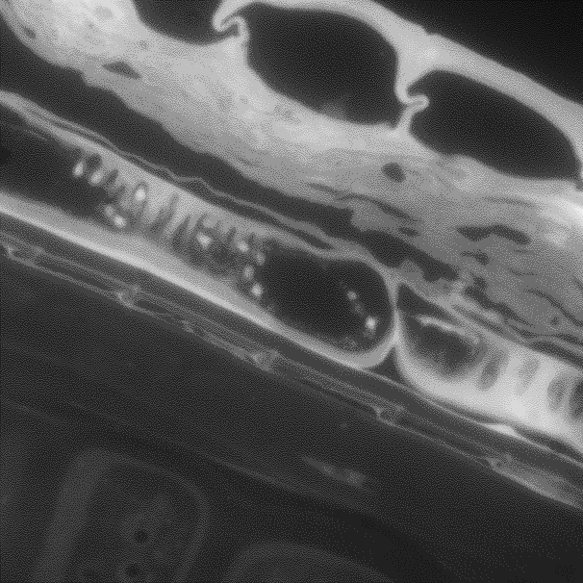
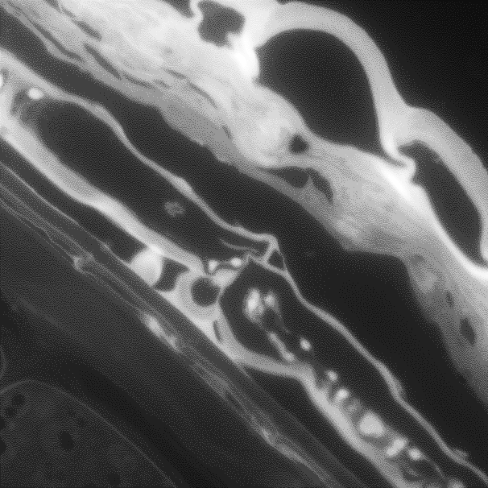
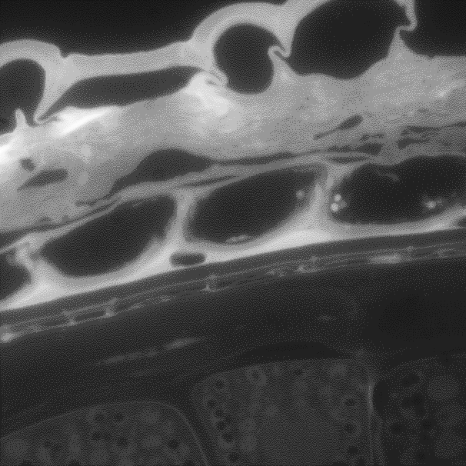
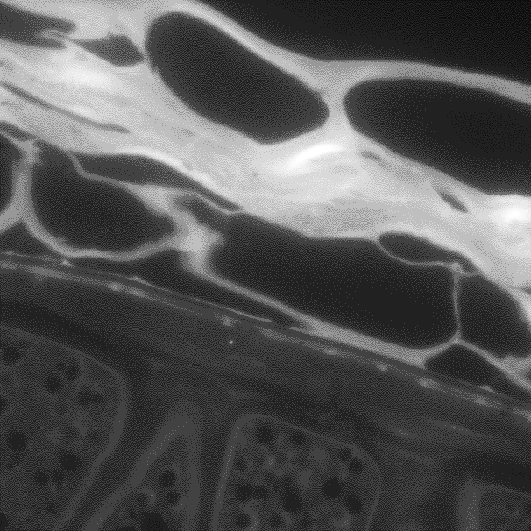
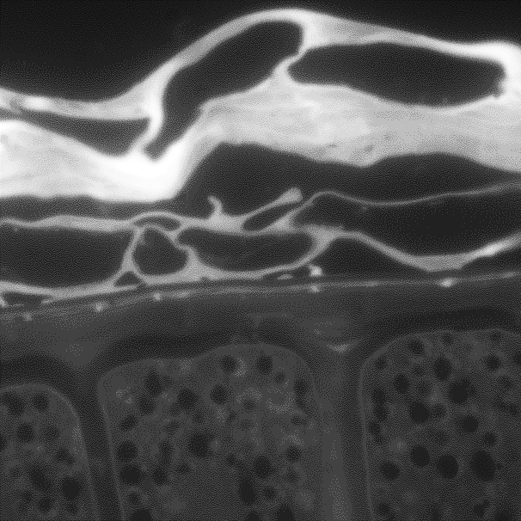
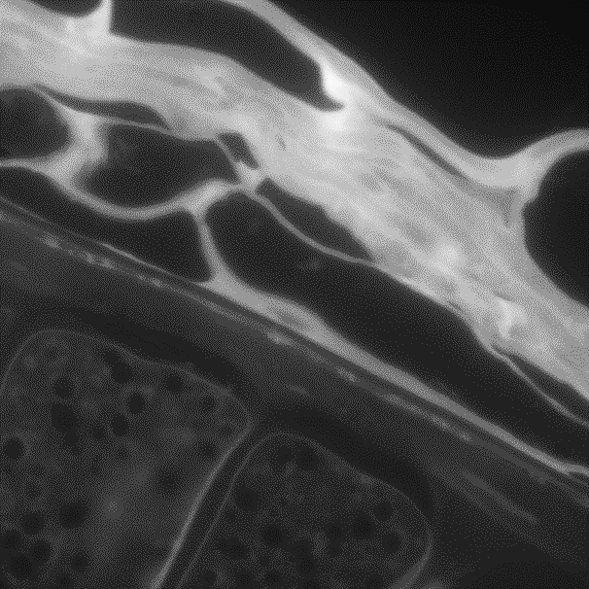
LX
LX+PL
10 µm

