Slide 1
Figure S1
4
**
Fed
3
**
Fasted, 8 h
Fasted, 24 h
Relative mRNA
Refed, 24 h
2
*
1
*
0
G6pase
Ces1

Slide 2
Figure S2
A
120
B
Ad-GFP
14
**
Ad-GFP
100
Ad-Ces1
12
Ad-Ces1
80
10
60
8
Plasma lipids (mg/dL)
Relative mRNA
40
6
4
20
2
0
0
TG
TC
Ces1
SR-BI
Abcg5
Abcg8
C
2
Ad-GFP
Ad-Ces1
Relative mRNA
1
*
*
0
Elovl6
Adrp
Acox1
Acox2
Mcad
Vlcad
Fabp5
Acl
Scd1
Cyp4a14

Slide 3
Figure S3
800
p=0.07
600
β-hydroxybutyrate
(μM)
400
200
0
Ad-GFP
Ad-Ces1

Slide 4
Figure S4
1.5
1
*
*
Relative mRNA
0.5
**
0
shLacZ
shCes1-a
shCes1-b
shCes1-c

Slide 5
Figure S5
A
2
Ad-shLacZ
Ad-shCes1
Relative mRNA
1
0
Lrp
Bsep
Ces2
Ces3
Apob
Soat1
Soat2
Lcat
Cyp7a1
B
3
Ad-shLacZ
Ad-shCes1
2
Relative mRNA
1
0
HL
Hsl
Lpl
Scd1
Cpt1a
Acox1
Acox2
Adrp
Atgl
Pepck
L-FABP
Angptl3
G6pase

Slide 6
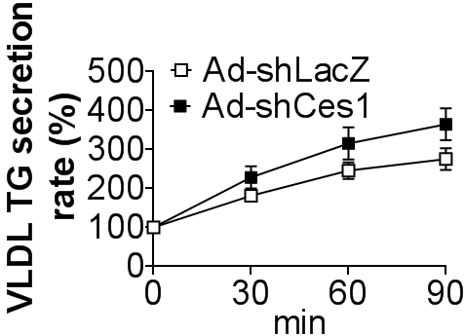
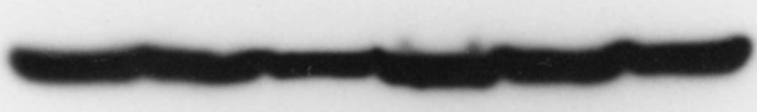
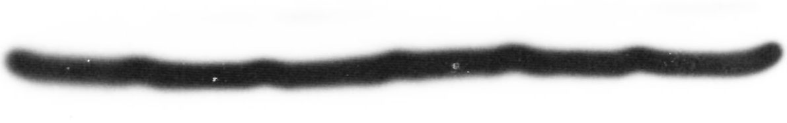
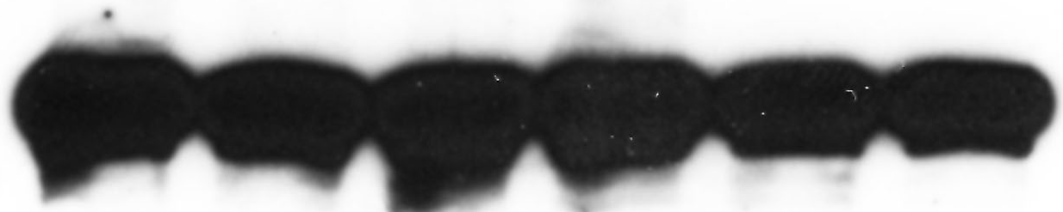

Figure S6
A
B
12
6
11
5
*
4
(μg/mg)
10
3
Free cholesterol
FFA (nmol/mg)
9
2
1
8
Ad-shLacZ
Ad-shCes1
0
Ad-shLacZ
Ad-shCes1
C
D
shLacZ
shCes1
Mtp
ApoB100
ApoB48
β-actin

Slide 7
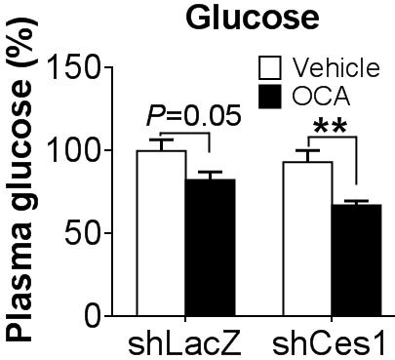
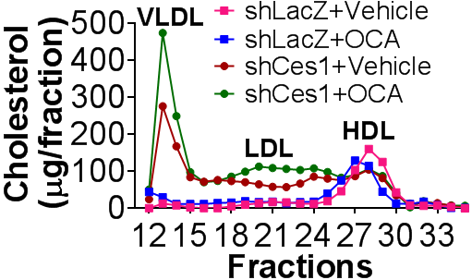
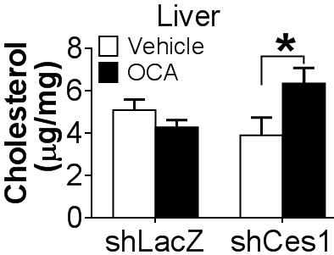
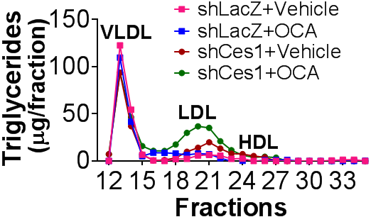
Figure S7
A
B
C
D

Slide 8
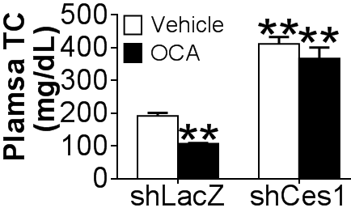
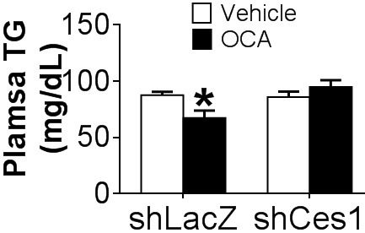
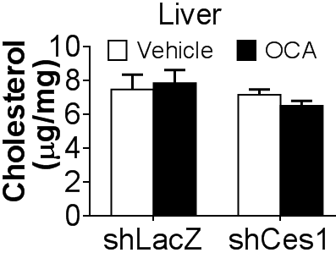
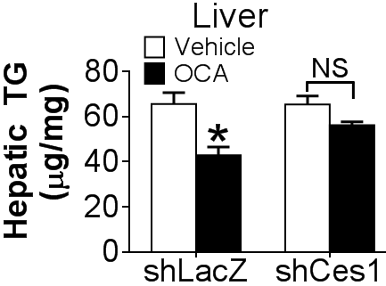
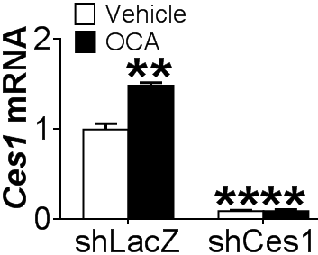
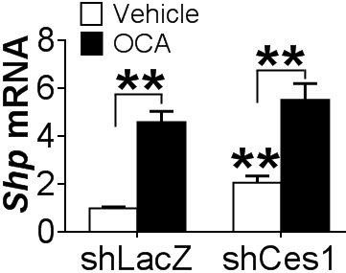
Figure S8
A
B
C
D
E
F

