Slide 1
Supplemental Figure 1. Experimental design.

Slide 2
0h 6h 18h 24h
Aβ oligomers
Supplemental Figure 2

Slide 3
FCCP
Oxygen Consumption
Control
Oligomycin
(min)
Supplemental Figure 3

Slide 4
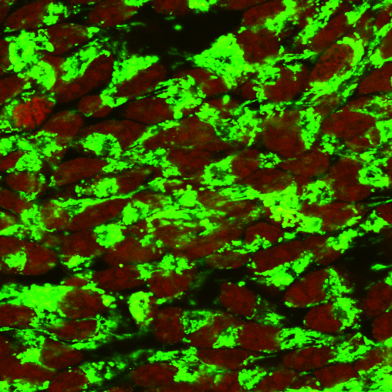
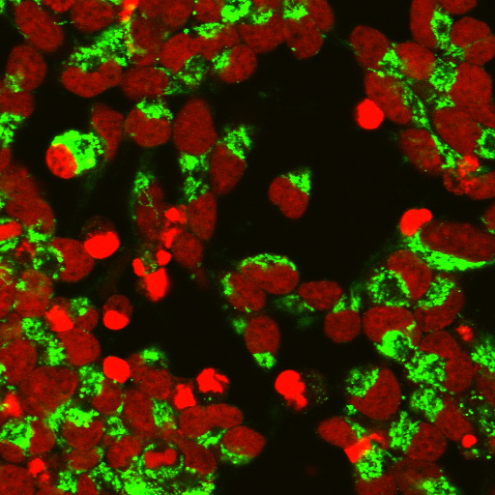
A
Con
Aβ5μM, 72h
B
Frequency distribution
Cyt-c fluorescence intensity
Supplemental Figure 4

