Slide 1
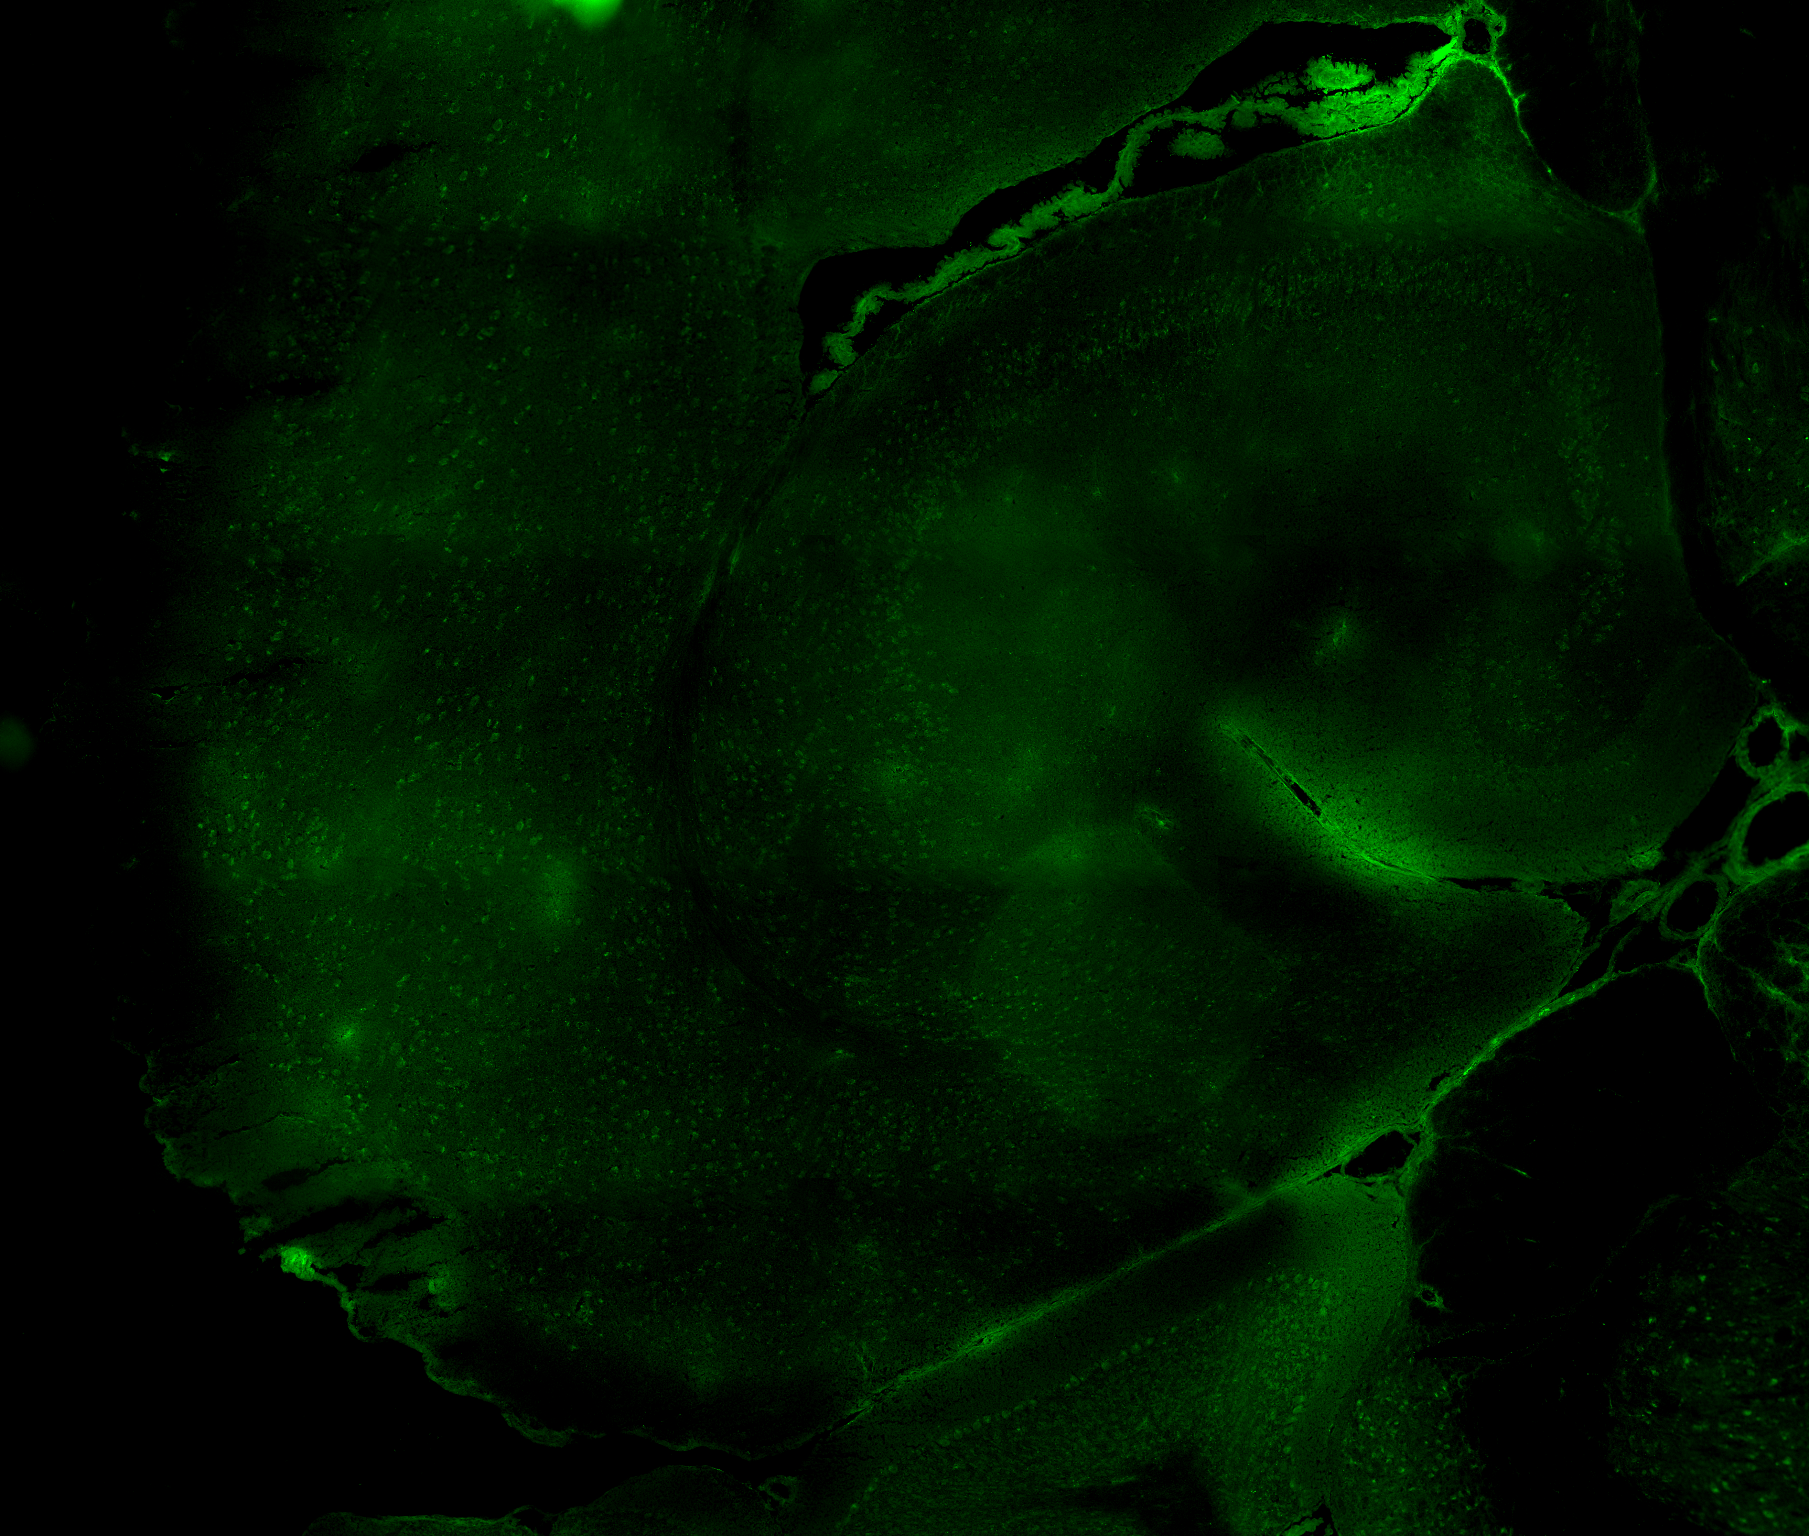
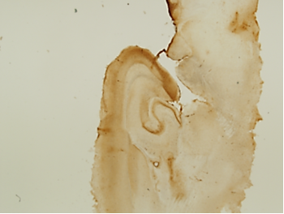
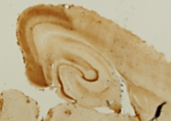
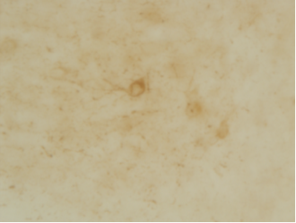
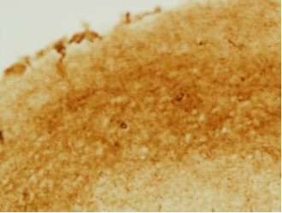

a
Control (16 months)
htau
b
9 m
Alz50
16 m
c
9 m
MC1
16 m
1x
1x
EC
EC
d
Tau Levels
9m
16m
Tau
55kDa
actin
42kDa
Supplemental Figure 1 (S1)

Slide 2
Open Field
16 month-old
a
b
Rotarod
Radial Arm Maze
c
16 month-old
d
16 month-old
e
Contextual Fear Conditioning
Behavioral Paradigm
Day 1
Day 2
Day 3
Training
24 hrs
Testing
24 hrs
Re-testing
2 min
2 min
1 min
3 min
3 min
2 s 0.5 mA
2 s 0.5 mA
f
9 months
g
16 months
Supplemental Figure 2 (S2)

Slide 3
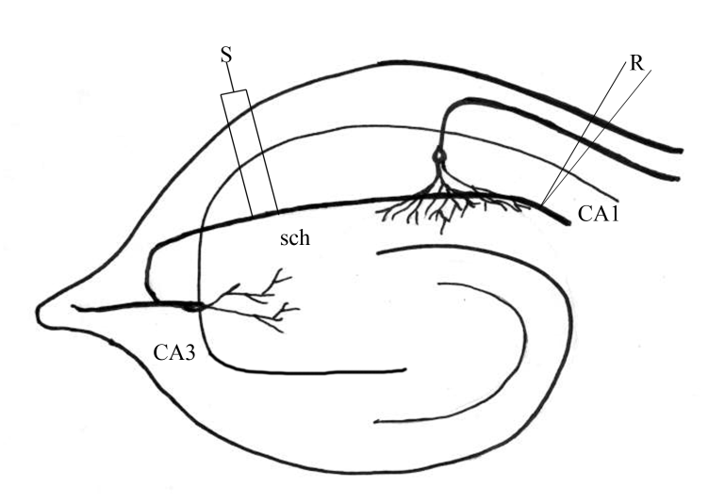
Schaffer Collateral to CA1 Synapse
a
d
Long-term Potentiation
HFS
e
b
Basal Synaptic Transmission
f
c
Paired pulse Facilitation
Supplemental Figure 3 (S3)

