Slide 1
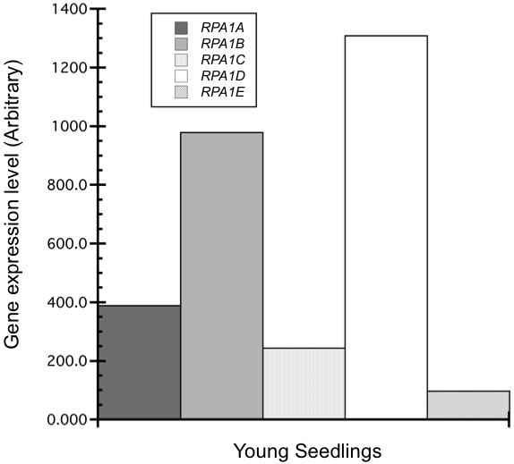
Supplemental Figure 1. Expression level of RPA1 in young seedlings. Expression levels (arbitrary) were retrieved from Genevestigator, an online visualization tool that summarizes results from thousands of high quality transcriptomic experiments.

Slide 2
1
2665
1
2960
1
2475
Supplemental Figure 2. T-DNA insertion line analysis. A. Line diagram of RPA1C, RPA1D, and RPA1E genes and their respective T-DNA insertion sites. Line numbers represent nucleotide positions starting at the ATG start and ending at the stop codon. Thick bars represent exons. Triangles represent the site of the T-DNA insertion within the respective gene. The T-DNA insertion sites are at nucleotide positions 1857 (rpa1c), 70 (rpa1d), and 1717 (rpa1e). B. Schematic diagram of a representative RPA1 cDNA and T-DNA insertion in the gene. Shown are primer positions for RT-PCR amplification, resulting in three possible products: P1, upstream of the T-DNA insertion; P2 overlapping the T-DNA insertion, shown is the expected product for the WT allele; P3, downstream of the T-DNA insertion. C. Resulting PCR amplification of cDNA isolated from the respective mutants. (+) indicates a positive PCR product at the expected size and (-) indicates no detectable PCR product. On the right, representative agarose gel pictures are shown for each line tested. PCR sizes are approximately 400bp, 1100bp, 500bp for RPA1C, 125bp, 750bp, 250bp for RPA1D, and 400bp, 1000bp, 300bp for RPA1E. In all cases, “no-RT template” controls were negative. cDNA was prepared from total RNA pooled from at least 30 individual plants.

Slide 3
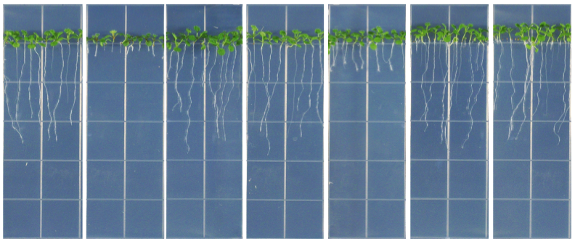
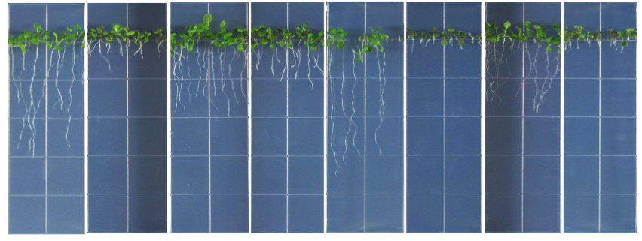
A
WT
atm
rpa1a
rpa1b
rpa1c
rpa1d
rpa1e
B
rpa1c
atr
rpa1e
atr
rpa1c
rpa1e
WT
atm
atr
rpa1c
rpa1e
Supplemental Figure 3. Representative examples of the hypersensitivity analyses included in this manuscript.(A) Hypersensitivity analysis of rpa1 single mutants. 11-days-old wild-type (WT) and mutant seedlings grown on MS medium supplemented with 15 nM camptothecin (CPT). (B) 12-days-old WT, single and double mutants grown on MS medium supplemented with 15 nM camptothecin (CPT). In every case, only the primary root (no secondary roots) was measured for the assay. Untreated controls are not shown, but in each case all lines grew at similar growth rates.

Slide 4
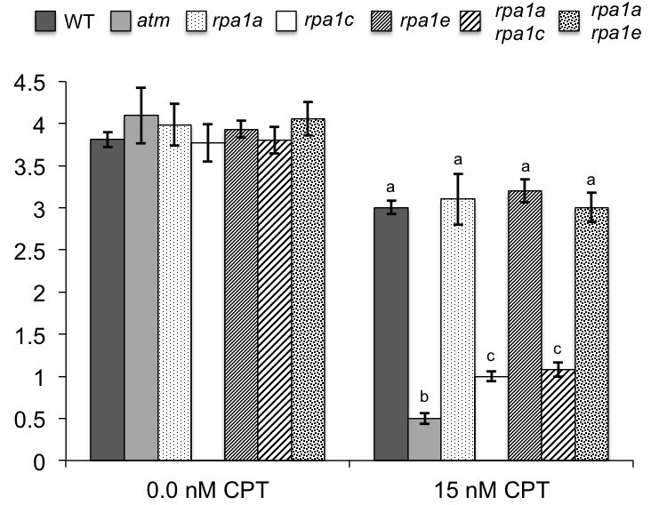
Root Length (cm)
11-day-old seedlings
Supplemental Figure 4. Interaction of rpa1a, rpa1c and rpa1e in response to camptothecin (CPT). WT and mutant lines were germinated on MS phytoagar containing 0.0 or 15.0 nM CPT. Data are mean ± SE (n >15). To analyze statistical difference with in each treatment group F- Test (ANOVA) and LSD were carried out at P ≤ 0.05. Bars with different letters indicate significant difference.

Slide 5
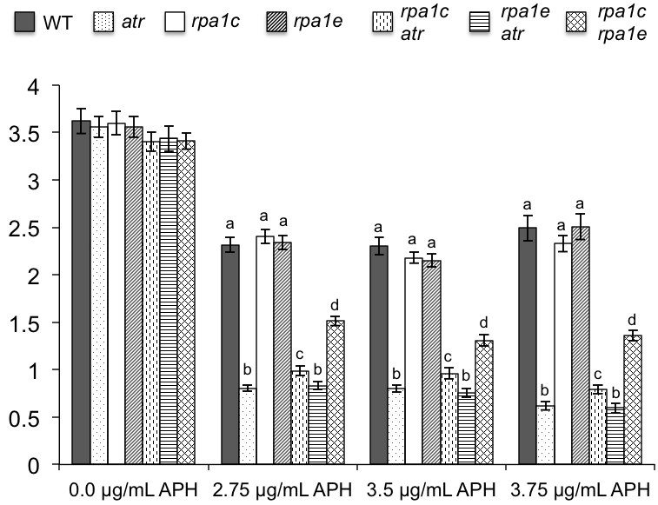
Root Length (cm)
9-day-old seedlings
Supplemental Figure 5. Interaction of rpa1c, rpa1e and atr in response to the replication blocking agent aphidicolin (APH; U.S. Biological, Swampscott, MA, USA), shown as a supplement to Figure 3F which employed APH from a different manufacturer (A.G. Scientific Inc., San Diego, CA, USA). WT and mutant lines were germinated on MS phytoagar containing different doses of APH. Data are mean ± SE (n >15). To analyze statistical difference with in each treatment group F- Test (ANOVA) and LSD were carried out at P ≤ 0.05. Bars with different letters indicate significant difference.

Slide 6
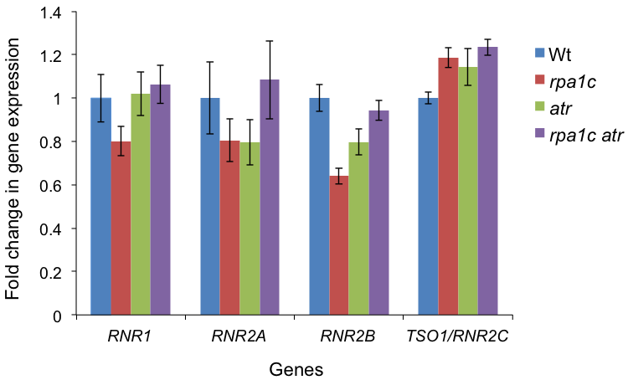
Supplemental Figure 6. Expression of RNR genes in wild-type and mutant plants subjected to HU treatment.

Slide 7
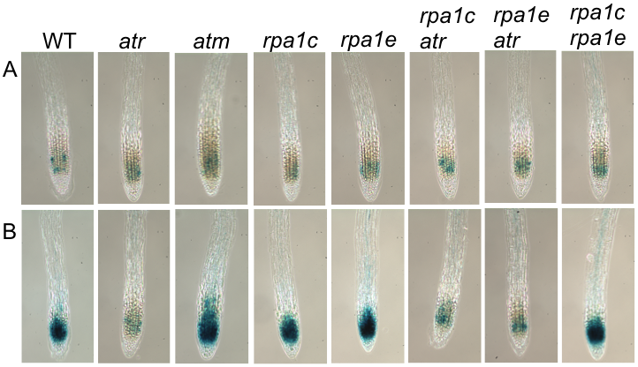
Supplemental Figure 7. GUS staining of root tips. 5-days-old wild-type and mutant seedlings (carrying P_{cyclinB1}:GUS) were left untreated (A), or (B) treated with 100 Gy of gamma radiation. Individual wild-type and mutant plants were then harvested after 24 hours for GUS staining of root tips. At least 10 individual plants from each line were harvested and stained for each treatment. One representative root tip is shown for each line.

Slide 8
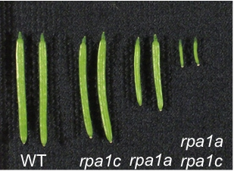
Supplemental Figure 8. Siliques harvested from ~6 weeks old wild-type and mutant Arabidopsis plants.

Slide 9
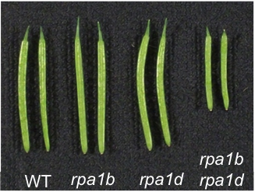
Supplemental Figure 9. Siliques harvested from ~7 weeks old wild-type and mutant Arabidopsis plants.

Slide 10
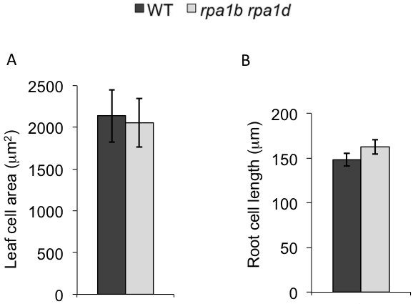
Supplemental Figure 10. Leaf and root cell sizes of wild-type and mutant plants. A. area of the abaxial side of epidermal pavement cells. B. Root cell length of differentiated cells found right above elongated cells. Data are mean ± SE (n > 40).

Slide 11
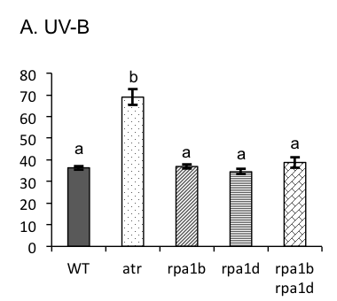
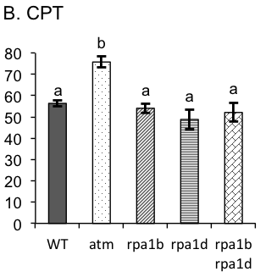
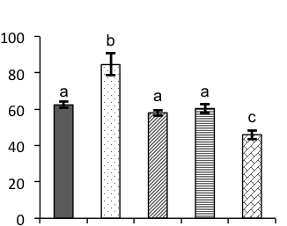
A. UV-B
B. CPT
Growth reduction (%)
WT
atr
rpa1b
rpa1d
rpa1b
rpa1d
WT
atm
rpa1b
rpa1d
rpa1b
rpa1d
C. MMC
Growth reduction (%)
WT
atr
rpa1b
rpa1d
rpa1b
rpa1d
Supplemental Figure 11. Relative (percent) growth reduction in WT, singles (atr, rpa1b, rpa1d) and the double (rpa1b rpa1d) mutants treated with DNA damaging agents. A. Plants were grown for 4 days on MS phytoagar plates and then treated with 0.5 J/sec/m² UV-B for 24 hours or left untreated. B-C, plants were grown for 4 days on MS phytoagar plates and then transferred to MS phytoagar plates with or without 22.5 nM CPT (B) or 2 ug/mL MMC (C). Data are mean ± SE (n >10). To analyze statistical difference F-Test (ANOVA) and LSD were carried out at P ≤ 0.05. Bars with different letters indicate significant difference.

