Slide 1
Research Techniques Made Simple:
Antibody phage display
Christoph M. Hammers
and John R. Stanley
Dept. of Dermatology, University of Pennsylvania, Philadelphia, PA, USA

Slide 2
Antibody phage display I
Development closely related to production of monoclonal antibodies
Initially described by Smith in 1985, further developed by other groups (e.g., Winter, McCafferty, Lerner, Barbas)
Based on genetic engineering of bacteriophages and repeated antigen-guided selection

Slide 3
Antibody phage display II
Allows in vitro selection of monoclonal antibodies (mAb; in form of scFv or Fab) of virtually any specificity
Enables research to study genetics and function of antigen-specific mAb
Facilitating dissection of immunological processes in microbiology/virology and in autoimmune diseases

Slide 4
Library construction
Human
cell source
mRNA,
reverse transcription
Isotype-specific PCR for VH and VL (scFv) or VH, CH1, VL, CL (Fab)
LIBRARY CONSTRUCTION
Cloning of overlap fragments into phagemid vector (e.g., pComb3X)
Electroporation into competent cells (suppressor strain), test of library complexity, rescue of phagemids by helper phage addition (e.g., VCSM13)

Slide 5
Panning
Pooled polyclonal Φ ELISA
Titration of output from selection (~10⁵-10⁸)
Phage (Φ)
preparation
Titration of polyclonal Φ pool (input to selection ~10¹²)
Helper Φ
Infect competent cells
Incubation with ag of interest
Incubation with 2nd ag of interest (double recognition panning)
Wash away
non-binders
PANNING
Elute binders

Slide 6
Analysis I
Genetic manipulation of sequence
Genetic analysis
ANALYSIS
I
Sanger sequencing
Soluble
mAb production (scFv, Fab) in nonsuppressor strains; subcloning into expression vectors (Ig)
Monoclonal Φ
preparation
(usually after 2-4 rounds of panning;
proceed if polyclonal Φ ELISA +)
Monoclonal
Φ ELISA
(proceed if +)
Plasmid preparation
of monoclonal

Slide 7
Analysis I
ANALYSIS II
Various downstream
analyses as
ELISA of sol. scFv/Fab/Ig
Immunofluorescence
Surface plasmon resonance
Western blotting/immunoprecipitation
Testing in tissue culture systems (e.g., pathogenicity studies)
X-ray crystallography
…

Slide 8
Peculiarities and limitations I
Sufficient depth of coverage to find ag-specific mAb even from rare ab-producing clones
Ease of constructing and screening antibody libraries, many well-established protocols
Various systems that facilitate production of soluble mAb

Slide 9
Peculiarities and limitations II
Random pairing of variable heavy and light chain during construction (however, in PF, scFv bind the same epitopes on Dsg as polyclonal patient IgG do)
Not all phage clones of a given library will display a protein (toxicity, interference with phage assembly)
Clones of interest may be missed due to significant loss of DNA material during library construction and/or due to undersized sampling of monoclonals after panning
Potent contamination sources (infective phages, plasmids) and >100 individual working steps per screen (probability of human error)

Slide 10
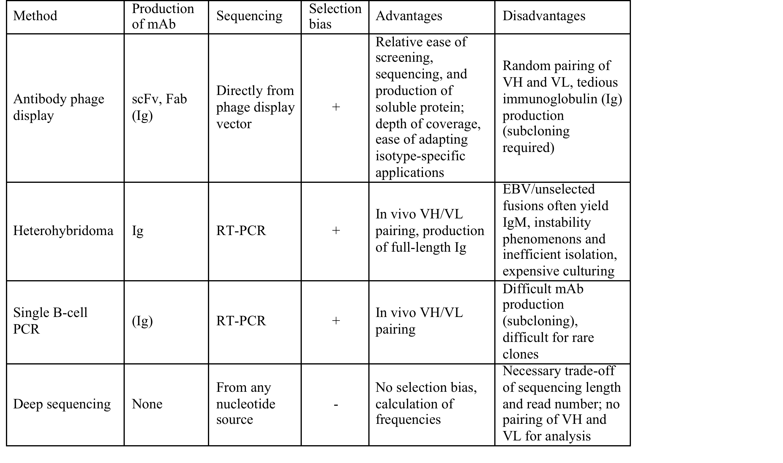
Comparison with other methods

