Slide 1
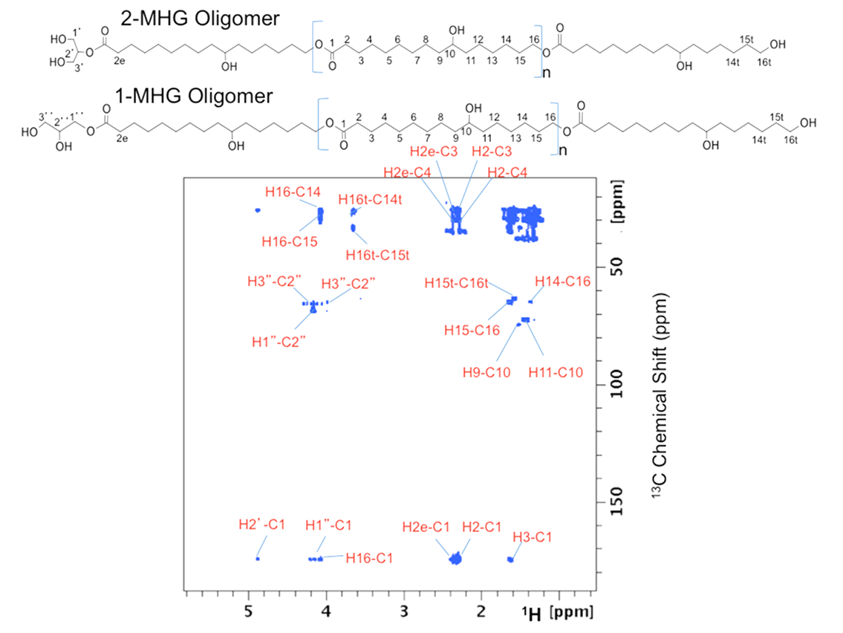
Figure S2. 2D ¹H-¹³C HMBC NMR spectrum of MHG oligomers.

