Slide 1
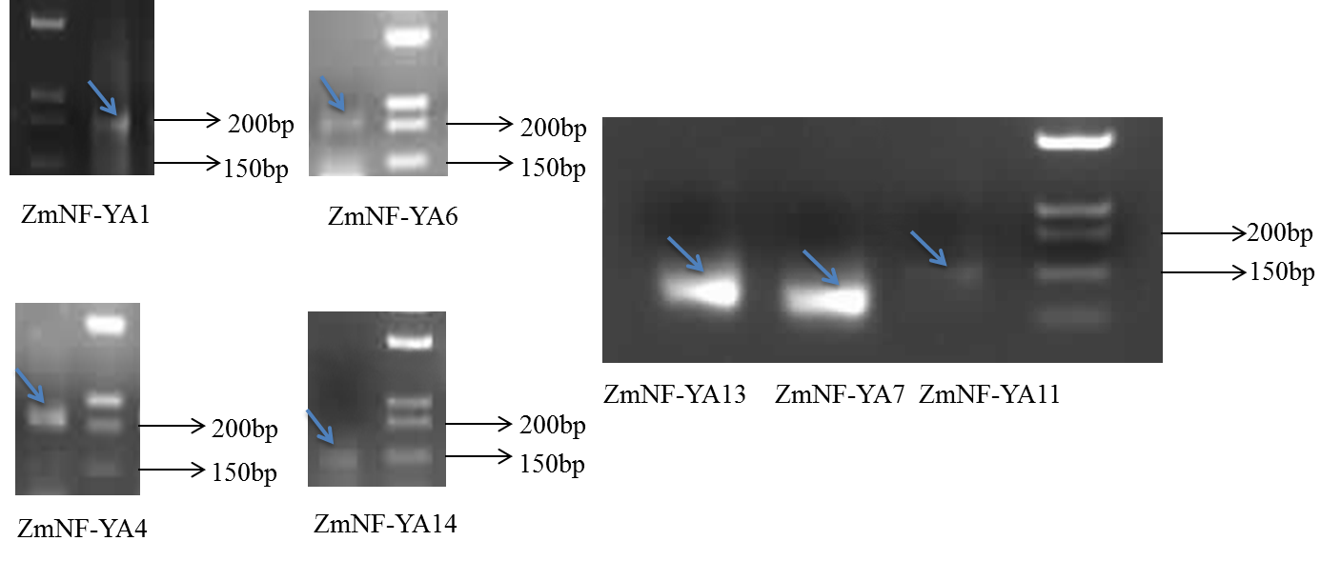
Figure S4. Special PCR products of RLM-5’RACE
Notes:
Figure S4. The amplified product of the 5' RACE on the ZmNF-YAs transcript by the specific nest-PCR primers ( Table S4).

