Slide 1
Genetic Mapping, Synteny and Physical Location of Two Loci for Fusarium oxysporum f.sp. tracheiphilum
Race 4 Resistance in Cowpea [Vigna unguiculata (L.) Walp]
Molecular Breeding
Authors and Affiliations
Marti O. Pottorff¹, Guojing Li², Jeffery D. Ehlers^{3,1}, Timothy J. Close¹ and Philip A. Roberts⁴
¹ Department of Botany & Plant Sciences, University of California Riverside, Riverside, CA, U.S.A.
² Zhejiang Academy of Agricultural Sciences, Hangzhou, P.R. China
³ Bill & Melinda Gates Foundation, Seattle, Washington, U.S.A.
⁴ Department of Nematology, University of California Riverside, Riverside, CA, U.S.A.
Corresponding author: timothy.close@ucr.edu and philip.roberts@ucr.edu

Slide 2
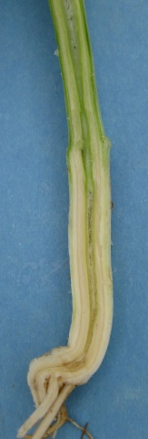
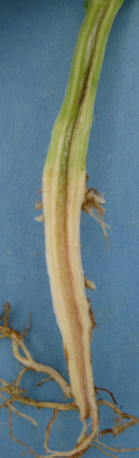
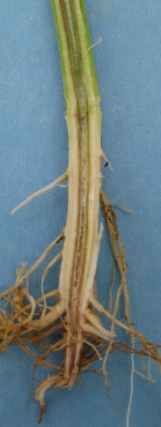
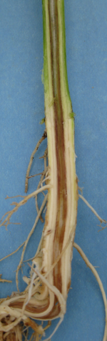
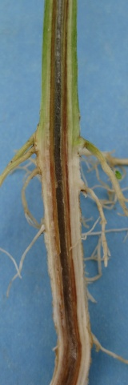
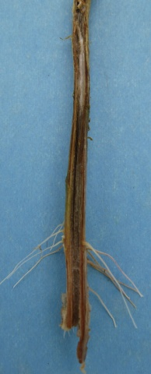
0 1 2 3 4 5

