Slide 1
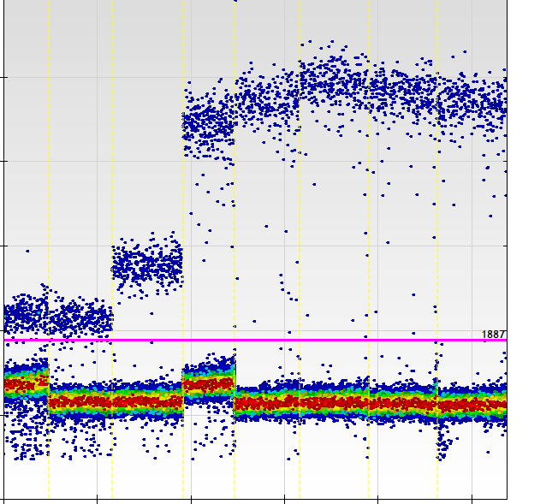
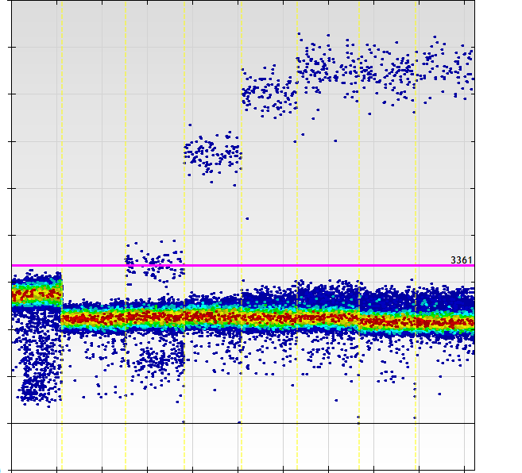
Supplemental Figure 1
A.
B.
FAM Amplitude
FAM Amplitude
65
64.5
63.3
61.9
58.9
57.1
55.8
55.0
65
64.5
63.3
61.9
58.9
57.1
55.8
55.0
°C
Annealing Temperature
Annealing Temperature
Assay optimization. For each TaqMan probe, the optimal annealing temperature was determined by testing each assay across a temperature gradient of 55.0 – 65°C. Typical FAM plots for EGFR L858R (A) and EGFR exon 19 deletion (B) are shown.

Slide 2
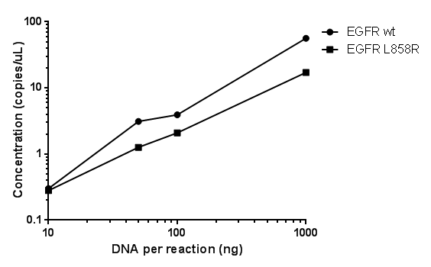
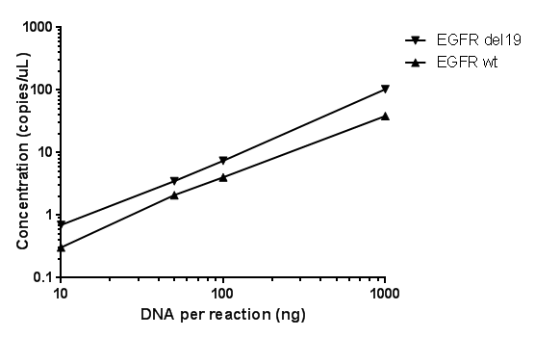
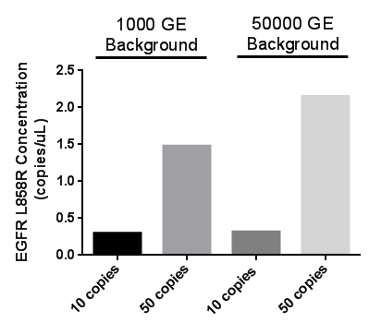
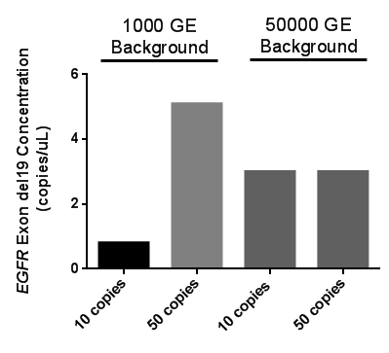
Supplemental Figure 2
A.
B.
C.
D.
Assay characteristics. As the sample input increases, the copies/μL output increases in a linear fashion across a wide dynamic range for both the L858R assay (A) and the exon 19 deletion assay (B). Testing for 10 and 50 copies of mutant EGFR in a background of 1000 and 50,000 genome equivalents (GE), the L858R assay demonstrates more consistent sensitivity (C) than the exon 19 deletion assay (D).

Slide 3
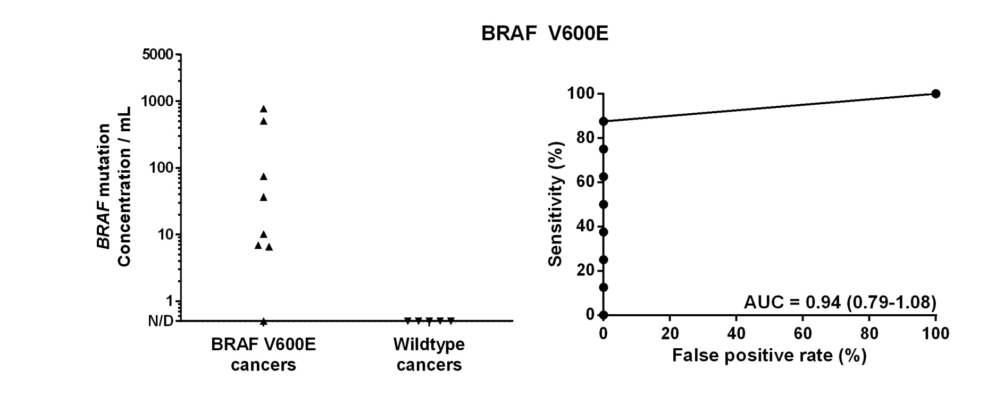
Supplemental Figure 3
Detection of BRAF V600E in cfDNA from patients with advanced melanoma.

Slide 4
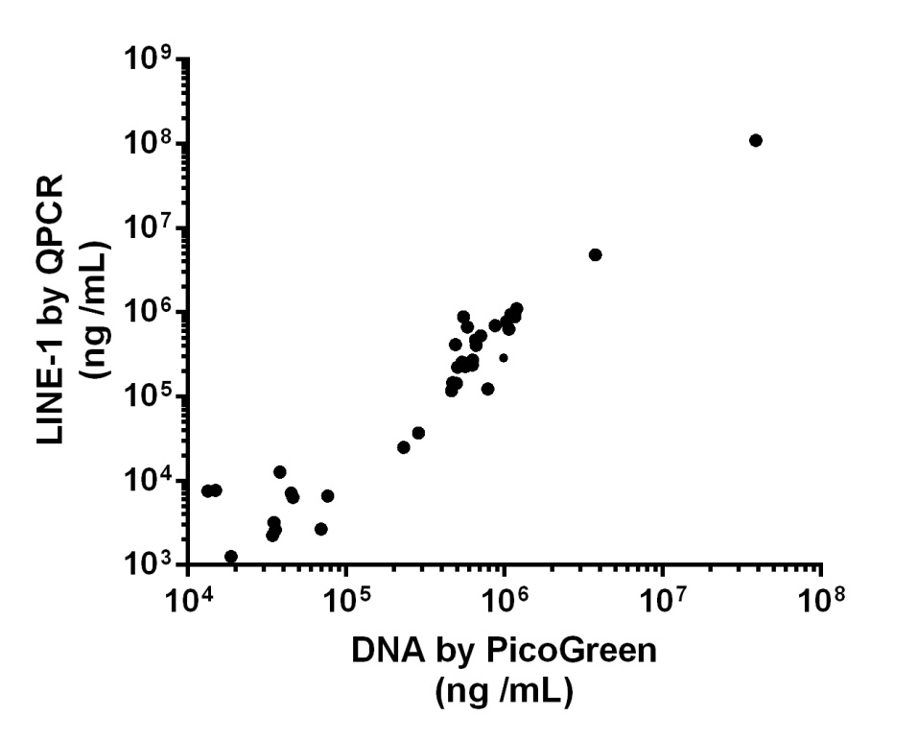
Supplemental Figure 4
Correlation of LINE-1 quantitative PCR (QPCR) levels with DNA concentration as measured with PicoGreen across 69 plasma specimens (R² = 0.94, p<0.0001).

Slide 5
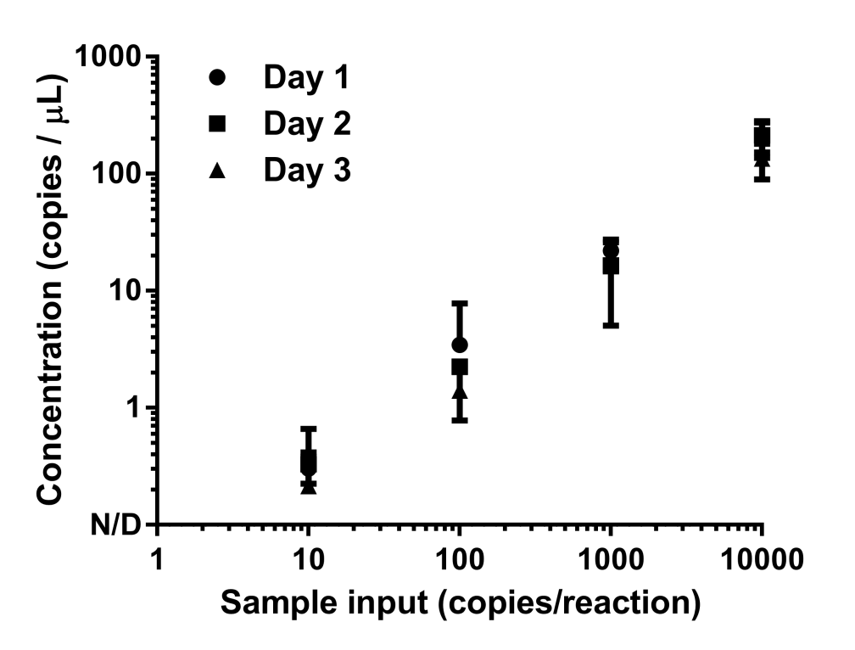
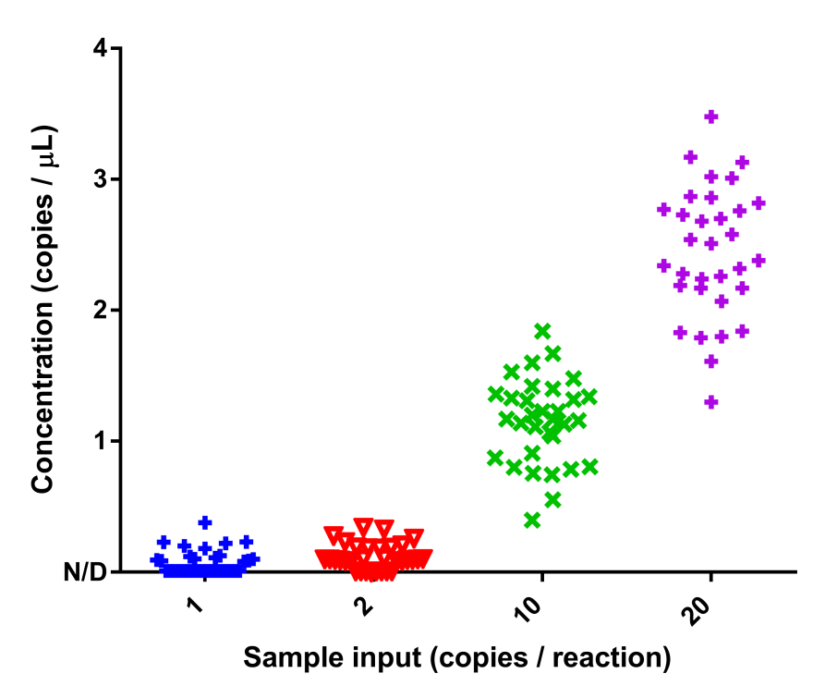
Supplemental Figure 5
A.
B.
Inter- and intra-day variation of the ddPCR assay. (A) Identical serial dilutions ranging from 10-10,000 T790M mutation copies per reaction were assayed in triplicates on three nonconsecutive days. Percent coefficients of variation ranged between 12.2-21.4% within days and 15.9-32.2% between days. (B) Technical replicates of samples containing either 1, 2, 10, or 20 copies of mutant T790M were assayed 32 times on the same day. Results show that ddPCR exhibits Poisson-distributed single molecule detection.

