Slide 1
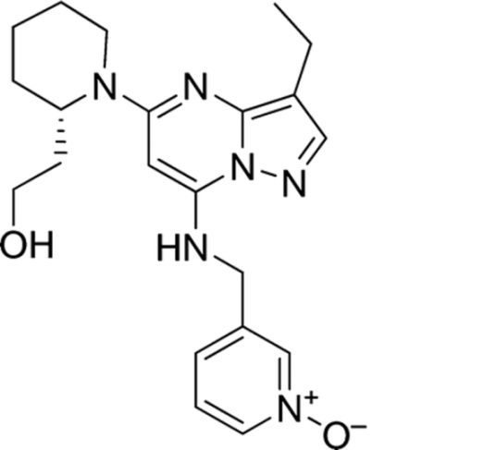




Supplementary Figure 1: SCH727965 blocks induction of XBP-1s and Grp78.
A
B
Tg
C
Tg
Tg+S
C
Tg
Tg+S
SCH (nM)
Cont
Cont
IRE1 cl3
0 2 5 10
XBP-1(s)
Grp78
8226
1 1 0.5 0.5 0.5
IRE1
tub
XBP-1(s)
XBP-1(s)
H929
NS
Grp78
1 1.1 1.1 0.9 0.75
tub
tub
(A) Structure of SCH727965. (B) 8226, H929 cells were exposed to Tg (0.5-2.5 μM) alone or in combination with SCH727965 (2-10 nM) for 4h, after which cells were lysed and analyzed. K562 cells were stably transfected with IRE1/pcDNA3 or a corresponding empty vector. A clone over-expressing IRE1 was selected, referred to as K562/Ire1/cl3. Both K562/cont and K562/IRE1/cl3 cells were exposed to 5 µM Tg with or without SCH727965 (5 nM) for 6h, after which cells were lysed and analyzed by Western blot. White arrows correspond to XBP-1s protein.

Slide 2
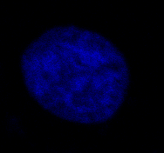
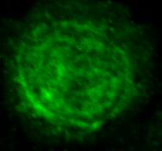
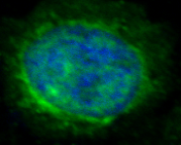
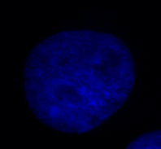
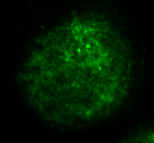
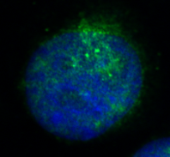
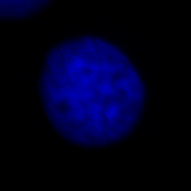
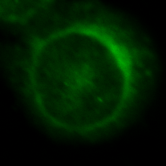
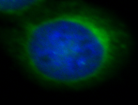
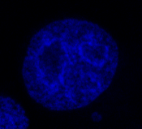
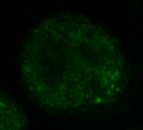
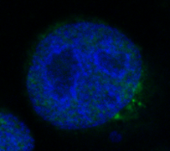
Supplementary Figure 2: Knockdown CDK1 or CDK5 reduced nuclear XBP-1s expression.
A
B
DAPI
XBP-1(s)
Merge
DAPI
XBP-1(s)
Merge
shC/Tg
shCTg
shCDK1/Tg
shCDK5/Tg
(A) U937 cells were transfected with shCont/pLKO.1 or shCDK1/pLKO.1 for 48h, after which cells were exposed to Tg ( 2μM; 3h) followed by confocal microscopy to monitor XPB-1s (blue-DAPI: nuclear, green: XBP-1s). (B) K562/shCont and K562/shCDK5 cells were exposed to Tg (5μM; 3h) followed by confocal microscopy to monitor XPB-1s (blue-DAPI: nuclear, green: XBP-1s).

Slide 3






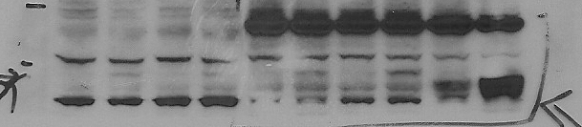




Supplementary Figure 3: Knockdown CDK2 or CDK9 exhibits very modestly or no changes in XBP-1s or Grp78 following Tg exposure.
B
shC shCDK2
shC shCDK2
A
shC shCDK9
shCont
shCDK9
Tg - + - + - + - +
Tg - + - +
Grp78
Grp78
XBP-1s
CDK9
NS
CDK2
Tub
XBP-1s
Tub
U937
K562
(A) K562 cells were transfected with shCDK9/pLKO.1 or shC/pLKO.1 constructs. After 72h, the cells were exposed to 5µM Tg for 6h, after which cell extracts were subjected to Western blot analysis using the indicated primary antibodies. (B) U937 and K562 cells were transfected with shCDK2/pLKO.1 or shCont/pLKO.1, after which a pooled clone from each transfection was selected. The clones were exposed to 2.5-5 µM Tg for 6h, after which the cell extracts were subjected to Western blot analysis using the indicated primary antibodies.

Slide 4
Supplementary Figure 4: Knockdown CDK1 or CDK5 increases sensitivity to ER stress inducers
P<0.05
% normalized apoptosis
U937 cells were transfected with shCDK1/pLKO.1, shCDK5/pLKO.1, or control/pLKO.1 constructs for 48 hr, after which the cells were exposed to Tg 50nM for 16 hr, after which cell death was monitored by 7-AAD.

