Slide 1
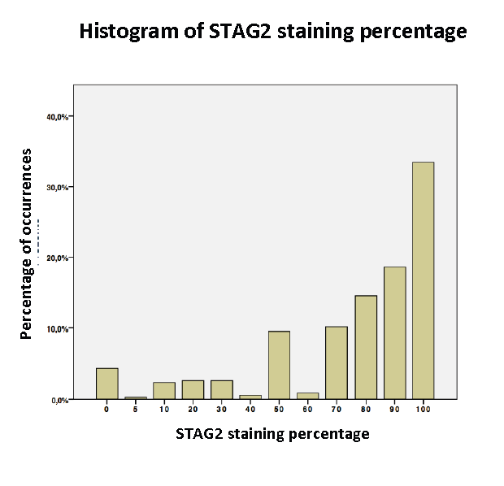
Evers et al., Supplemental Figure 2

