Slide 1
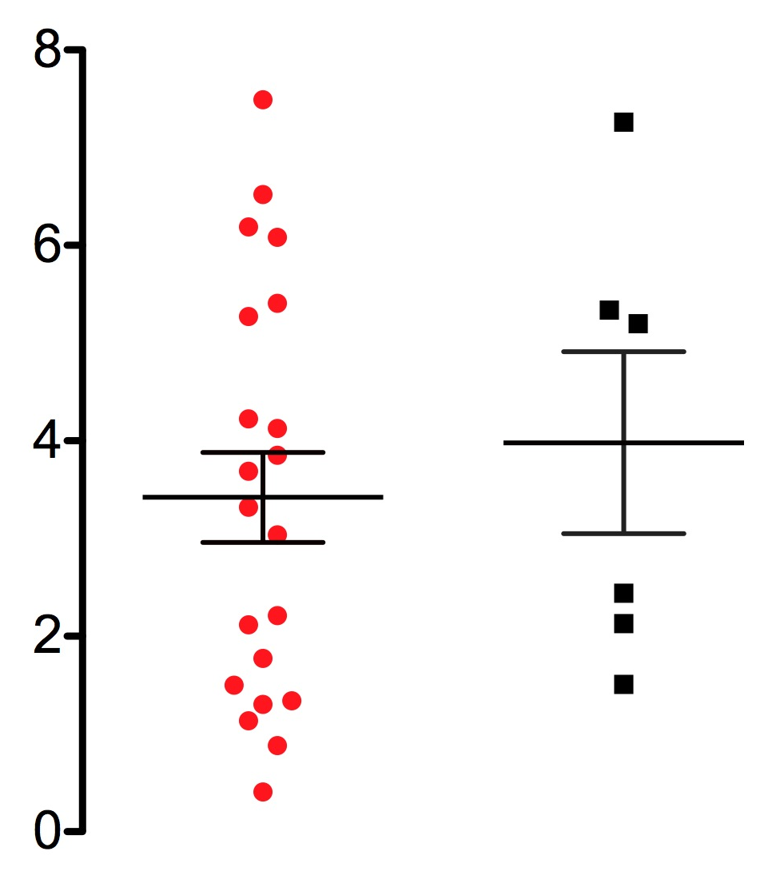
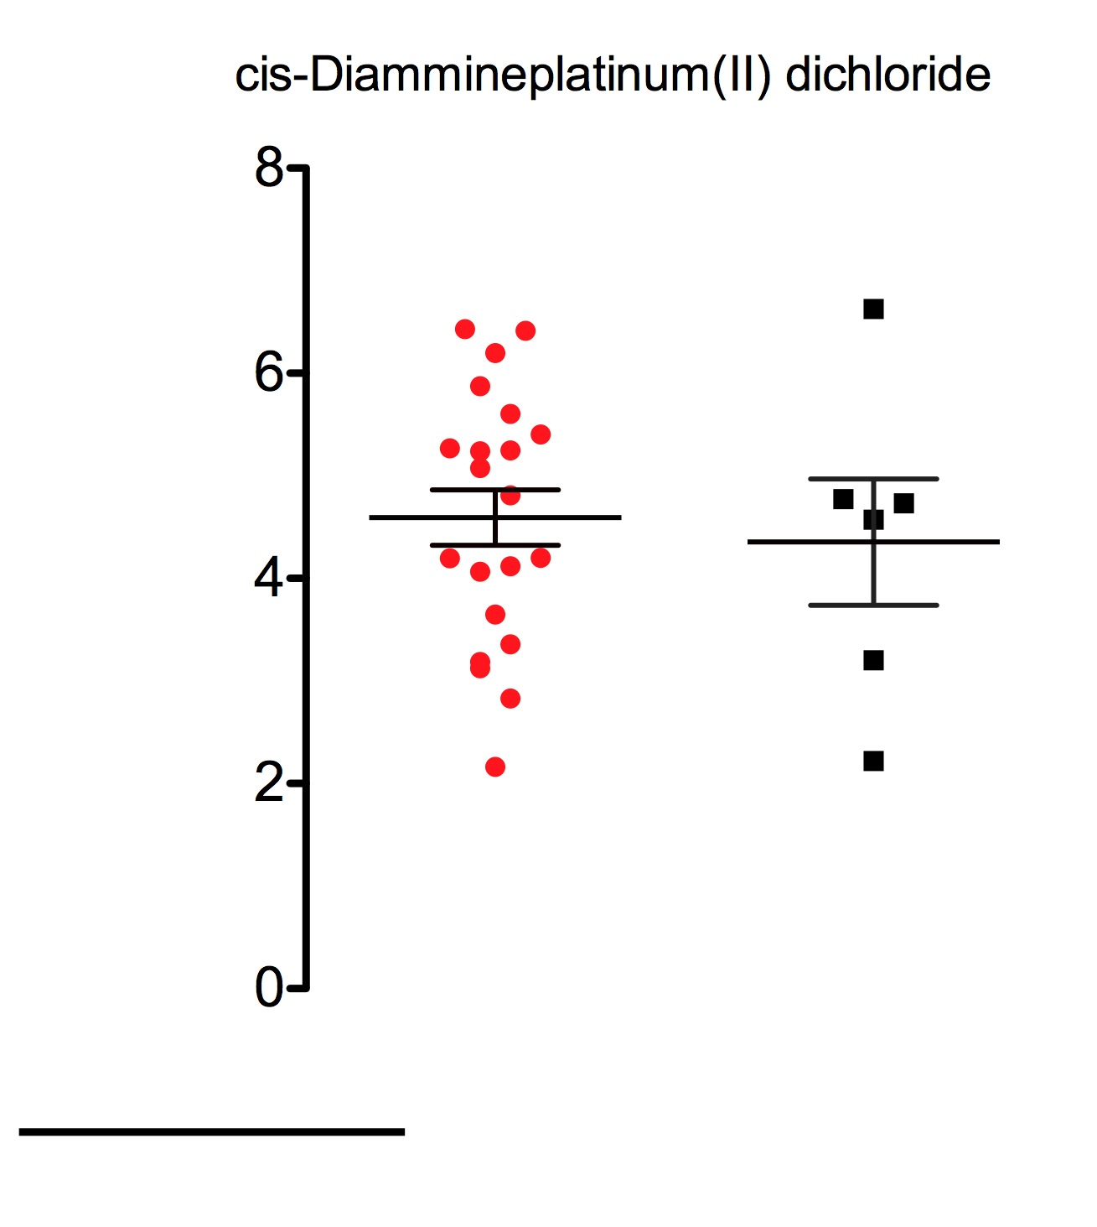
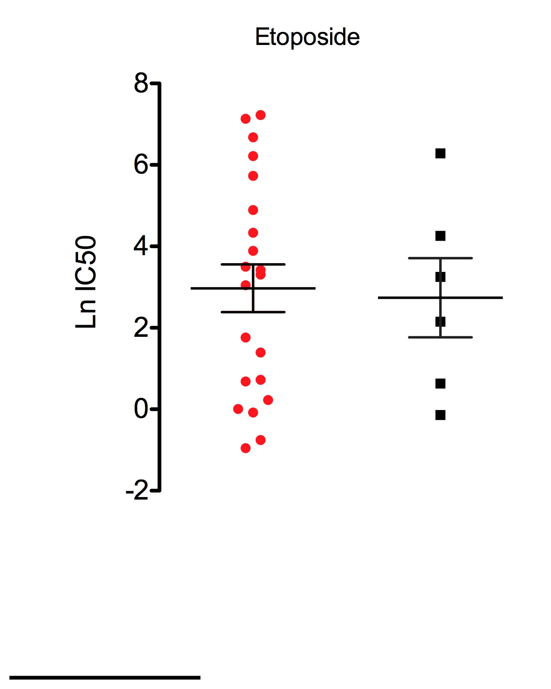
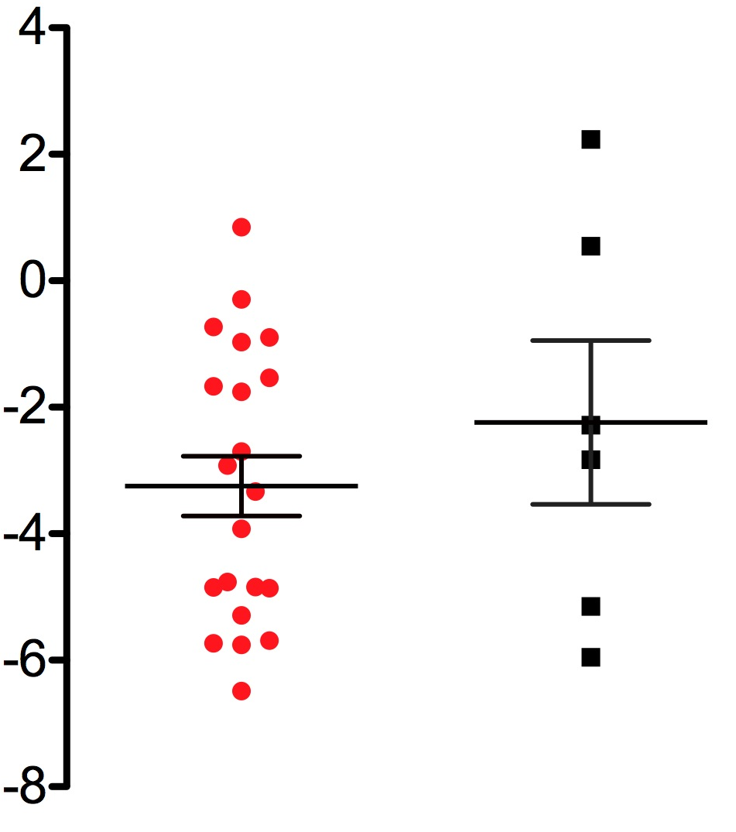
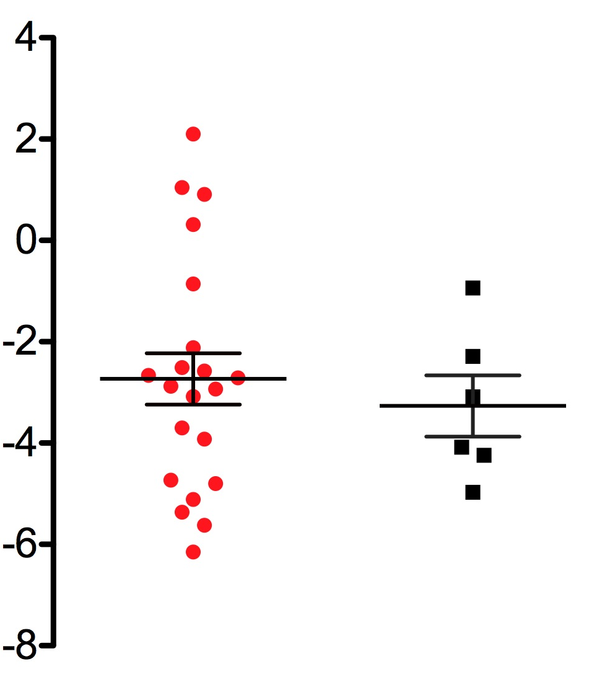
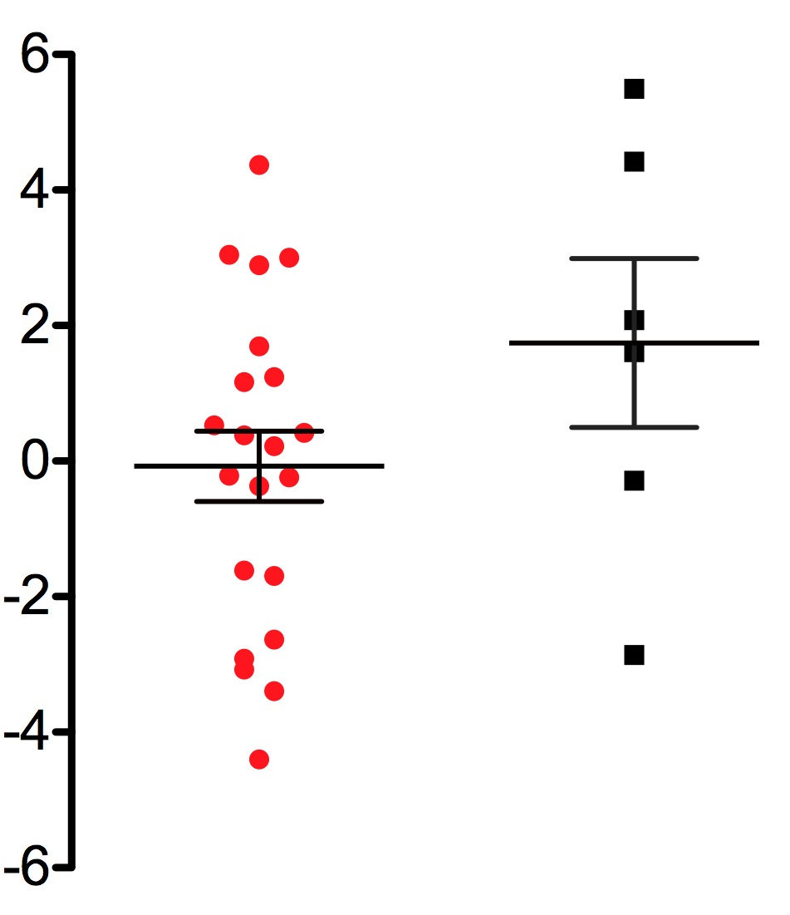
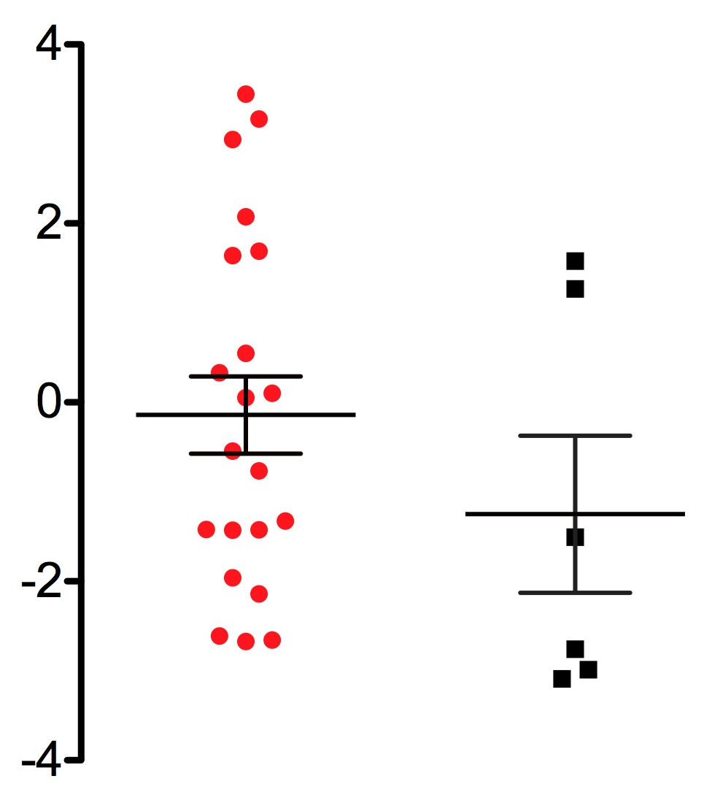
5-Fluorouracil
cis-Diammineplatinum(II) dichloride
Etoposide
ln IC50
ln IC50
ln IC50
MT
WT
MT
WT
MT
WT
Vinorelbine
Vinblastine sulphate
BMS-754807
ln IC50
ln IC50
ln IC50
MT
WT
MT
WT
MT
WT
17-AAG
ln IC50
MT
WT
Faber et al. Sup. Figure 1

Slide 2
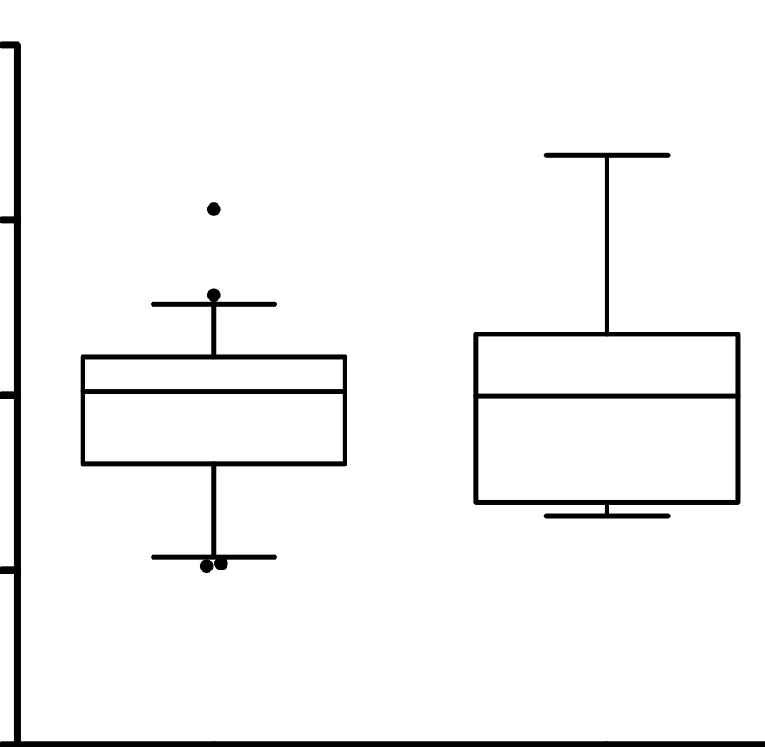
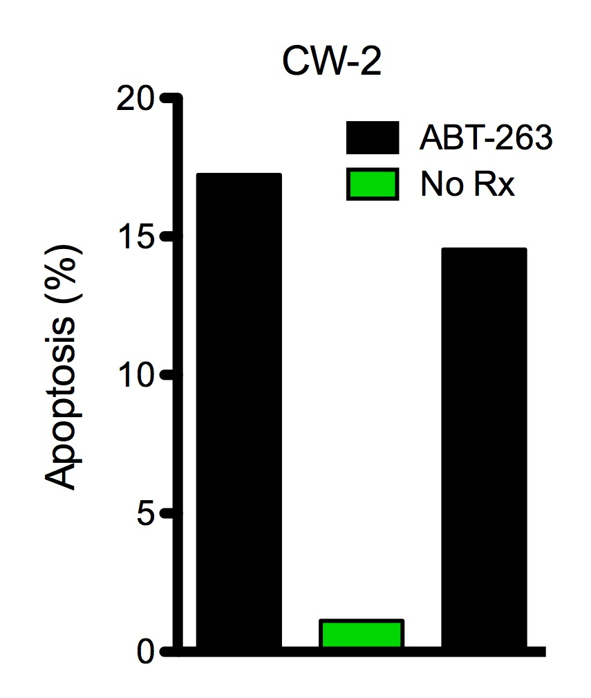
A
B
12
KRAS MT
WT
11
C2BBe1
KM12
H747
HT55
LS-174T
SW1463
SW837
SW620
CW-2
MCL-1 RNA Expression
10
BIM
9
Bcl-XL
P= NS
BCL-2
KRAS MT
KRAS/BRAF WT
MCL-1
GAPDH
C
D
sc
MCL-1
COLO-205
LS-411N
MCL-1
ACTIN
ABT-263
combination
ABT-263
No Rx
AZD8055
combination
20
ABT-263
AZD8055
No Rx
15
No Rx
MCL-1
Apoptosis (%)
GAPDH
10
MCL-1/GAPDH:
1 .04 .64 .36
1 .30 1.46 .28
5
0
sc
MCL-1
Faber et al. Sup. Figure 2

Slide 3
AZD8055
ABT-263
No Rx
combination
AZD8055
ABT-263
combination
AZD8055
ABT-263
No Rx
No Rx
combination
MCL-1
MCL-1
MCL-1
GAPDH
GAPDH
GAPDH
SW620
SW837
LS-1034
AZD8055
ABT-263
No Rx
combination
AZD8055
ABT-263
No Rx
combination
MCL-1
MCL-1
GAPDH
GAPDH
COLO-205
LS-411N
Faber et al. Sup. Figure 3

Slide 4
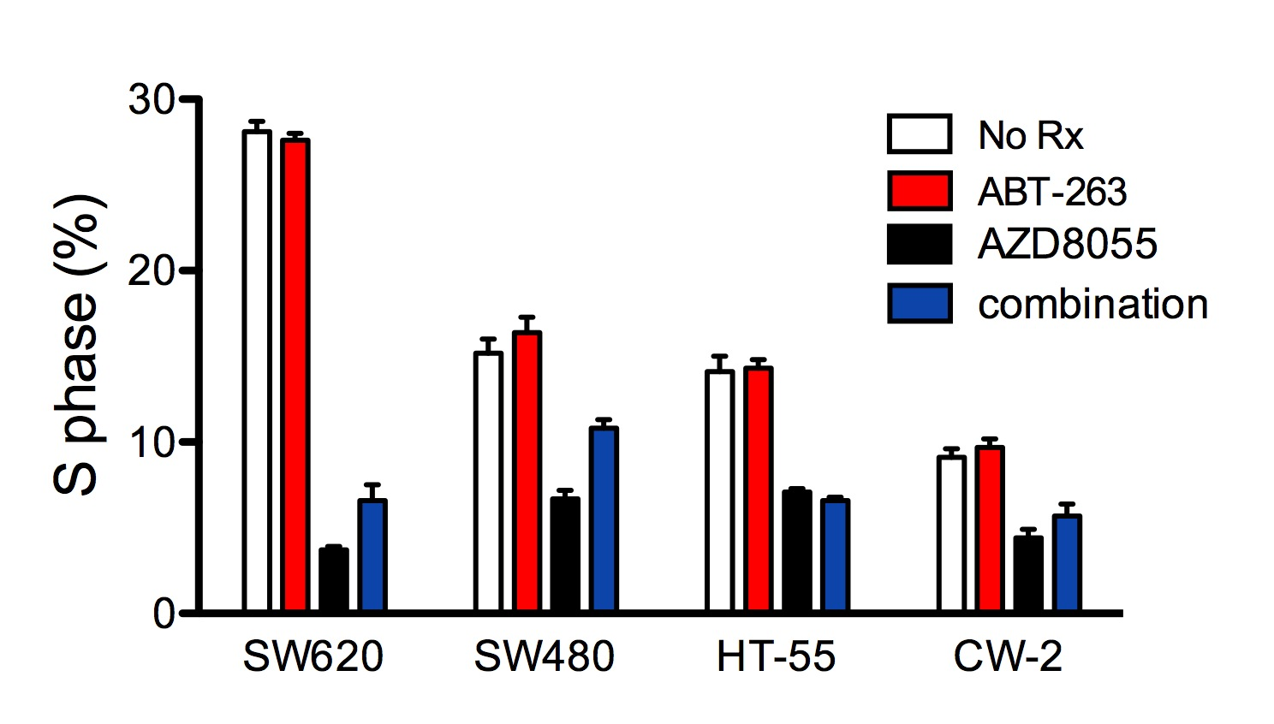
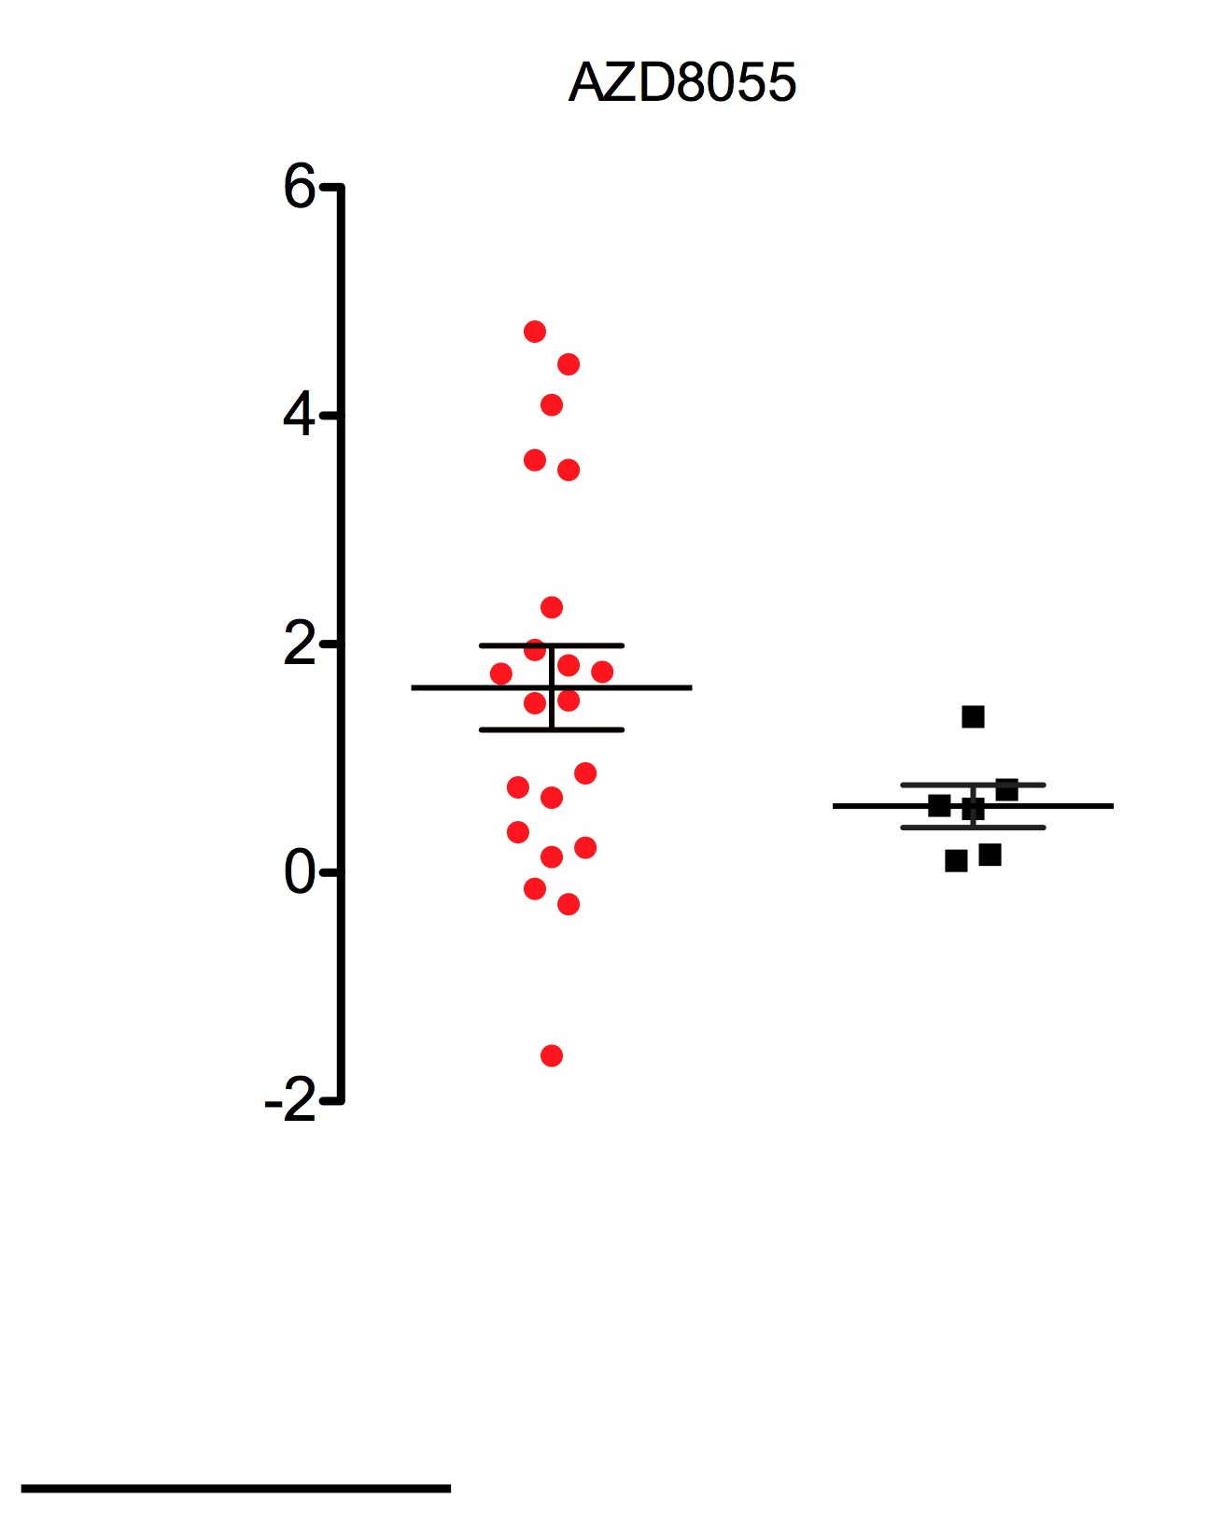
A
*
No Rx
ABT-263
30
AZD8055
*
combination
20
*
S phase (%)
*
10
0
SW620
SW480
HT-55
CW-2
B
AZD8055
6
4
ln IC50
2
0
-2
P = NS
MT
WT
Faber et al. Sup. Figure 4

Slide 5
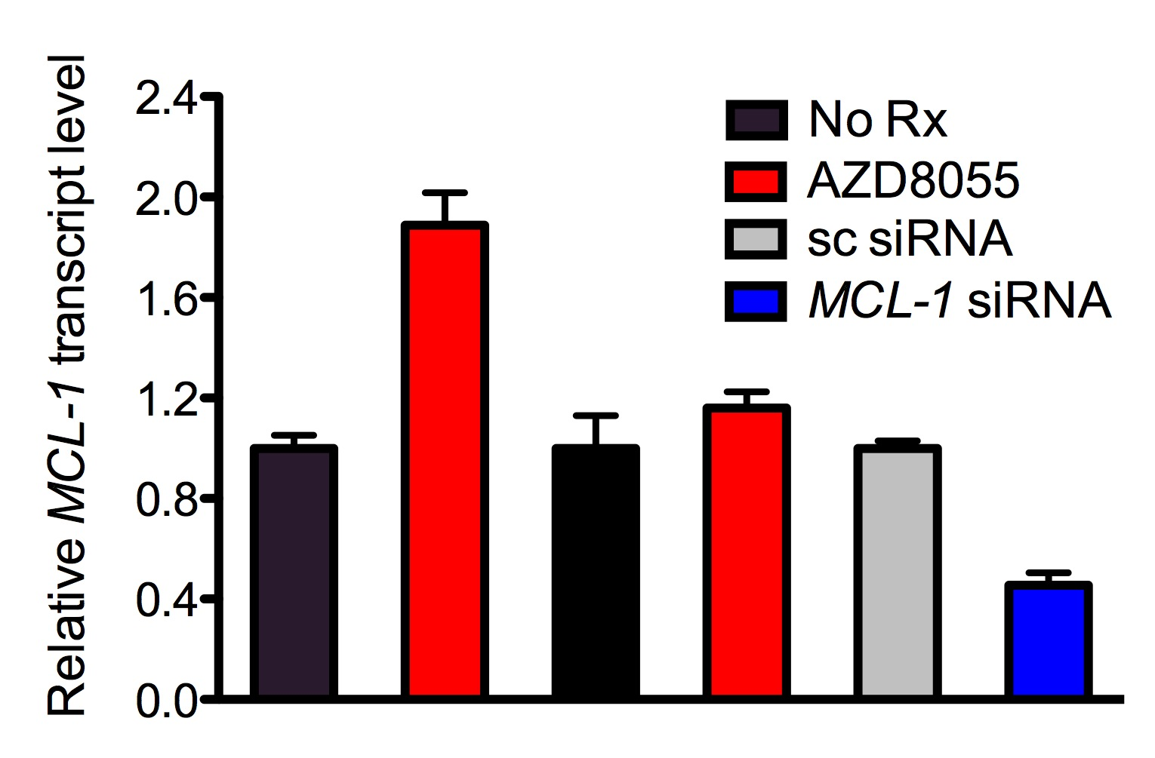
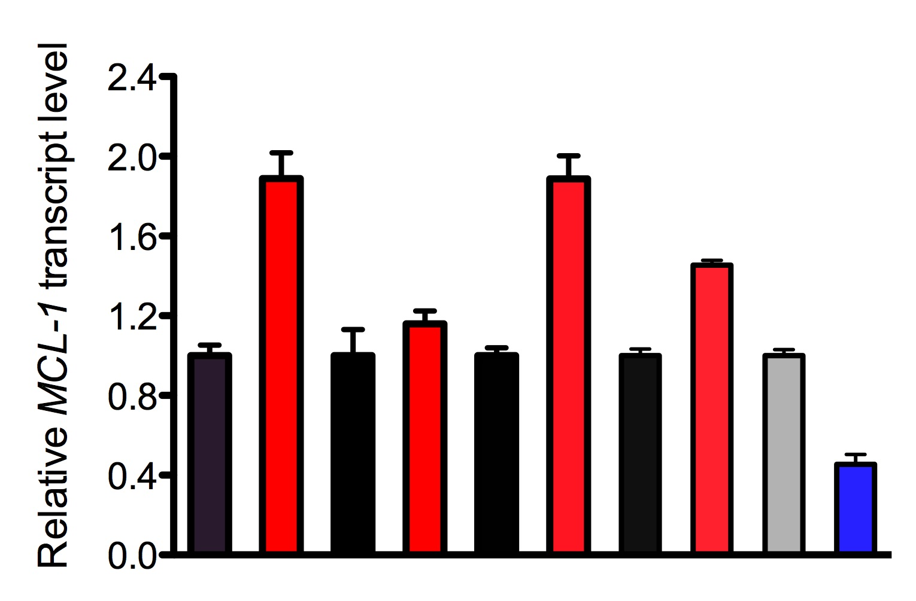
A
2.4
2.0
1.6
1.2
Relative MCL-1 transcript level
0.8
0.4
0
SW620
H747
CW-2
HT-55
SW620
KRAS MT
KRAS WT
B
No Rx
No Rx
2
4
8
(hrs)
2
4
8
(hrs)
MCL-1
p-4EBP1
SW620 (KRAS MT)
GAPDH
CW-2 (KRAS WT)
C
CW-2 (KRAS WT)
DOX:
-
-
+
+
KRAS
MCL-1
GAPDH
Faber et al. Sup. Figure 5

Slide 6
A
GFP
MCL-1
combination
No Rx
AZD8055
ABT-263
combination
MCL-1
GAPDH
B
IgG
combination
combination
No Rx
AZD8055
ABT-263
No Rx
AZD8055
ABT-263
Bcl-XL
Bcl-XL
MCL-1
MCL-1
BIM_{EL}
BIM
IgG
GAPDH
IP:BIM
whole cell extracts
Faber et al. Sup. Figure 6

Slide 7
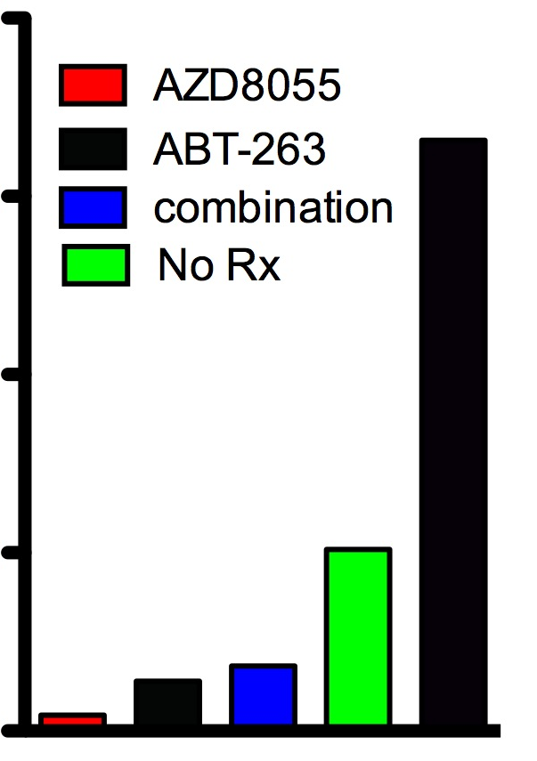
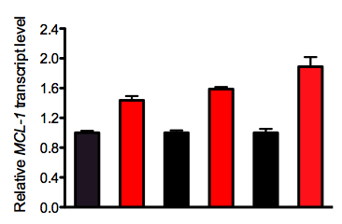
A
B
80
AZD8055
KRAS MT lung
60
ABT-263
H2009
H460
H2030
combination
AZD8055:
-
+
-
+
-
+
Apoptosis (%)
MCL-1
40
p-4EBP1
20
GAPDH
0
H2009
H460
H2030
SW620
lung
CRC
C
D
80
AZD8055
60
ABT-263
combination
sc
No Rx
MCL-1
Apoptosis (%)
40
MCL-1
ACTIN
20
H2030
H2009
SW620
0
lung
CRC
sc
MCL-1
E
H358
H2009
DOX:
-
-
+
+
DOX:
-
-
+
+
KRAS
KRAS
MCL-1
MCL-1
GAPDH
GAPDH
Faber et al. Sup. Figure 7

Slide 8
1h
2h
4h
1h
2h
CHX
4h
CHX
-
-
MCL-1
p-4EBP1
KRAS MT CRC
GAPDH
MCL-1/GAPDH:
1 0.32 0.13 0.14
1 0.76 0.39 0.29
SW620
SW837
1h
2h
4h
1h
2h
CHX
4h
CHX
-
-
MCL-1
p-4EBP1
KRAS MT lung
GAPDH
MCL-1/GAPDH:
1 0.56 0.25 0.26
1 0.44 0.18 0.21
H2009
H2030
Faber et al. Sup. Figure 8

Slide 9
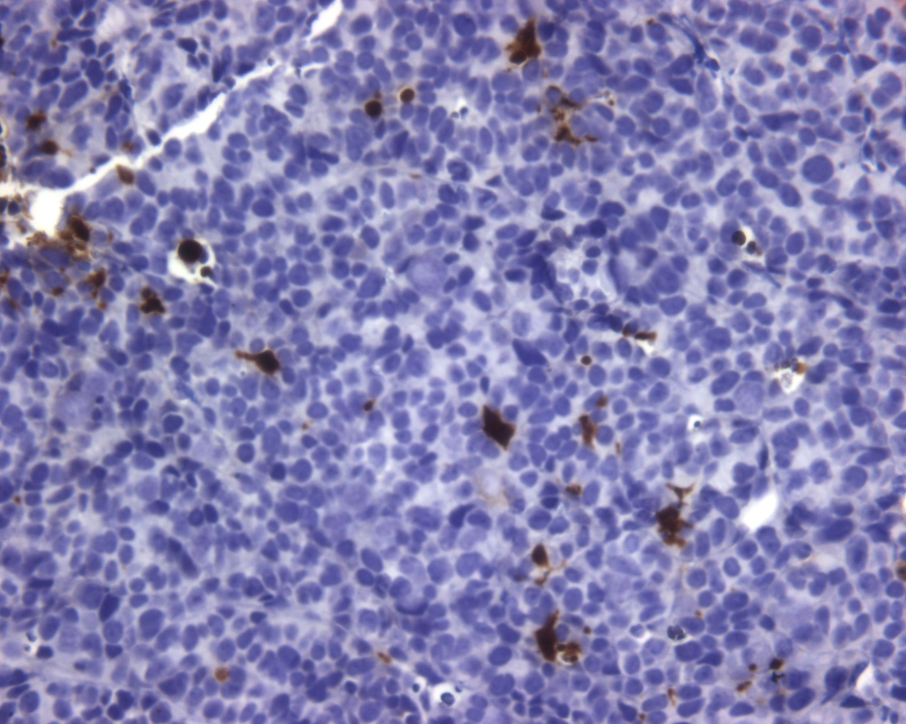
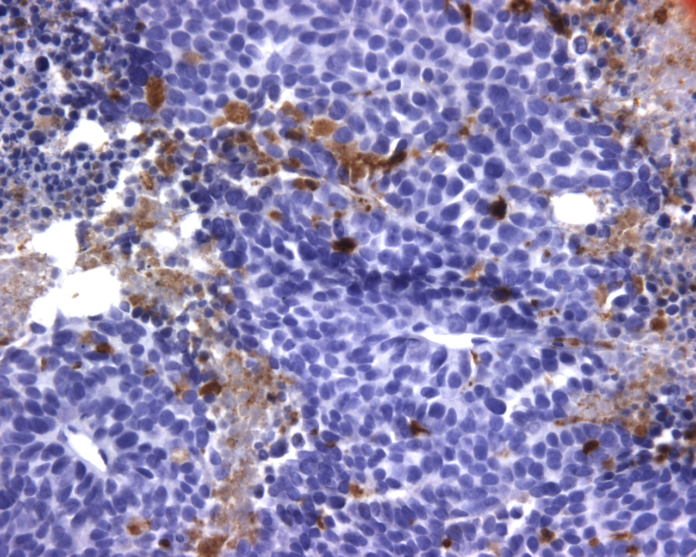
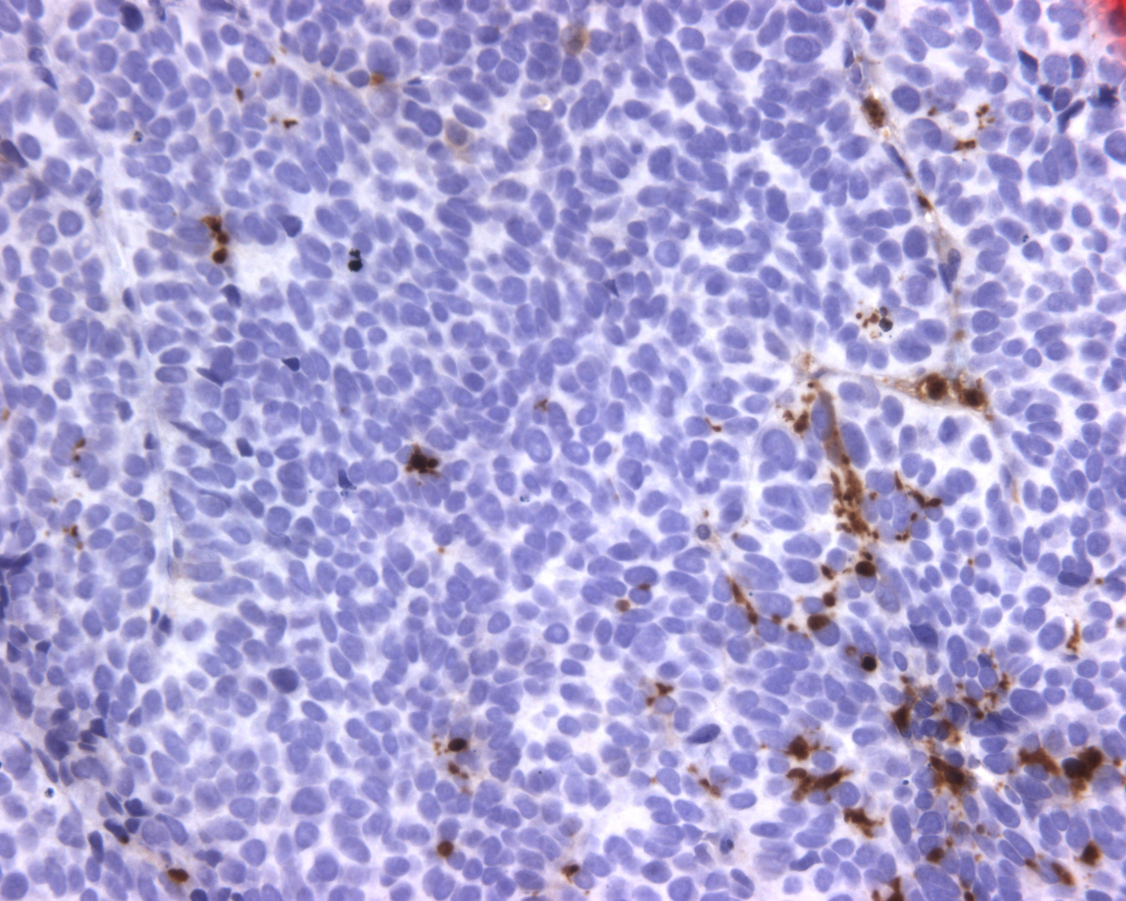
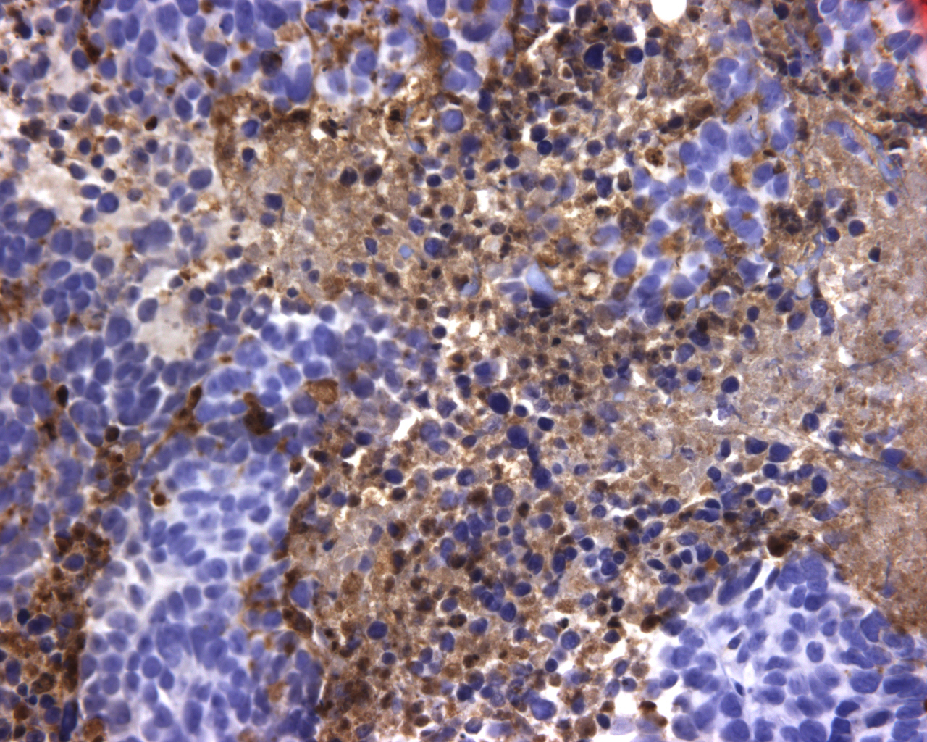
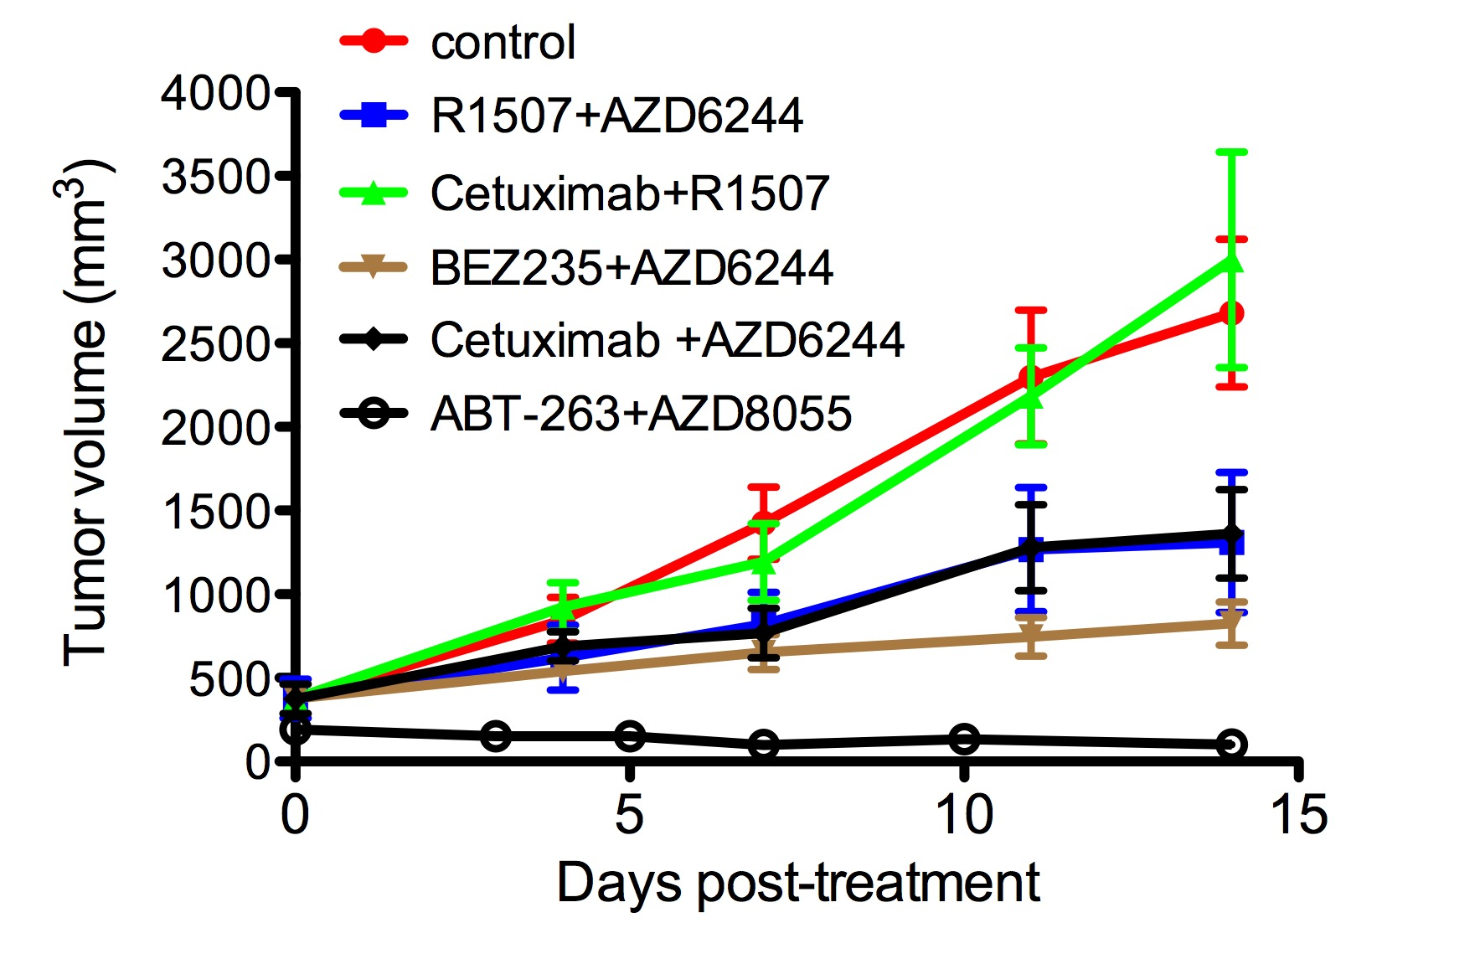
A
CC3 IHC
control
ABT-263
AZD8055
combination
B
SW620
Faber et al. Sup. Figure 9

Slide 10
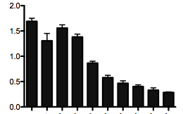
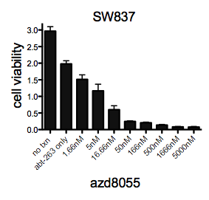
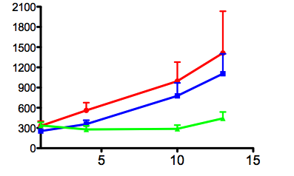
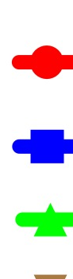
A
SW620
SW837
fold change in cell number
fold change in cell number
No Rx
No Rx
ABT-263 only
ABT-263 only
1.66 nM
5 nM
16.6 nM
50 nM
166 nM
500 nM
16666 nM
1.66 nM
5000 nM
5 nM
16.6 nM
50 nM
166 nM
500 nM
16666 nM
5000 nM
AZD8055
AZD8055
a
a
B
AZD8055
AZD8055
50 nM
166 nM
500 nM
1666 nM
5000 nM
50 nM
166 nM
500 nM
1666 nM
a
5000 nM
-
5 nM
-
a
1.66 nM
16.6 nM
5 nM
1.66 nM
16.6 nM
MCL-1
p-4EBP1
GAPDH
SW620
SW837
C
SW620
control
AZD8055 (2mg/kg)
Tumor Volume (mm³)
combination
Days post-treatment
Faber et al. Sup. Figure 10

