Slide 1
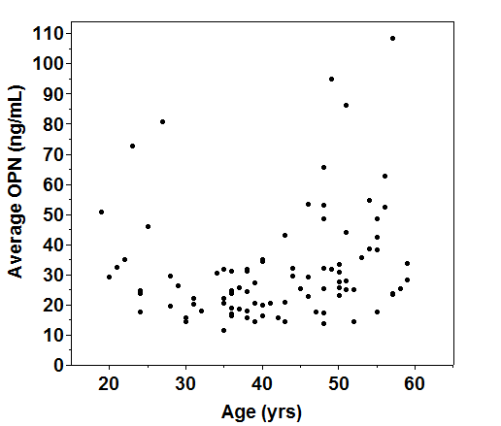
Supplemental Figure A
Average plasma OPN by Age for 90 Healthy Women

