Slide 1
A
Suppl. Figure 1
B
C
D
PC3
HMEC-1
HUVEC

Slide 2
Suppl. Figure 2
A
B
C

Slide 3
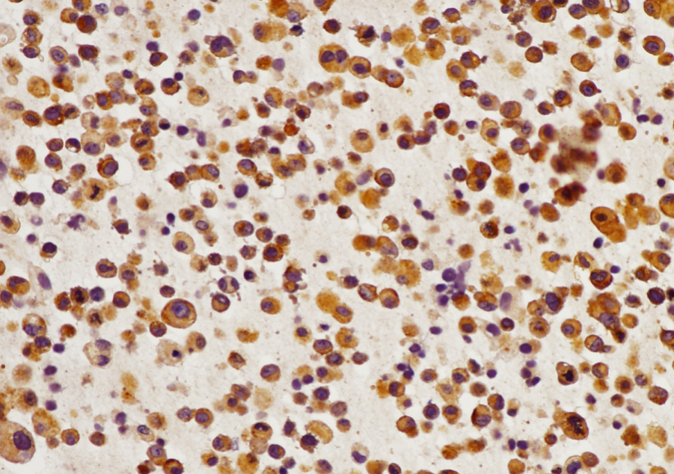
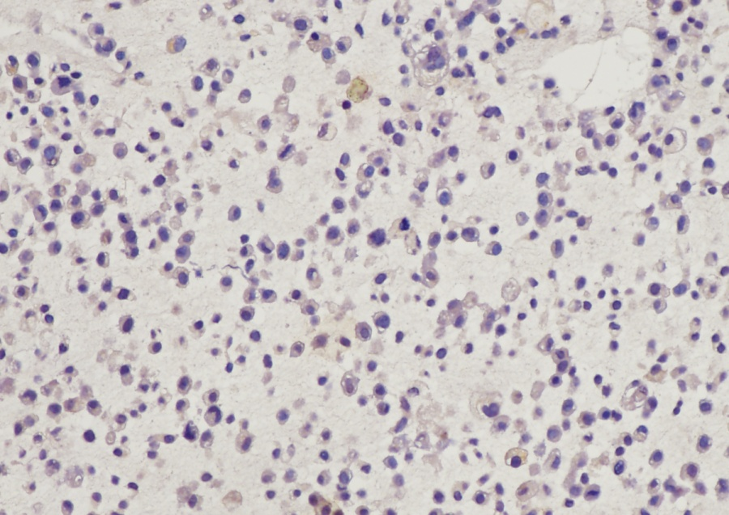
A
Suppl. Figure 3
nt-siRNA
DKK1-siRNA
B

Slide 4
Suppl. Figure 4
A
B
--- ZOL
placebo
0
6
12
0
6
12
months
months

