Slide 1
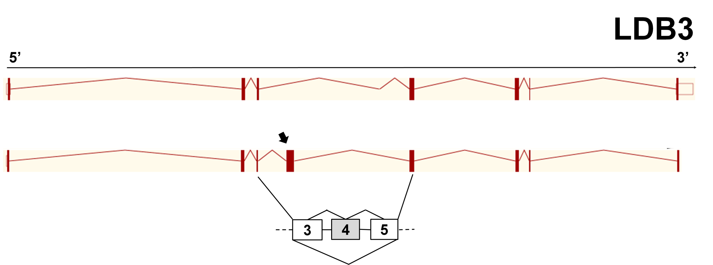
A
B
SI 1.4
EXON GENE LEVEL-
NORMALIZED INTENSITY
DM2
CTR
Fig S3

