Slide 1
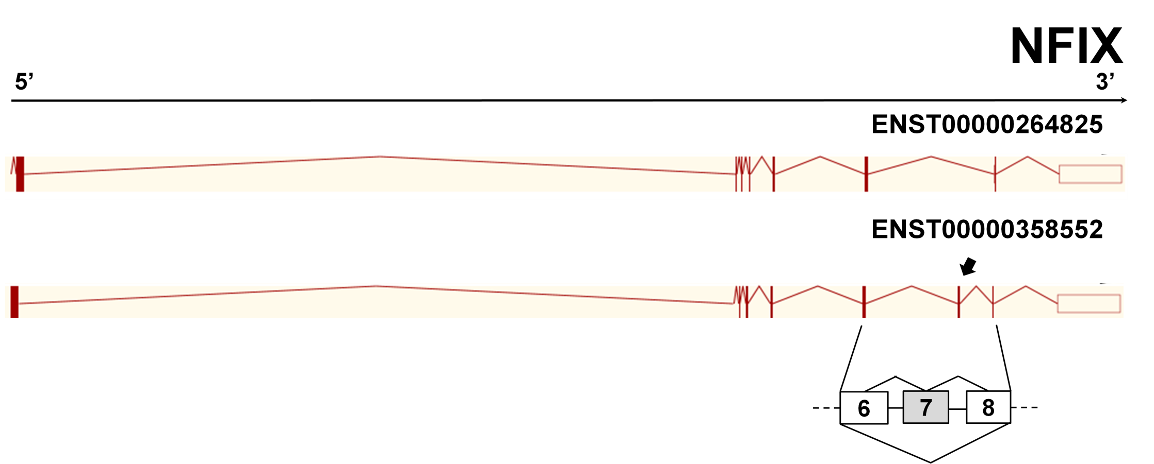
A
B
SI 1.0
GENE LEVEL-
NORMALIZED INTENSITY
DM2
CTR
Fig S4

