Slide 1
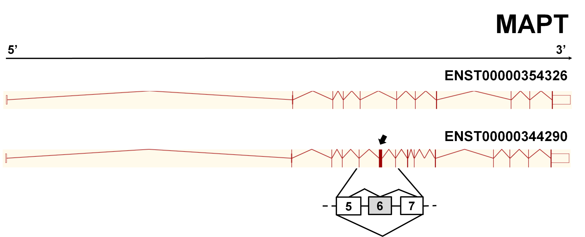
A
B
SI 0.9
GENE LEVEL-
NORMALIZED INTENSITY
DM2
CTR
Fig S5

