Slide 1
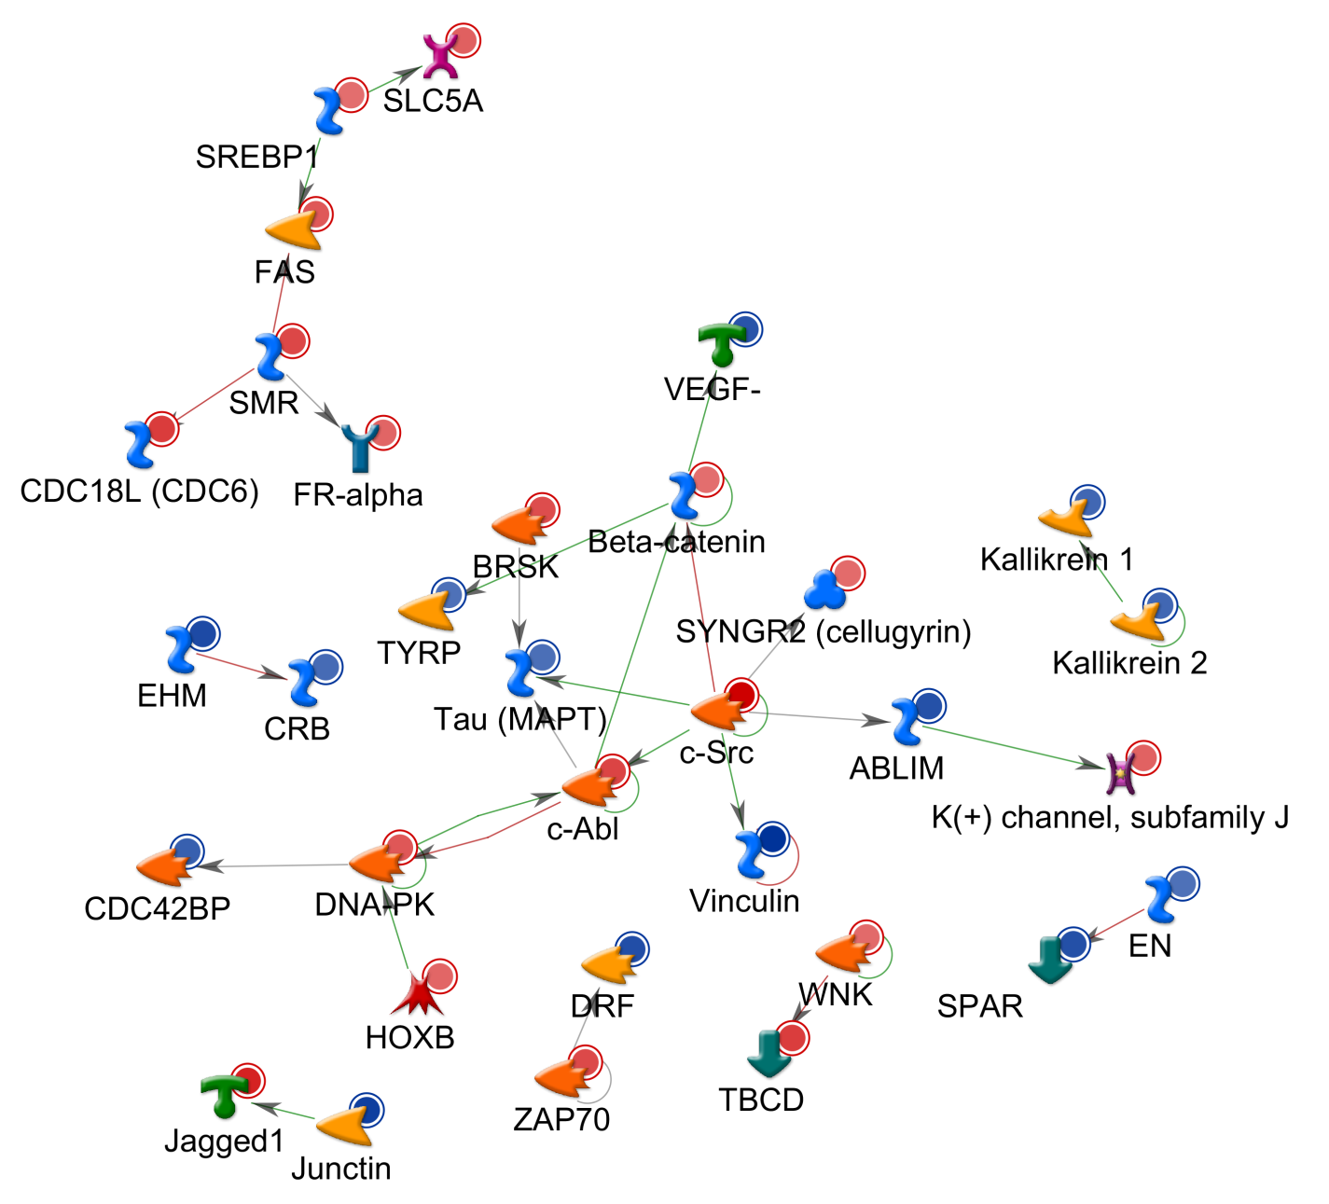
DIRECT INTERACTIONS NETWORK
Fig S6

