Slide 1
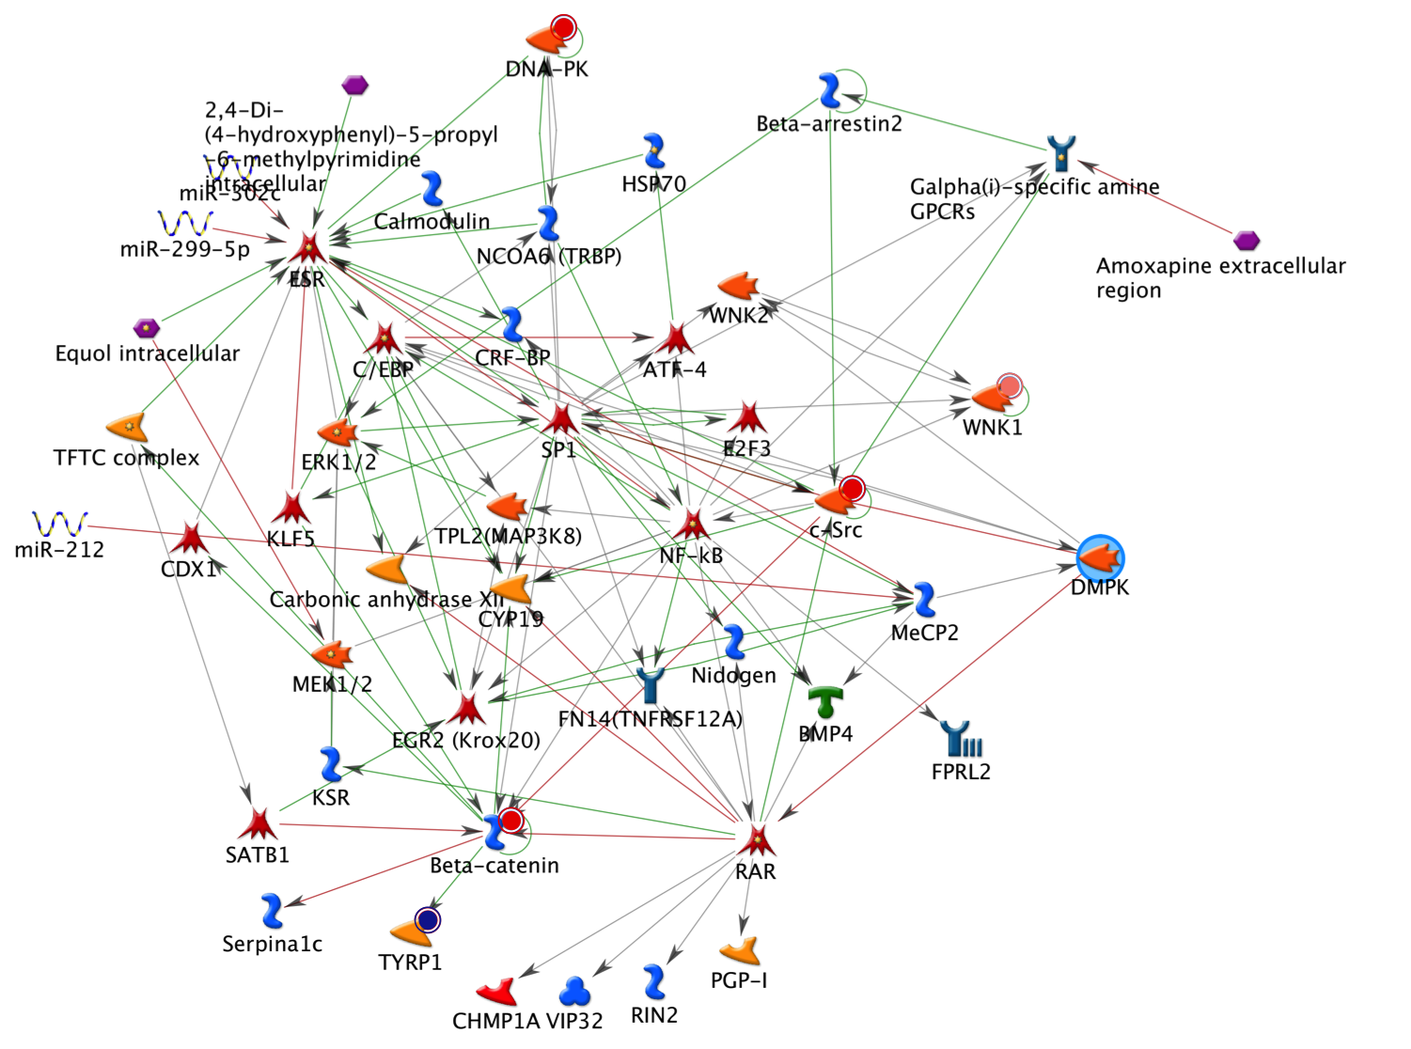
DMPK NETWORK
Fig S7

